Slide 1
Formal Method in Software Engineering
Lecture#1
Waqas Swati
20 February 2019
1100-1400Hrs

Slide 2
Introduction
MS(SE) COMSATS Islamabad
BS(CS) Arid Agriculture Rawalpindi
muhammadwaqas657@gmail.com
Teaching Methodology: Outcome Based Education (OBE)

Slide 3
Grading Criteria
Cheater never prosper
Be faithful
Evaluation Method | Marks Weightage out of 100
Lab Class Learning Outcome | 30%
Final Term Exam | 50%
Sessional (Quiz, Class Participation) | 20%

Slide 4
Course Outline
Lecture# | Duration | Topics Covered
Week#1 | 03 hrs. | Introduction to class and course, discussion about the course contents, reference materials grading scheme, paper pattern, assignment, quizzes, class presentation
Week#2 | 03 hrs. | Introduction to Software Engineering, challenges in Software engineering, Software Engineering vs Other Engineering, Software Process Models, Software Project Management
Week#3 | 03 hrs. | Software reliability, availability, dependability, software defects, computer security, safety critical systems
Week#4 | 03 hrs. | Overview of formal method, introduction, need of formal methods, industrial usage of formal methods, industrial techniques and tools for formal methods, proofs in formal methods, model checking, usability of formal methods
Week#5 | 03 hrs. | Set, relation and function, introduction to set theory, computer representation of sets, relations, types of relation, function of relations, functions and application of functions
Week#6 | 03 hrs. | Propositional and predicate logic, introduction, proposition logic, truth tables, propositional calculus and its proofs
Week#7 | 03 hrs. | Introduction to Predicate calculus, sketch of formalization of predicate calculus, properties and application of predicate calculus, limitation of propositional calculus
Week#8 | 03 hrs. | Overview of research, How to do research, Where to start? Discussion on selecting a research topic for research paper presentation, assignment about paper presentation, Revision of mid-term course.
(Mid-Term Exam)

Slide 5
Course Outline
Week#9 | 03 hrs. | Discussion on mid-term solution and generic mistakes made by students in exam.
Week#10 | 03 hrs. | Advanced topics in logic, temporal logic and fuzzy logic, temporal logic, logic and artificial intelligence.
Week#11 | 03 hrs. | Z formal specification language, introduction, sets, relations, functions, sequence, schemas and schemas compositions, proofs in z, industrial applications of z, hands on experience of difference use-cases.
Week#12 | 03 hrs. | Discussion on papers presentation, issues related to presentation, dummy presentation
Week#13 | 03 hrs. | Model checking, introduction to model checking, Introduction to Petri-nets, Advantages and disadvantages of low and high level petri-nets, CTL and LTL modeling concurrent systems, linear temporal systems, computational tree logic, tools for model checking, industrial application of model checking
Week#14 | 03 hrs. | Industrial tools for model checking, introduction, tools for z specification, tools for modeling checking, tools for UML, Hands on experience on tools with difference case studies and scenarios.
Week#15 | 03 hrs. | Formal Research Paper Presentation. On the spot analysis of work and presentation skills.
Week#16 | 03 hrs. | Revision and discussion about the course, feedback from the class and thorough question answer session for final-term paper.

Slide 6
Course Learning Outcomes
Upon completion of the course, students will be able to:
Apply the concepts of standard mathematical logic to produce proofs or refutations of well-formed propositions or arguments phrased in English or in a variety of formal notations (first order logic, petri-nets and Z).
Write formal specifications and contracts in Z.
Given an inductive definition of a simple data structure, write a recursive definition of a given simple operation on data of that type. Given some such recursively defined operations, prove simple properties of these functions using the appropriate structural induction principle.
Notes:
Human factors for HCI. Computer factor for HCI

Slide 7
Recommended Resources
Text book
Concise Guide to Formal Methods | Theory, Fundamentals and Industry Applications (2017, Springer International Publishing)
Other
Understanding Formal Methods by Jean-François Monin (2003)
Using Z Specification, Refinement, and Proof by Jim Woodcock and Jim Davies

Slide 8
Introduction
Mongolian Hordes Approach (1950)
The completed code will always be full of defects.
The coding should be finished quickly to correct these defects.
Design as you code approach
Notes:
The “Mongolian Hordes” management myth is the belief that adding more programmers to a software project that is running late will allow it to catch-up.
The reality is that adding people to a late software project actually makes it later.

Slide 9
Software Failure ☹
Standish Report
Software Complication
Inherently complex
No silver bullets to resolve the issues
Failure
Life, time and $$$$

Slide 10
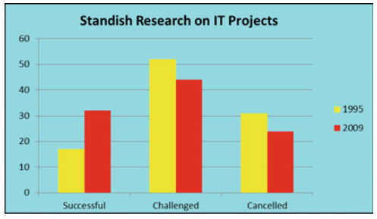
Comparison [1995-2009]

Slide 11
What Is Software Engineering?
IEEE 610.12
Software engineering is the application of a systematic, disciplined, quantifiable approach to the development, operation, and maintenance of software; that is, the application of engineering to software, and the study of such approaches
Mathematics as foundation

Slide 12
Challenges in SE…
Challenged project?
33% of projects are between 21- 50% overestimate.
18% are between 51-100% overestimate.
11% of projects are between 101-200% overestimate.
Notes:
Assignment Failed project in SE?

Slide 13
Software Process Models
The choice of a particular software development life cycle is determined from the particular needs of the specific project.
The processes employed are fit for purpose

Slide 14
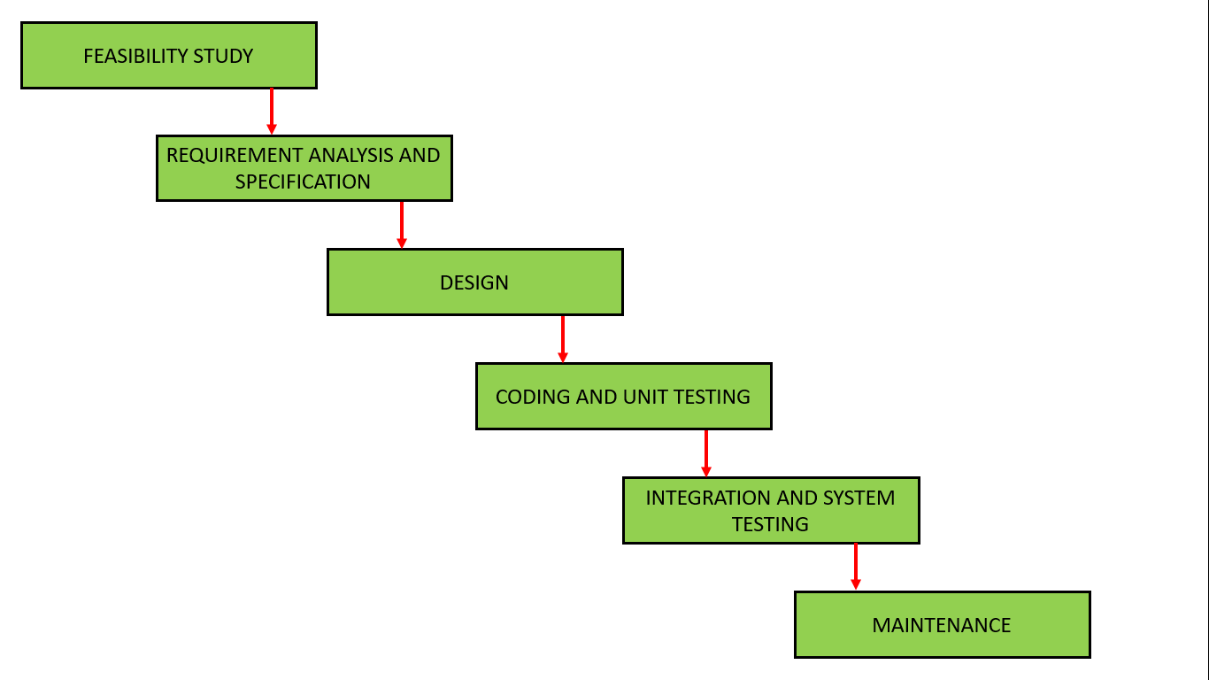
Water Fall Process Model
Notes:
Starts with requirements gathering and definition. It is followed by the system specification (with the functional and non-functional requirements), the design and implementation of the software, and comprehensive testing. The software testing generally includes unit, system and user acceptance testing.
. The waterfall model is employed for projects where the requirements can be identified early in the project life cycle or are known in advance

Slide 15
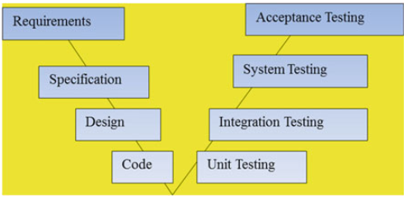
Water Fall and V&V

Slide 16
Assignment#1
Spiral Model
Rationale Unified Model
Agile?

Slide 17
What are Formal Methods?
Rigorous mathematically-based techniques and tools for the specification, development, and verification of software and hardware systems.

