Slide 1
Financial & E- Commerce Systems
E-Commerce Management
By Sanaa Jeehan

Slide 2
Classes of IP address
There are five classes of IP addresses, namely, A, B, C, D and E. Classes A, B and C are for general public use, whereas Classes D and E are used by people belonging to certain special groups. To find which class a particular IP address belongs to, the rule is to look at the number in the first byte. If this number falls within the calculated range of a specific class, then we can say that this IP address belongs to such particular class.

Slide 3
Classes of IP address
There are five classes of IP addresses, namely, A, B, C, D and E. Classes A, B and C are for general public use, whereas Classes D and E are used by people belonging to certain special groups. To find which class a particular IP address belongs to, the rule is to look at the number in the first byte. If this number falls within the calculated range of a specific class, then we can say that this IP address belongs to such particular class.

Slide 4
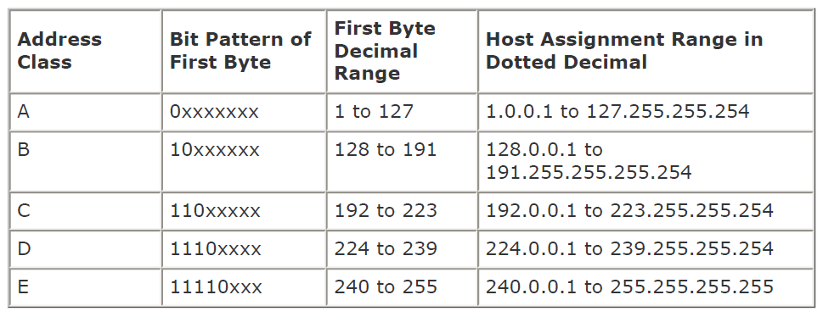
IP Address Classes

Slide 5
HOW MANY CLASS A, B, C NETWORKS AND HOSTS ARE POSSIBLE?
Note that 126 class A networks are possible (0 and 127 are not used for general purposes). Each class A network can accommodate a maximum of 16 million hosts on it. There are 16384 class B networks possible and each can host upto 65000 host machines. There are 2 million class C networks possible each having the capacity to accommodate upto 256 host machines on it.

Slide 6
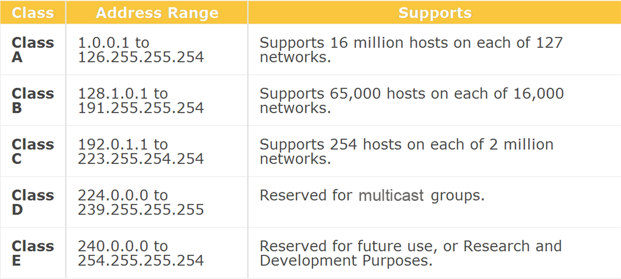
Class Support

Slide 7
Subnet mask
An IP address is meaningless for the computers unless it is accompanied by a subnet mask. A Subnet mask is a 32-bit number that masks an IP address, and divides the IP address into network address and host address. Subnet Mask is made by setting network bits to all "1"s and setting host bits to all "0"s. Within a given network, two host addresses are reserved for special purpose, and cannot be assigned to hosts. The "0" address is assigned a network address and "255" is assigned to a broadcast address, and they cannot be assigned to hosts.
Class A: 255.0.0.0 Class B: 255.255.0.0 Class C: 255.255.255.0

Slide 8
IP version
The existing IP scheme (version 4) is likely to be replaced by IP version 6. It would provide 128 bits IP addresses in hexadecimal format. According to an estimate a total of 3.4 x 10 38 addresses would then be available.

Slide 9
Domain name system
A Domain Name is a user friendly name used to locate a web site on the internet. For example, vu.edu, bestcomputers.com etc. Domain Name System (DNS) provides the structure and the strategy that is used to refer to computers on the internet by these user friendly names. Domain Names are Unique. They are assigned as one has to pay and register for them. With the help of DNS a domain name is translated into its corresponding IP address (see Fig. 1 below). A fully qualified domain name is processed from right to left for its translation into the corresponding IP address. A fully qualified domain name can be made up of a top level domain (TLD), second level domain (SLD) and subdomains, as shown in Fig. 2 below. Seven popular TLDs are “.com,.edu,.org,.gov,.net,.countryname,.int”. SLDs represent the name of a company/institution/entity. Subdomains represent the geographical or functional units of a company/institution etc.

Slide 10
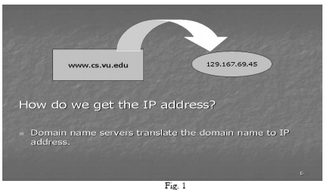

Slide 11
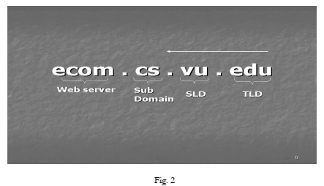

Slide 12
Name resolution
The translation or resolution of a fully qualified domain name into its IP address takes place using the hierarchy of special computer machines called Domain Name Servers. A DNS server is a server on the network that maintains a database/table that contains the list of domain names and their corresponding IP addresses. The name servers for TLDs are also called Root Name Servers. There is a program called ‘Resolver’ built into the browser, which sends the request for resolution of the domain name to the machine called Local Name Server. Local name server then contacts the root name server, which looks into its database and where possible provides the IP address of the name server below in the Hierarchy. Hence in a similar number of steps the fully qualified domain name is completely translated into the IP address of the web server where the requested web page is stored. The process of name resolution has been shown in an example in Fig. 3 below:

Slide 13
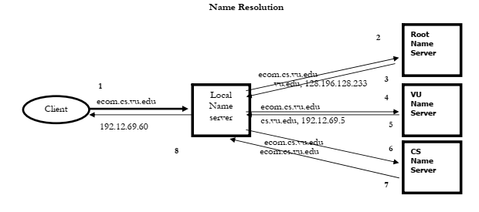

Slide 14
Getting domain names and IP addresses
Domain names are administered in a hierarchy. At the global level the task of registration/administration of domain names is supervised by the organization called Internet Corporation for Assigned Names and Numbers (ICAAN). There are organizations working under ICAAN in different regions. For example, APNIC is for Asia and Pacific Rim, ARIN for America and South Africa, RIPE-NCC for Europe and North Africa etc. Each of the above are further connected to Internet Service Providers (ISPs) at the local level. One can register one’s domain name through an ISP also. Similarly, one can lease IP addresses from a local ISP apart from the direct sources of IP addresses, that is, APNIC, ARIN or RIPE-NCC. ISPs can use a server to dynamically supply the IP addresses to their clients for a session. Such a server is called DHCP (Dynamic Host Configuration Protocol) server.

Slide 15
Media access control (MAC) address
Data to be delivered on a network has to be converted first into serial transmission. This is done through a device called Network Interface Card (NIC) that must be installed in a computer on the network. NIC has also got printed on it a 48 bits unique address called the MAC or hardware address of the computer machine. In other words, it consists of 12 hexadecimal characters and can have different format as shown below:
090017A9B2EF 09:00:17:A9:B2:EF 09-00-17-A9-B2-EF

Slide 16
Media access control (MAC) address
Whereas the IP address of a computer may change from time to time, its MAC address would remain the same unless the existing NIC is replaced with another. It can easily be inferred that there are 248 unique MAC addresses possible (which is an unimaginably high number). An organization called Institute of Electrical and Electronic Engineers (IEEE) administers the allocation of MAC addresses, worldwide. It ensures that there is no duplication of MAC addresses by the manufacturers of NICs.

