Slide 1
Financial & E- Commerce Systems
E-Commerce-Enabled Business Paradigm
By Sanaa Jeehan
October 19th, 2020 – 3rd Week

Slide 2
Functional Characteristics
Human-like interaction: Through support for collaborative features and functions, e-commerce systems enable users to interact with customers. Such an interaction provides the customer with the feeling of interrelating with a live human-like system, unlike traditional systems that exhibited robot- and machine-like behavior, thus sometimes frustrating users.
Intelligent learning: E-commerce systems support automatic and intelligent learning. These systems track customer behavior and preferences as they interact with the enterprise services and information and use this information to customize and personalize user’s future interactions with the Web site.

Slide 3
Functional Characteristics
Scalability/global connectivity: E-commerce systems, especially those that fall within the business-to-consumer computing environment, expect global exposure. Accordingly, the systems have to be designed to be scalable to react to increasing customer connectivity. Increasing connectivity can result in the need to connect to a large number of customers, register a large number of customers, process their requests, and so on.
Richer functionality: E-commerce systems pack more functionality than their traditional counterparts. For example, it is common for an e-commerce system to pack communication functions, collaboration functions, interactive communication, transaction, and inquiry functions into one e-commerce system.

Slide 4
Functional Characteristics
Provide rapid user response and fulfillment: E-commerce systems enable rapid fulfillment times. In the business-to-consumer domain, these times usually do not exceed 3 to 4 seconds. Building systems to deliver rapid response times is necessary to keep users attracted to the site.
Support electronic payments: E-commerce systems allow automatic triggering of payments for products and services, unlike traditional systems that require a customer service representative to interact with a customer either on a one-to-one basis or through a telephone.
Flexible and secure application access: The emergence of security technologies and extranets enables the design of e-commerce systems that internal users, external users, and business partners can access equally, thus streamlining business processes. A business partner, for example, can access an enterprise’s stock replenishment system to order stocks.

Slide 5
Infrastructural Characteristics
The construction, deployment, and operations of an e-commerce system require the existence of an ecosystem that includes relevant technological and nontechnological elements.
This is analogous to building a house that depends upon water, electricity, and other utilities, as well as infrastructure, roads, and so on, to make the house livable.
An e-commerce system similarly requires the existence of a network infrastructure that extends the users’ reach, a payment infrastructure to pay for products and services, and an infrastructure that reconciles payments among various institutions.
Other infrastructure elements include the PSTN, wireless communication infrastructures, the Internet, and public e-commerce services (portal services, e-commerce hosting, etc.). The following highlights certain key elements of the technology infrastructure.

Slide 6
Infrastructural Characteristics
Wireless network infrastructure: The need for mobility, remote access, and the ubiquity of the Internet have triggered the emergence of the wireless networks. Wireless networks have played a vital role in facilitating the exchange of short messages and wireless telephony for the past few years. Their importance has further risen due to their fast emerging role in the world of e-commerce. Users can access the Internet and other enterprise computing resources by connecting to various wireless networks.
Operational infrastructure: Ongoing operations of e-commerce systems require the existence of an operational infrastructure. An operational infrastructure hosts applications, provides ongoing support for those systems and applications, and ensures the upkeep of all components required for the ongoing functioning of any IT system. The existence of such an infrastructure within the enterprise or external to the enterprise is quite vital for e-commerce systems.

Slide 7
Infrastructural Characteristics
Internet domain infrastructure: An Internet-enabled e-commerce system requires the seamless and flawless operation of the Internet’s domain infrastructure. Also referred to as the Domain Name System (DNS), this infrastructure allows for a rapid lookup of e-commerce sites on the Internet. Establishing an e-commerce presence on the Internet requires a basic understanding of the issues in registering domain names and the multiple registrars that exist for providing such registration services.
Application hosting: Though not an absolute requirement for the hosting of e-commerce systems, an application hosting infrastructure provides small organizations a quick entry into the e-commerce arena. Application hosting service providers assist in the development of basic services required for engaging in online e-commerce activities.

Slide 8
Infrastructural Characteristics
Payment infrastructure: E-commerce systems would be incomplete without the existence of a payment infrastructure. The payment infrastructure facilitates payments among parties and reconciles payments. The payment infrastructure allows consumers to pay using traditional payment methods such as credit cards, debit cards, and checks. Businesses, on the other hand, use the Automated Clearing House (ACH) infrastructure for transfers between accounts. The Fedwire payment infrastructure facilitates payments of large sums between financial institutions. Organizations offering e-commerce systems need to interface their Web sites with these payment networks and infrastructures to allow for automatic processing of payments.
Internet infrastructure: Internet access is the cornerstone of e-commerce systems. ISPs and various other NSPs facilitate access to the Internet through various channels. An enterprise’s primary challenge is to choose appropriate ISPs and NSPs that will form the primary infrastructure for the future rollout of its e-commerce systems.

Slide 9
Infrastructural Characteristics
Public key infrastructure (PKI): E-commerce systems by their nature require tighter security controls. Public-key cryptography offers opportunities for secure e-commerce solutions. However, doing so requires a PKI. An organization has multiple options for leveraging on PKI services. Organizations can rely on an external PKI infrastructure, develop their own PKIs, or jointly develop an enterprise-specific PKI in conjunction with external PKI service providers.
Legal infrastructure: Conducting commerce electronically has numerous legal ramifications that enterprises need to consider when designing e-commerce applications. Various government regulations put the onus of addressing those requirements on online sites. Such considerations include incorporating privacy statements on the site, copyrighting certain content before publishing on the Web, and so on.

Slide 10
Infrastructural Characteristics
Network architecture: An enterprise’s network architecture has to be flexible to accommodate connectivity from the general public, remote employees, and business partners. The network and related applications should build in appropriate security controls and performance to support this diverse set of users. Such issues addressed at an infrastructure level, as opposed to each individual e-commerce system’s level, provides better performing and secure applications.

Slide 11
E-Commerce Technology Architecture
Embarking on e-commerce initiatives involves linking the business processes and activities of an organization’s entire value chain.
This includes processes for building the appropriate products and services, acquiring products and services from external trading partners, selling them to external customers, and various other administrative processes.

Slide 12
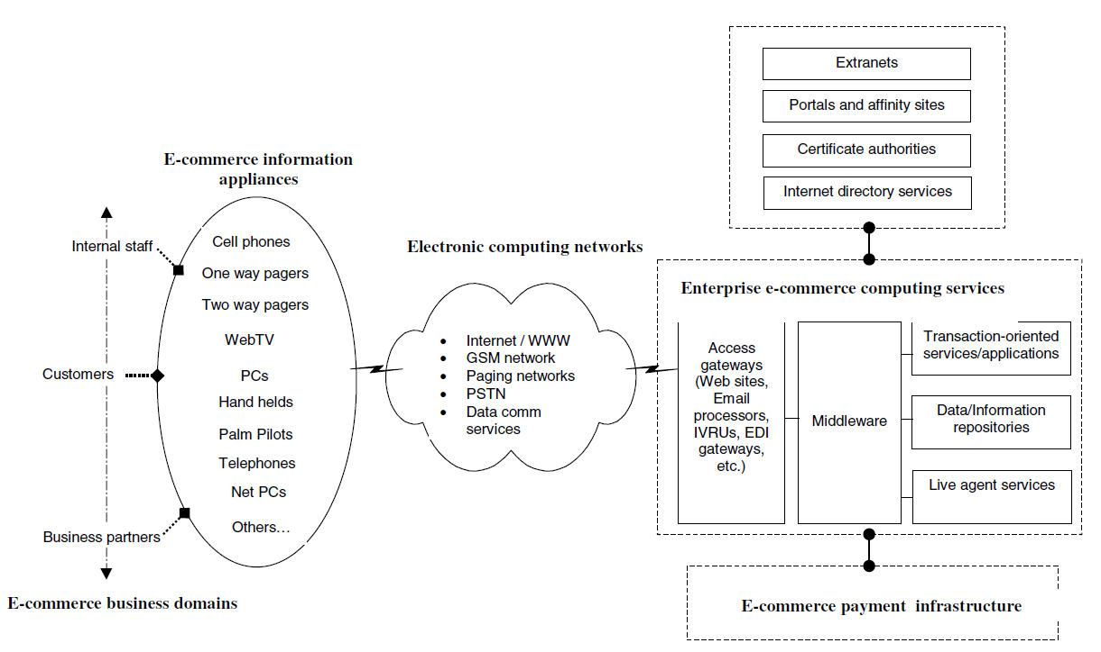
E-Commerce Technology Architecture

