Slide 1
Enterprise Design Methodology
Lecture

Slide 2
Outline
Enterprise design methodology
Cross life-cycle activities
Enterprise design methodology phases
Strategy theory
Strategy formulation

Slide 3
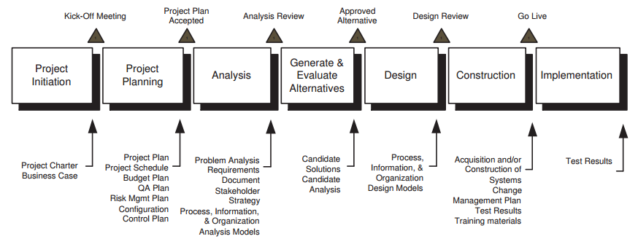
Enterprise Design Methodology
Seven life-cycle phases, each phase is delimited by milestones
Each phase has one or more activities and generates one or more deliverables
Some milestones are deliverables:
Project plan
Some milestones are meetings or events that mark the end of a phase

Slide 4
Cross life-cycle Activities
Project Management
Planning, directing, and controlling project resources
Requirements Management
Specifying requirements and then managing change to the requirements
Quality Assurance
Systematic approach to provide adequate confidence that a product conforms to functional and non-functional requirements
Configuration Management & Control
Identification, control, and maintain the integrity and traceability of configuration items
Risk Management
Risk Identification
General risk categories are: technical, business, configuration, implementation, organizational, and project management.
Risk Analysis
The activity to assign a probability to the risk event and to assess the consequences of the risk event
Risk response Planning
The activity to develop options and determine actions to enhance opportunities and reduce threats to the project’s objectives from risk

Slide 5
Risk response Planning
There are four basic responses:
Avoidance - whereby the project plan is changed to eliminate the risk or to protect the project objectives from the risk impact.
Transference - whereby the consequences of the risk are shifted to a third party ith ownership of the response.
Mitigation - whereby the project team takes action to reduce the probability and/or consequences of the risk event.
Acceptance - whereby the project team does nothing in response to the risk.

Slide 6
Enterprise Design Methodology Phases

Slide 7
Phase 1: Project Initiation
A process to define and obtain formal approval for a new enterprise engineering project.
Activities:
Project definition
Project scope definition
Project Scheduling
Project budgeting
Create business case
Input:
Project stimulus: problem, opportunity, directed, planned
Strategic plan: company’s strategy, mission, and vision
Enterprise architecture:
Notes:
In the project initiation phase, a formal grant/allowance/clearance/permission is defined and obtained.
Business case describes why it is beneficial to do the project.

Slide 8
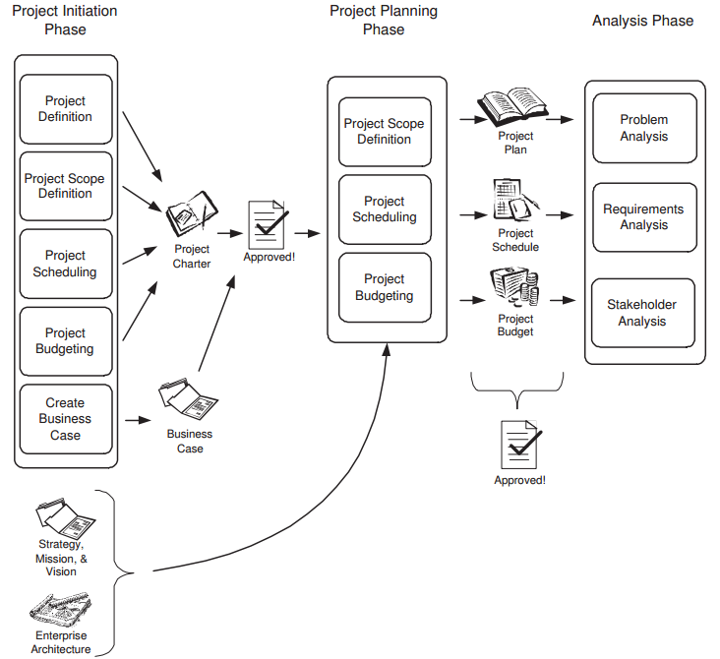
Phase 1: Project Initiation
Main Outputs:
Project charter: describes the purpose and scope of enterprise engineering project.
Project Definition
Scope
Deliverables
Constraints
Project Implementation
Project Control (progress monitoring?)
Quality Control (deliverables quality evaluation?)
Risks (probability, impact, mitigation?)
Business case:
Benefits that the project will deliver
Options (considered while developing this project)
Notes:
Project control: How will the progress be monitored and controlled?
Quality Control: How will the quality of deliverables be evaluated?
Risks: Risks, their probability, and their impact. Also include mitigation strategies.
Benefits: What are the benefits do you expect this project will deliver?
Options: What other actions were considered while designing and developing this project?

Slide 9
Phase 2: Project Planning
Defines all work activities, schedule, & budget needed to complete the project.
Ensures all pre-requisites are in place for successful project execution.
Primary input: project charter
Primary output: project plan
“Project plan is a document used to manage
the execution of a project.”
Important elements of project plan:
Selected enterprise architecture
Selected life-cycle methodology
Work breakdown structure (WBS)
Project schedule, budget

Slide 10
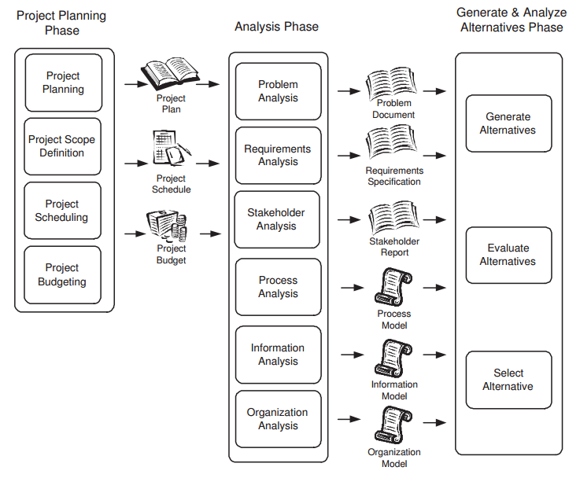
Phase 3: Analysis
Systematic approach to study a problem.
Activities:
Problem Analysis
Requirements Analysis
Stakeholder Analysis
Process Analysis
Information Analysis
Organization Analysis
Notes:
Systematic approach to study a problematic situation, understand it, derive requirements for a solution.
Problem Analysis: Collect data, document the problem, analyze the causes and effect.
Stakeholder Analysis: Identify key stakeholders, identify their interest from project outcomes, and device a strategy to deal with each stakeholder.
Process Analysis: Identify the process impacted by the project, model the processes, and analyze their performance.
Information Analysis: Identify the information objects affected by the project, model the information, and analyze the availability and quality of info.
Organization Analysis: Identify the organizational units impacted by the project, model the units, and analyze their performance.

Slide 11
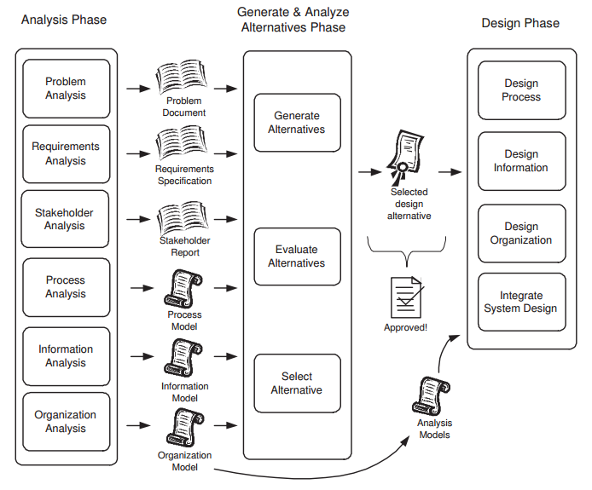
Phase 4: Generate & Evaluate Alternatives
To identify alternative solutions, evaluate alternative solutions and then recommend the alternative that will become the design solution.
Activities:
Generate Alternatives
Evaluate Alternatives
Select Alternative

Slide 12
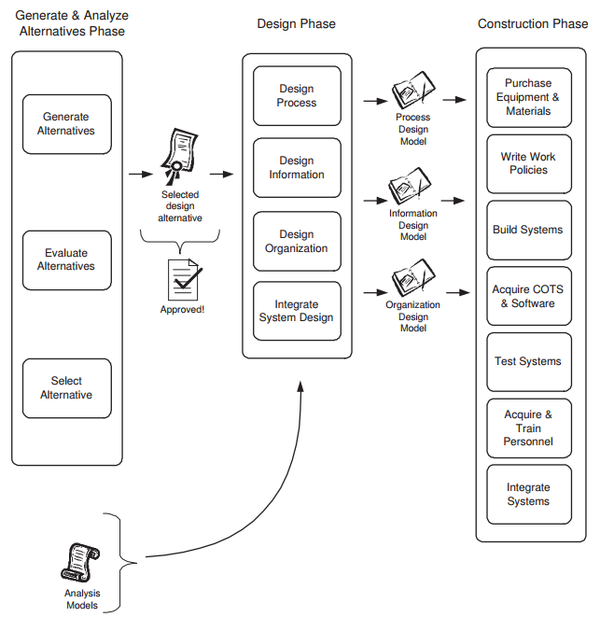
Phase 5: Design
The selected alternative is evolved into a complete specification for a new enterprise system.
Activities:
Design process
Design information
Design organization
Integrate system design

Slide 13
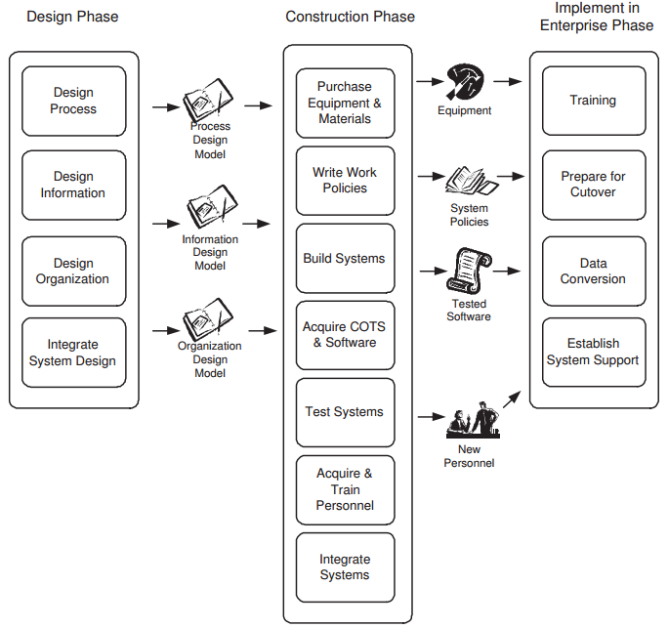
Phase 6: Construction
Takes the design specification, and purchases necessary systems or equipment, builds the system, integrates the system, and tests the system.

Slide 14
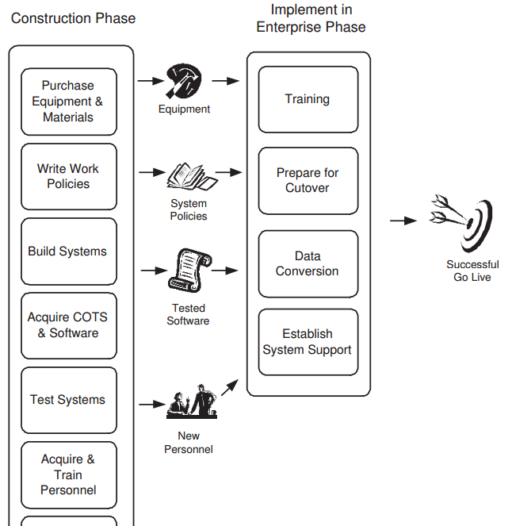
Phase 7: Implementation
Takes the new enterprise system and installs them in the enterprise.
It is a change management process.
Notes:
Implementation of enterprise systems is a change management process. The enterprise employees need to convert from the old way of working to the new.
Cutover: direct cutover, phased cutover, pilot cutover

Slide 15
Strategy

Slide 16
Strategy
Strategy is a plan to achieve the long-term goals of an enterprise.
Enterprise design is a strategic endeavor because it has a long-term, fundamental effect on the enterprise.
Three decision levels:
Strategic: long-term decisions having broad impact over the enterprise
Tactical: medium-term decisions having impact on individual business unit
Operational: day-to-day decisions made at low-level
These decisions are taken in order to gain a sustainable competitive advantage
Notes:
The strategic decisions set guidance and constraints for lower-level decisions. For example, a strategy to pursue market differentiation by providing superior quality and customer service becomes the guiding criteria for tactical and operational decisions in the enterprise. The strategy is long-term, which is usually defined as five or more years out, but will differ by company, industry, and country.
The result hoped for in any strategy is for the enterprise to gain a sustainable competitive advantage over its competition. Competitive advantage is the ability of an enterprise to achieve higher than industry-average profits [11]. Sustainable means that it is not temporary, but maintained over a long period of time.
The strategic plans an enterprise makes are developed to help the enterprise attain its goals. All enterprises have goals, and there are only a handful of goals that make sense for most enterprises. For-profit enterprises must have as a basic goal to make money, or more precisely to maximize shareholder value.1 Shareholder value is derived from the profits the enterprise generates compared to the costs to generate those profits, which is the profitability of the enterprise. To ensure long-term profitability, an enterprise needs to satisfy its customers and grow its business. This explains why many startups forgo profits in their early years in order to build market share, which is intended to maximize shareholder value over the long term. Non-profit enterprises might have a goal to help as many people as possible, or to have the greatest measurable impact possible. Government and quasi-government enterprises might have a goal to provide a particular service.
Achievement of long-term profitability implies market growth as an enterprise goal because in order to increase profits, an enterprise must either grow market share or must improve its products and services in terms of quality, timeliness, or cost so as to derive more profits from the same market share [1, 13]. Growth can be measured in terms of revenues, profits, return on investment, number of customers, or market share. In a growing market all companies in the market may grow. In a stable market or a declining market it is a zero-sum game; in other words, growth is at the expense of a competitor.

Slide 17
Mission, Vision, and Core values (http : //www.mch.com/)
Vision
Describes what the enterprise aspires to be. It states audacious goals of the enterprise.
For instance: Miami Children’s Hospital will continue to be recognized as one of America’s best children’s hospitals
Mission
A brief description of the enterprise’s purpose that projects the enterprise’s image to customers.
For instance: To provide excellent family-centered healthcare to children in an academic environment that meets or exceeds the expectations of those we serve and educate.
Core Values
Deeply held values of the organization that guide the enterprise’s internal behavior and how it interacts with its environment.
For instance: We will always do what is best for each child. We will always value those who serve children.
Notes:
To communicate the purpose and goals of an enterprise, the organization develops a vision statement, a mission statement, and a statement of core values.
A vision statement Miami Children’s Hospital will continue to be recognized as one of America’s best children’s hospitals and as Florida’s academic center of pediatric clinical excellence providing a number of Centers of Specialty Pediatric Excellence nationally and internationally.
The mission statement is a brief description of the enterprise’s purpose that projects the enterprise’s image to customers. Usually, the mission statement describes how the enterprise provides a product or service which satisfies the needs or desires of one or more customers. The mission must usually be accomplished in competition with other enterprises vying for the same business. A mission statement does not change frequently. For example, the mission of the U.S. Army is to protect the United States, and this has been their mission since the Army’s inception more than 200 years ago.
Core values are the deeply held values of the organization that guide the enterprise’s internal conduct and how it interacts with its environment. Core values should not change as the enterprise’s environmental circumstances change.

Slide 18
Strategy Hierarchy
Corporate Level Strategy
A corporate strategy determines what markets to compete in, what business units to have, how to allocate resources among the business units, what values to promote, how to achieve synergies through sharing and coordinating resources across business units, and how to govern the business units
Business Unit/Division Level Strategy
Product and Marketing strategy
Operational strategy
Manufacturing strategy
Service strategy
Information strategy
Functional Level Strategy
Functional level strategy is a response to operational level strategy. It advocates for the business to see its management decisions as specific to a functional area of the organization, such as marketing, human resources, finance, information management and public relations.
Notes:
• Product and Marketing Strategy – All enterprises provide a product or service, and they need a strategy for what products to make and how to position those products in the market. The product and market strategy determines the outward face of the enterprise to the clients and the rest of the world.
• Operational Strategy – The operations unit creates the product or service. If it is a product, then it is a manufacturing strategy; if it is a service, then it is a service strategy. The operational strategy determines the overall approach of operations, defining the consistent pattern of decision making done in operations. The decisions include capacity management, manufacturing capabilities, outsourcing, supply chain operations, and inventory decisions.
• Information Strategy – The information an enterprise has is considered a valuable resource and the use of IT is required for all enterprise operations. The information strategy determines the overall approach to developing and deploying information systems to support the enterprise. It describes the relationship between technology choices and business choices.

Slide 19
Strategy Theory

Slide 20
Strategy Theory
Resource-based theory of strategy:
Resources and capabilities are the basis for generating profits.
Enterprise strategy should be based on exploiting these resources.
Resources are inputs into an enterprise’s production process.
Tangible resources: real estate, production facilities, raw materials, equipment and other readily identified objects.
Intangible resources: business culture, reputation, brand name, patents. These are strategically more valuable
Market-based theory of strategy
There are two basic strategies an enterprise can pursue. A company can either provide value more efficiently than competitors by being the low-cost provider, or provide greater value than competitors by differentiating how it provides that value.
Low-cost leadership
The enterprise emphasizes its cost leadership to its customers. In a market, there can usually be only a single low-cost leader
Differentiation
The enterprise attempts to differentiate its products or services from other enterprises in its market. Differentiation may be in terms of product features, product quality, or any other characteristic valued by customers.
Notes:
The resource-based theory of strategy is based on two premises:
first, the resources and capabilities of an enterprise are the basis for generating profits, and
second, the enterprise strategy should be based on exploiting these resources and capabilities.
The market-based theory of strategy says that competitive advantage comes from the optimized position of the enterprise in a market vis-a-vis its competitors. In the market-based theory, it is the enterprise’s position in the external competitive environment that is examined, not the internal resources or capabilities of the enterprise. The foremost author promoting the market-based theory is Porter [11], who argues compellingly that there are two basic strategies an enterprise can pursue. A company can either provide value more efficiently than competitors by being the low-cost provider, or provide greater value than competitors by differentiating how it provides that value.

Slide 21
SWOT Analysis
Internal Factors
What resources, people, and knowledge give us an advantage in the marketplace?
Tangible resources (e.g., natural resources, location)?
Intangible resources (e.g., reputation, intellectual property, brand names, cost advantage due to proprietary know-how)?
Human resources (e.g., training, culture)?
What capabilities give us an advantage in the marketplace?
Processes (e.g., order fulfillment, product development)?
Technology expertise (e.g., small part manufacture, chemical knowledge)?
What is the strongest resource?
What resources, people, or knowledge can be improved?
What resources, people, or knowledge is lacking?

Slide 22
SWOT Analysis
External Factors
What trends (political, economic, social, or technological sometimes abbreviated PEST) might impact your industry?
What is the competition doing that you are not?
What are the advantages/disadvantages due to location (e.g., access to markets, workforce)?
Are there new entrants?
How are the relationships with partners, suppliers, distributors?

Slide 23
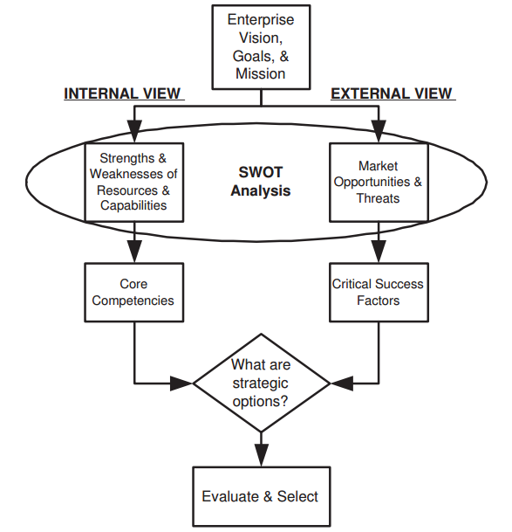
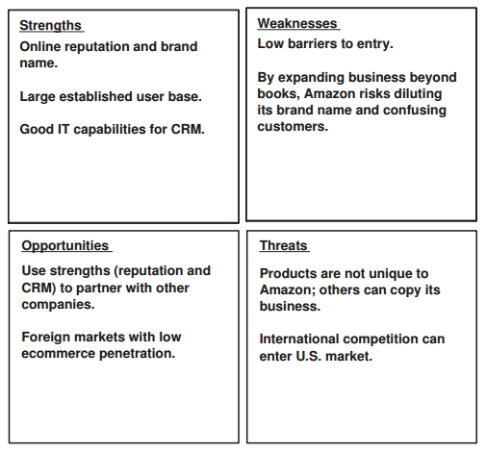
Strategy Formulation
A process by which an organization creates a strategy.

Slide 24
Strategy in Highly Dynamic Environments
In a complex market, the manager cannot predict the effectiveness of a strategy.
Therefore, an enterprise must seek out the best strategy to survive.
For example: following multiple strategies in such case.
Sometimes multiple strategies are incompatible.
Notes:
Incompatible strategies: you cannot simultaneously be both the low-cost producer and differentiate yourself by serving customers who demand high quality.

Slide 25
Any Question?

