Slide 1
QTM
Chapter 6

Slide 2
Scaling and units of measurement

Slide 5
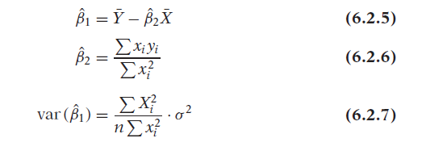

Slide 6
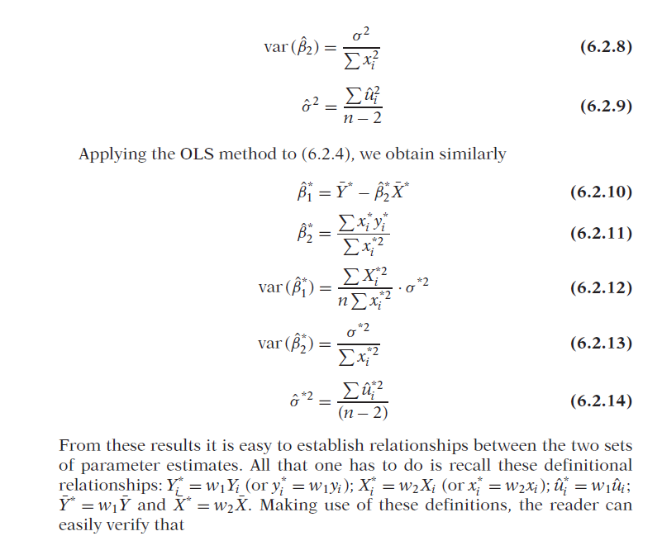

Slide 7
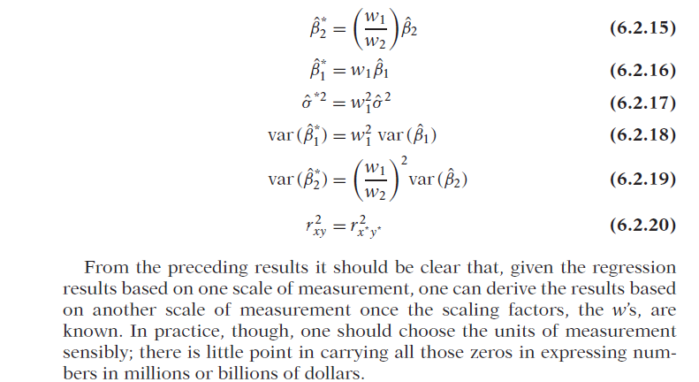

Slide 8
Regression on Standardized variables

Slide 10
FUNCTIONAL FORMS OF REGRESSION MODELS
As noted in Chapter 2, this text is concerned primarily with models that are linear in the parameters; they may or may not be linear in the variables. In the sections that follow we consider some commonly used regression models that may be nonlinear in the variables but are linear in the parameters or that can be made so by suitable transformations of the variables. In particular,
we discuss the following regression models:
1. The log-linear model
2. Semilog models
3. Reciprocal models
4. The logarithmic reciprocal model
We discuss the special features of each model, when they are appropriate, and how they are estimated. Each model is illustrated with suitable examples.

Slide 11
HOW TO MEASURE ELASTICITY: THE LOG-LINEAR MODEL

Slide 15
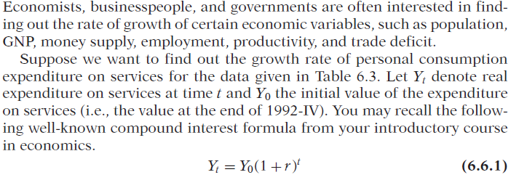
Semilog Models:LOG_LIN and LIN-LOG

Slide 16
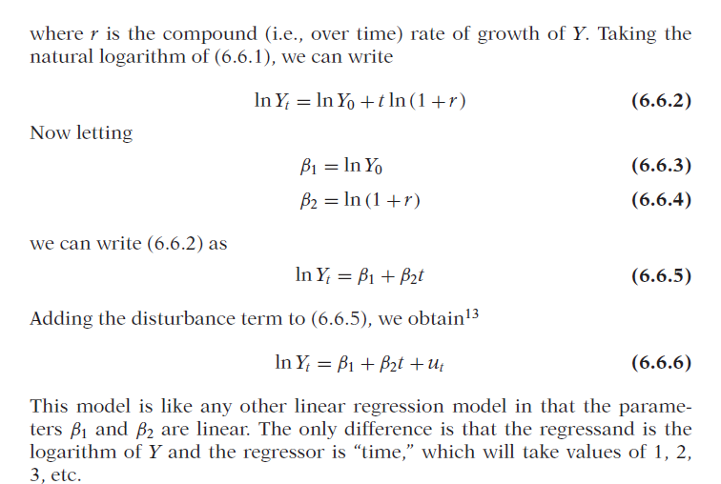

Slide 20
Lin log model

Slide 21
Reciprocal Models

Slide 22
Log Hyperbola or logarithmic reciprocal Model

