Slide 1
Dummy variable
Up till now we have dealt exclusively with the variables which can measures in quantitative terms. But sometimes variables which we consider important are of qualitative character. The presence of such variables cannot be measured quantitatively, but can only be noted whether the given character is present or not. For example, suppose that we want to explain the consumption behavior of different households. In addition to the level of disposable income,

Slide 2
Dummy variable
we may believe that consumption depends on order of other character i.e. the presence or absence of children, posses or not own house, the literacy of the head of household, religion etc. Since we cannot measure these character but we can assign 1 to presence and zero to absence. In this way the attribute is transferred to a variable known as dummy or binary variable.

Slide 3
Dummy variable are commonly used in econometric research for qualitative factor, Such as profession, religion, sex, region etc. Dummy variable can be used in regression models just as easily as quantitative variables.

Slide 4
In order to explain consider the example of simple linear regression model in which the explanatory variable is represented by dummy variable. Assume that in a factor salary offered to a worker depends on literacy, i.e.

Slide 5
is salary offered
1 if the worker is educated
= 0 if the worker is uneducated
If then
If then

Slide 6
The intercept term gives mean salary of the worker having low qualification and the slope coefficient tells us by how much the mean salary of worker having qualitative different from the mean salary of low qualification on workers.
A test of hypothesis is equivalent to the test that there is no difference between the mean salaries of the workers.

Slide 7
The model which contain explanatory variables that are exclusively dummy variable are called analysis of variance (ANOVA) model. In most of economic research the regression model contains a admixture of qualitative and quantitative variables are called ANCOVA model.

Slide 8
Where is the consumption of head H.H.
is the income of head of H.H.
=0 if H.H has no childern.
=1 if H.H has childern.
=0 if H.H has no house.
=1 if H.H has house.

Slide 9
=0 if the head H.H is illiterate.
=1 if the head H.H is literate
If a person has no children, has no own house and illiterate then the mean consumption function

Slide 16
Uses of Dummy variables
Use of dummy variable for measuring the shift of a function over time
A shift of a function implies that the constant intercept changes in different period, while other coefficient remains constant. Such type of shift can be examined by introducing dummy variables in function under study. For example we wish to study the aggregate consumption function for the period 1910-1960. There were two wars, partition of the countries and also depression, hence the condition were not normal, during war times for given income we might expect downward shift of consumption.

Slide 17
Use of Dummy variable for measuring change in (slope)parameter over time
It is known that over long period of time or abnormal year , not only the function is shifted but also their slope will be expected to change. The change in parameters may be captured by introducing appropriate dummy in the model.

Slide 18
Features of Dummy variables in Regression model
One dummy variable is sufficient to distinguished two categories. We introduce a dummy variable with zero for one category and one for other category.
The category which is assigned the value zero is often referred to as the base or control category.
If we have more than two categories, let say K then (k-1) dummy variables will be used. The value one of each dummy variable will be used for each category other than base category and the zero of all dummy will represent the base category.

Slide 19
Intercept Dummy

Slide 20
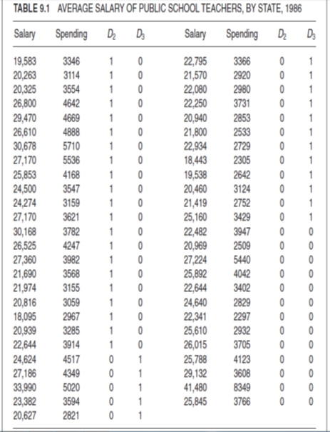

Slide 22
Slope Dummy
Example

Slide 23
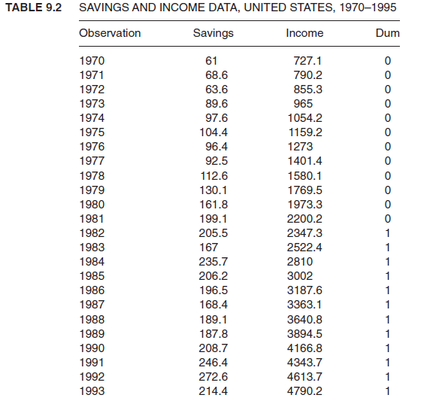

Slide 27
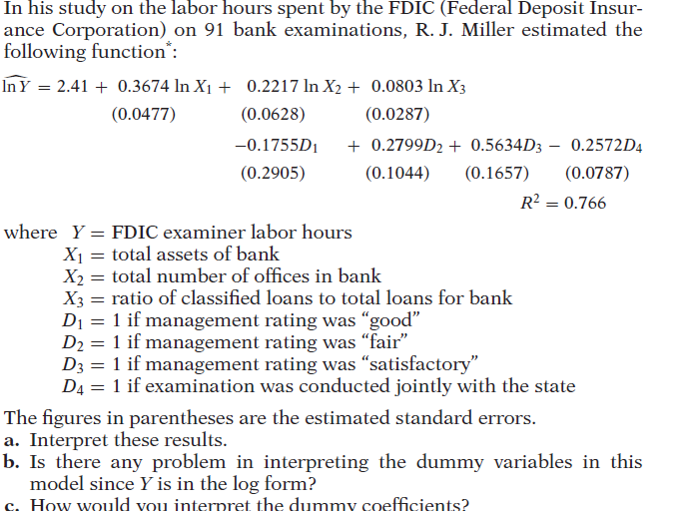

Slide 28
assignment
Question 1: Using your EAEF data set, regress S on ASVABC, SM, SF and MALE, a dummy variable that is 1 for male respondents and 0 for female ones. Interpret the coefficients and perform t tests. Is there any evidence that the educational attainment of males is different from that of females?

Slide 29
Question 2: Does ethnicity affect educational attainment? In your EAEF data set you will find the following ethnic dummy variables:
ETHHISP 1 if hispanic, 0 otherwise
ETHBLACK 1 if black, 0 otherwise
ETHWHITE 1 if not hispanic or black, 0 otherwise.
Regress S on ASVABC, MALE, SM, SF, ETHBLACK and ETHHISP. (In this specification ETHWHITE has been chosen as the reference category, and so it is omitted.) Interpret the regression results and perform t tests on the coefficients

Slide 30
Question 3. Are earnings subject to ethnic discrimination? Using your EAEF data set, regress LGEARN on S, ASVABC, MALE, ETHHISP and ETHBLACK. Interpret the regression results and perform t tests on the coefficients.

Slide 31
Question No 4: Is the effect of the ASVABC score on educational attainment different for males and females? Using your EAEF data set, define a slope dummy variable MALEASVC as the product of MALE and ASVABC:
MALEASVC = MALE*ASVABC
Regress S on ASVABC, SM, SF, ETHBLACK, ETHHISP, MALE and MALEASVABC, interpret the equation and perform appropriate statistical tests

