Slide 1
Descriptive and Observational Study Designs

Slide 2
Research?
The systematic investigation and study of materials, sources, etc, in order to establish facts and reach new conclusions.
[Oxford Concise Dictionary]
Notes:
An endeavour to discover new or collate old facts etc by the scientific study of a subject or by a course of critical investigation.

Slide 3
Research is what we do when we have a question or a problem we want to resolve
We may already think we know the answer to our question already
Notes:
We may think the answer is obvious, common sense even but until we have subjected our problem to rigorous systematic search, our 'knowledge’ remains little more than guesswork or at best, intuition.

Slide 4
Study design
A study design is a specific plan or protocol for conducting the study,
It allows the investigator to translate the conceptual hypothesis into an operational one.

Slide 5
Classification of Epidemiological Research/Study Designs
Descriptive Research
Analytical Research
5

Slide 6
Descriptive Research
Individual based
Population based
Case report
Case series
Ecological /
Correlational
Cross-sectional surveys
Notes:
https://explorable.com/correlational-study

Slide 7
Analytical Research
Observational
Experimental / Interventional
Cohort study
Randomized Control Trials
Case–control study
Cross-sectional study
Quassi
7

Slide 8
Notes:
https://www.ncbi.nlm.nih.gov/pmc/articles/PMC2998589/

Slide 9
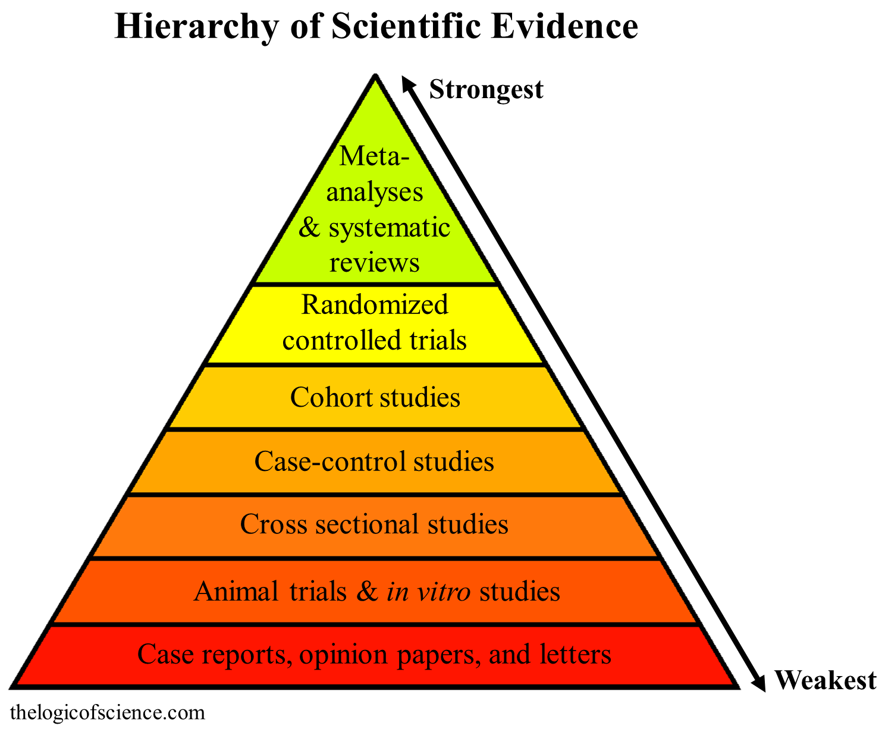

Slide 10
Develop
hypothesis
Descriptive Studies
Investigate it’s
relationship to
outcomes
Case-control Studies
Increasing Knowledge of
Disease/Exposure
Define it’s meaning
with exposures
Cohort Studies
Test link
experimentally
Clinical trials

Slide 11
Objectives at various levels
Study Types
Objectives
Knowing the frequency of disease
Knowing the distribution
Developing the hypothesis
DESCRIPTIVE STUDIES
OBSERVATIONAL ANALYTICAL
Testing the hypothesis
Establishing association
EXPERIMENTAL OR INTERVENTIONAL STUDIES
1. Strength of association
2. Establishing the cause

Slide 12
Descriptive Studies
Describe only; do NOT examine associations between Exposure (E) and health Outcome (O).
Generally the purpose is to describe the variability in a health outcome and/or formulate hypotheses.
A descriptive study involves describing the characteristics of a particular situation event or case.
Descriptive studies can be carried out on a small or larger scale.

Slide 13
Ecological studies
Sometimes called correlational studies
Compares outcomes between groups, not individuals
Useful to examine trends over time or to explain differences between groups

Slide 14
VITAL STATISTICS
Common data source for ecologic studies
Describes disease patterns in entire geographic or political populations
Routinely collected information from birth and death certificates; allow comparisons between countries over time
Comparison by age, race, gender, geographic areas and time period

Slide 15
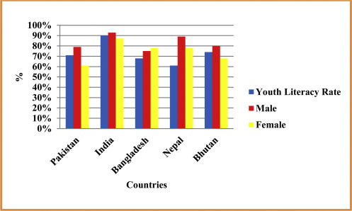
Example
Notes:
https://www.sciencedirect.com/science/article/pii/S2405883116300247#fig4

Slide 16
Vital statistics advantages
Inexpensive
Representative of large groups and large geographic areas
Available over long periods of time

Slide 17
Vital Statistics Disadvantages
Group “ecologic” data -- not individual
Uncertain accuracy of diagnoses
Changes in ICD codes
Variability in coding practices
Limited to available data
Mortality may not reflect incidence
Subject to ecological fallacy

Slide 18
Types of Ecological Studies
Ecological studies can be of 2 types:
Geographical
Health outcomes and risk-modifying factors are averaged for populations divided along geographical lines.
Temporal
Health outcomes are examined for seasonal variations or trends.
Notes:
https://www.ncbi.nlm.nih.gov/pmc/articles/PMC4862381/

Slide 19
Ecological studies on BMJ Journals
https://jech.bmj.com/collection/ecologic-studies?page=1

Slide 20
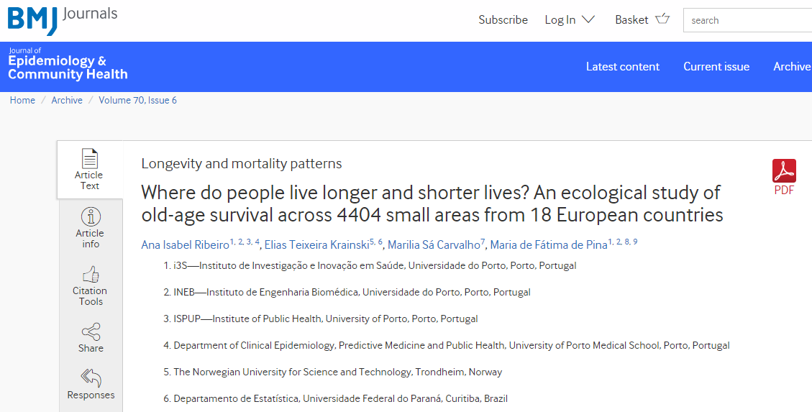
Example
Notes:
https://jech.bmj.com/content/70/6/561

Slide 21
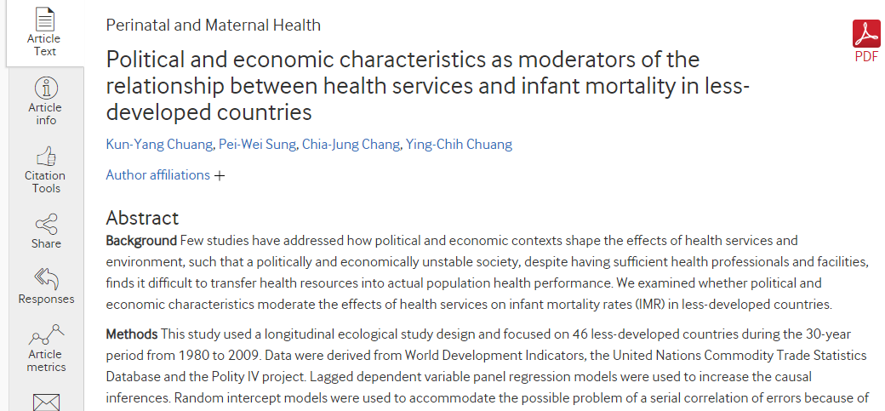
Example
.
Notes:
Chuang K, Sung P, Chang C, et al
Political and economic characteristics as moderators of the relationship between health services and infant mortality in less-developed countries
J Epidemiol Community Health 2013;67:1006-1012.

Slide 22
Example
Notes:
https://www.ncbi.nlm.nih.gov/pmc/articles/PMC4862381/

Slide 23
Example
Grant WB. A multi country ecological study of cancer incidence rates in 2008 with respect to various risk-modifying factors.
Notes:
Grant WB. A multicountry ecological study of cancer incidence rates in 2008 with respect to various risk-modifying factors. Nutrients 2014; 6:163-89; http://dx.doi.org/10.3390/nu6010163

Slide 24
Example
People from countries that ate large amounts of meat had high cancer rates, whereas people from countries such as Italy, where people favored pasta, or China, where people ate rice, had low rates of cancer.
Notes:
Cameli M, Khayyal M, Marino F, Augustine D, Forshaw T, Mondillo S, Stankovic I, Surkova E, Timeshova T, Vasco N, et al. Club 35 EACVI web spotlight: comments on right ventricle assessment in the new echocardiography recommendations. Eur Heart J Cardiovasc Imaging 2015; 16(11):1185-6

Slide 25
Case report
A case report is a detailed description of the clinical presentation, diagnosis, treatment, and outcomes of a patient (or case), often with an unusual or novel condition, to be shared for medical or educational purposes.
In physical therapy, case reports provide detailed descriptions of how therapists meet clinical, managerial, and educational challenges (Fitzgerald, 2007) and
In a study case reports in PT have been called the “currency of practice” (Rothstein, 2002, p. 1063).
https://files.eric.ed.gov/fulltext/EJ915929.pdf

Slide 26
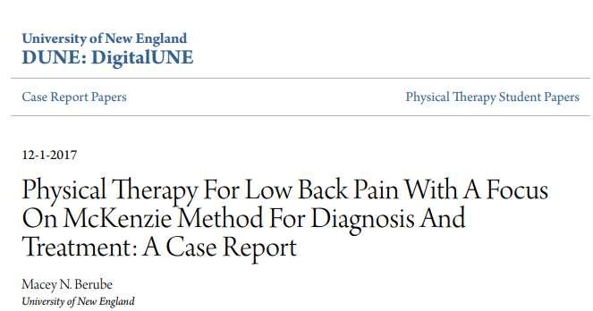
Example https://dune.une.edu/cgi/viewcontent.cgi?article=1081&context=pt_studcrpaper

Slide 27
Example https://dune.une.edu/cgi/viewcontent.cgi?article=1067&context=pt_studcrpaper

Slide 28
Example
https://dune.une.edu/cgi/viewcontent.cgi?article=1086&context=pt_studcrpaper

Slide 29
Case reports of PT
Collection of more than 80 case reports in physical therapy published from 2014-18
https://dune.une.edu/pt_studcrpaper/

Slide 30
Steps of writing case report in physical therapy Step 1: Examination and Purpose
What is the patient’s chief complaint or problem? What is the medical diagnosis?
State the reasons for referral to physical therapy.
Provide pertinent information about the patient’s medical and social history, living environment, social and health habits, functional status and activity level, and medications.
Provide pertinent information from the systems review.
Notes:
https://files.eric.ed.gov/fulltext/EJ915929.pdf

Slide 31
Step 1: Examination and Purpose cont …
Construct a Table that reports the results of the tests and measurements.
Provide citations on the reliability and validity of the individual tests and measures.
Explain why you selected this patient/client for a case report. How will your case report add to the body of knowledge in physical therapy?
State the purpose of your case report.

Slide 32
Step 2: Evaluation, Diagnosis, and Prognosis
Discuss your interpretation of the information you obtained in the examination
What are the patient’s impairments, functional limitations, and disabilities?
Explain how any comorbidities may affect prognosis, goals, expected outcomes, and plan of care.
What is the patient’s physical therapy diagnosis from the Guide to Physical Therapist Practice?

Slide 33
Step 2: Evaluation, Diagnosis, and Prognosis cont …
What is the patient’s prognosis for improvement with physical therapy?
Provide a rationale for your prognosis that is based on theoretical argument, clinical experience, or previous research?
What are the short-term and long-term or discharge goals for physical therapy?
What goals and outcomes does the patient (or family) have for physical therapy?

Slide 34
Step 3: Plan of Care and Interventions
Outline the physical therapy plan of care for: coordination, communication, and documentation, patient/client related instruction, and procedural interventions.
Explain your decision-making process that led from evaluation, diagnosis, and prognosis to the plan of care and the selection of the interventions.
What interventions were provided?
Describe the chronology of interventions and explain the rationale for any changes over time.
Provide a rationale for the interventions based on theoretical argument, clinical experience, or previous research.
Explain the rationale for any changes that were made in the intervention.

Slide 35
Step 4: Outcomes
Estimate the number of physical therapy treatment sessions the patient received.
Include Table(s) of the results of the most relevant tests and measures or outcome measures made at admission and discharge from PT (or initial and final measures).
Include any Figure(s) (e.g., photographs, etc) or Appendix you plan to include in the report.

Slide 36
Case Series
The case series design is an extension of the case report.
Experience of a group of patients with a similar diagnosis
Cases may be identified from a single or multiple sources
Generally report on new/unique condition
May be only realistic design for rare disorders

Slide 37
Usually a coherent and consecutive set of cases of a disease (or similar problem) which derive from either the practice of one or more health care professionals or a defined health care setting e.g. a hospital or family practice.
A case-series is, effectively, a register of cases.
Analyse cases together to learn about the disease.
Clinical case-series are of value in epidemiology.
Studying symptoms and signs.
Creating case definitions, Clinical education, audit and research.

Slide 38
Advantages
Useful for hypothesis generation
Informative for very rare disease with few established risk factors
Characterizes averages for disorder
Disadvantages
Cannot study cause and effect relationships
Cannot assess disease frequency

Slide 40
Distinguishing features of studies
Experimental or observational
Randomised or non-randomised
Longitudinal or cross-sectional
Prospective or retrospective
Descriptive or comparative

Slide 41
Cohort studies
The observation of a cohort over time to measure outcome(s)
Synonymous terms
Follow-up
Longitudinal
Prospective
Often analytical (analyse associations between rates of outcomes and risk factors or predictive factors)
Can also be descriptive (describe incidence rates of an outcome over time or natural history of disease)

Slide 42
Cohort studies
Recruitment
Prospective
Exposure
Outcome
Retrospective
Exposure
Outcome
Exposure
Outcome
Ambidirectional
Exposure
Outcome
Time

Slide 43
Prospective Cohort study
Exposed
Outcome
Measure exposure
and confounder
variables
Non-exposed
Outcome
Baseline
time
Study begins here

Slide 44
Relative Risk
 | Diseased | Healthy
Exposed | De | He | Ne=De + He
Not exposed | Dn | Hn | Nn = Dn + Hn

Slide 45
Relative Risk = risk in exposed people
risk in unexposed people

Slide 47
Advantages of cohort studies
Useful for rare exposures
Useful for more than one outcome
Incidence of the outcome (and incidence rates)
Temporal relationship between exposure and outcome is clear as exposure status defined at start of study
If prospective, minimises bias in measurement of exposure
Notes:
Cohort studies work well for rare exposures–you can specifically select people exposed to a certain factor.
Useful for more than one outcome -------- An added advantage is that you can examine a range of outcomes/diseases caused by one exposure (e.g. heart disease, lung disease, renal disease caused by smoking).

Slide 48
Disadvantages of cohort studies
Not good for study of rare outcomes
If retrospective they rely on the adequacy of records
Exposed may be followed more closely than unexposed
If prospective they can be very expensive and slow
As they are follow up studies, the validity of results is highly sensitive to losses to follow up (migration, withdrawal, lack of participation, death)
Notes:
this design does not work for rare diseases (outcomes)–you would then need a large study group to find sufficient disease cases.

Slide 49
Case-control studies
An analytical epidemiologic study design in which individuals who have the disease under study, also called cases, are compared to individuals free of disease (controls) regarding past exposures.
The purpose is to determine if there are one or more factors associated with the disease under study.
Notes:
Case-control study designs are used to estimate the relative risk for a disease from a specific risk factor. The estimate is the odds ratio, which is a good estimate of the relative risk when the disease is rare. However, because these studies collect data after disease has already occurred, they are considered retrospective, which is a limitation. study. While a case-control study design offers less support for a causation hypothesis than the longer and more expensive cohort design, it does provide stronger evidence than a cross-sectional

Slide 50
The case-control design is a research design that is used to investigate the relationship between an exposure and a health outcome. The exposure can be any variable that precedes the outcome.
They require much smaller sample sizes than cohort studies.
Compared to prospective cohort studies they tend to be less costly and shorter in duration.
Notes:
https://www.journalofphysiotherapy.com/article/S1836-9553(17)30105-4/pdf
https://en.wikipedia.org/wiki/Case–control_study

Slide 51
Odd Ratio
 | Diseased | Healthy
Exposed | De | He | Ne=De + He
Not exposed | Dn | Hn | Nn = Dn + Hn

Slide 53
Two characteristics distinguish case-control studies from other quantitative research designs.
First, case-control studies are observational studies. This means that the investigators do not manipulate which participants are and are not exposed to the exposure of interest. This distinguishes it from clinical trials.
Second, participants in case-control studies are sampled in a way that depends on the participants’ health outcomes. This distinguishes case-control studies from other observational studies, such as cohort studies, that sample without regard to outcome.

Slide 54
An example of a case-control study that is relevant to physical therapy is a study that examined whether leg-length discrepancy causes back pain.
In this study the exposure of interest was leg-length discrepancy and the outcome was back pain.
The study compared leg-length discrepancies in 70 people with back pain and 70 controls.
The investigators found similar proportions of participants with leg-length discrepancies in the group with back pain and the control group, and concluded that leg-length discrepancy ‘is not a significant causal factor for back pain’.
Notes:
Grundy PF, et al. Lancet. 1984;2:256–258

Slide 55
Case-control study design offers less support for a causation hypothesis than the longer and more expensive cohort design, it does provide stronger evidence than a cross-sectional.
However, because these studies collect data after disease has already occurred, they are considered retrospective, which is a limitation.

Slide 56
Exposed
Cases
(disease)
Non-Exposed
Study
population
Exposed
Controls
(no disease)
Case-Control Design
Non-Exposed
present
past
time
Study begins here

Slide 57
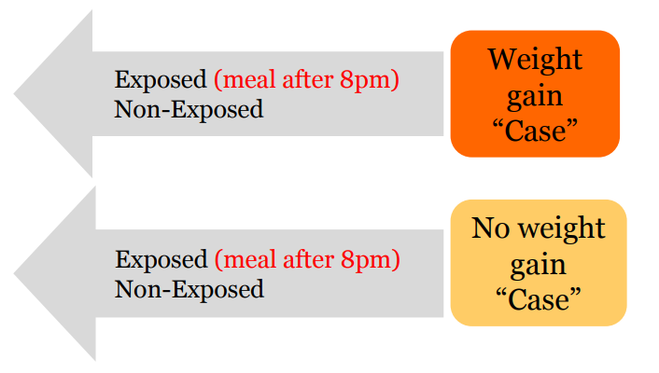
Case-Control Design - Example
Notes:
adverse drug reaction (ADR)

Slide 58
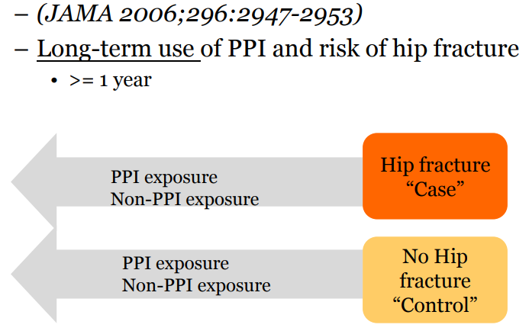
Example

Slide 59
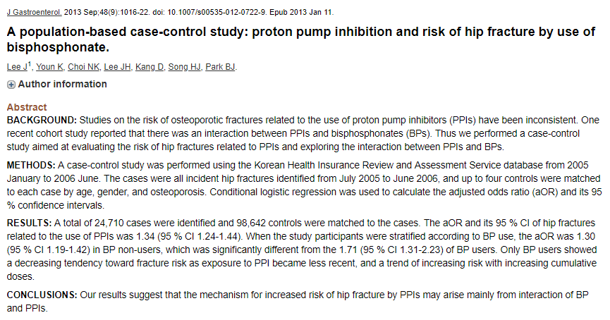
Example
Notes:
https://www.ncbi.nlm.nih.gov/pubmed/23307040

Slide 60
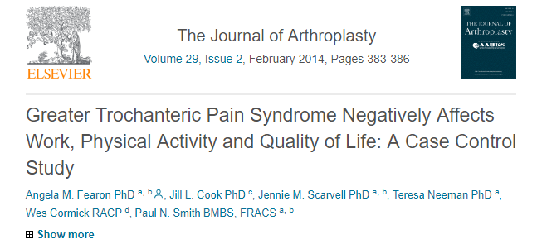
This study examined work participation, function and quality of life in people with greater trochanteric pain syndrome (GTPS, n = 42), severe hip osteoarthritis (OA, n = 20) and an asymptomatic group (ASC, n = 23).
https://www.sciencedirect.com/science/article/pii/S0883540313000752
Notes:
Fearon AM, Cook JL, Scarvell JM, Neeman T, Cormick W, Smith PN. Greater trochanteric pain syndrome negatively affects work, physical activity and quality of life: a case control study. The Journal of arthroplasty. 2014 Feb 1;29(2):383-6.

Slide 61
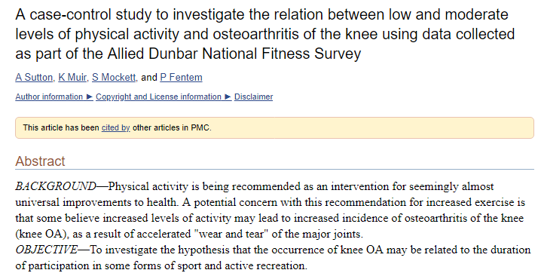
https://www.ncbi.nlm.nih.gov/pmc/articles/PMC1753811/

Slide 62
Advantages of case-control Studies
Can be carried out quickly and quite cheaply
Useful for rare diseases and outcomes
Can study multiple exposures for a single outcome
Can study diseases with long latent periods
Notes:
This design is especially useful for rare diseases (as you select the cases yourself)
https://onlinecourses.science.psu.edu/stat507/node/48
http://sphweb.bumc.bu.edu/otlt/MPH-Modules/EP/EP713_AnalyticOverview/EP713_AnalyticOverview5.html

Slide 63
Disadvantages of case-control studies
Selection of control population, overmatching
Information bias as exposures – similar status determined after outcome has occurred e.g. Recall
Selection bias especially regarding controls
Cannot establish sequence of events (temporal relationship)
Not good for rare exposures
Cannot usually be used to estimate incidence rates
Notes:
Although controls must be like the cases in many ways, it is possible to over-match. Over-matching can make it difficult to find enough controls.
attributable risk the amount or proportion of incidence of disease or death (or risk of disease or death) in individuals exposed to a specific risk factor that can be attributed to exposure to that factor; the difference in the risk for unexposed versus exposed individuals.
empiric risk the probability that a trait will occur or recur in a family based solely on experience rather than on knowledge of the causative mechanism.
genetic risk the probability that a trait will occur or recur in a family, based on knowledge of its genetic pattern of transmission.
relative risk

Slide 64
Cross-sectional studies
An “observational” design that surveys exposures and disease status at a single point in time (a cross-section of the population)
time
Study only exists at this point in time

Slide 65
Cross-sectional Design
factor present
No Disease
factor absent
Study
population
factor present
Disease
factor absent
time
Study only exists at this point in time

Slide 66
Cross-sectional study
This study type can be thought of as providing a "snapshot" of the frequency and characteristics of a disease in a population at a particular point in time.
Often used to study conditions that are relatively frequent with long duration of expression (nonfatal, chronic conditions)

Slide 67
Cross-sectional study
Data that are collected as part of a cross-sectional study can be used to assess the prevalence of acute or chronic conditions in a population.
A cross sectional design may also make it difficult to establish what is cause and what is effect.
If milk drinking is associated with peptic ulcer, is that because milk causes the disease, or because ulcer sufferers drink milk to relieve their symptoms?

Slide 68
Cross-sectional research studies all have the following characteristics:
takes place at a single point in time
variables are not manipulated by researchers
provide information only; do not answer why

Slide 69
Advantages of cross-sectional
Outcomes and exposures measured at the same time
Uncovers associations for further study
Useful for hypothesis generation
Quick & cheap (no follow up)
Best way to determine prevalence
Questionnaire/interview based
Useful for assessing practice, attitudes, knowledge, beliefs , utilisation of services etc

Slide 70
Disadvantages of cross-sectional
It may not provide definite information about cause-and-effect relationships.
This is because such studies offer a snapshot of a single moment in time; they do not consider what happens before or after the snapshot is taken.
It difficult to establish what is cause and what is effect.
Usually researcher don’t know when disease occurred

Slide 71
Not suitable for studying rare diseases or diseases with a short duration.
Unable to measure incidence

Slide 72
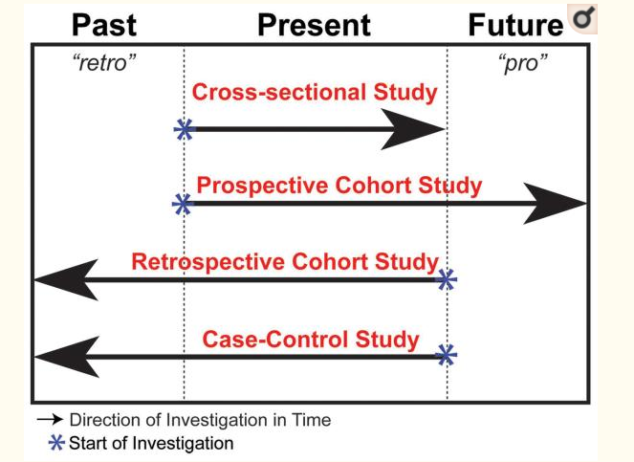
Notes:
https://www.ncbi.nlm.nih.gov/pmc/articles/PMC2998589/

