Slide 1
Discrete Structure
Daud Khan Khalil
School of Computer Science
IQRA National University
Peshawar

Slide 2
Relations and Functions

Slide 3
Lets take a start

Slide 4
Ordered Pair
An ordered pair (a, b) consists of two elements “a” and “b” in which “a” is the first element and “b” is the second element.
The ordered pairs (a, b) and (c, d) are equal if, and only if, a= c and b = d.
Note that (a, b) and (b, a) are not equal unless a = b.

Slide 5
Exercise
Find x and y given (2x, x + y) = (6, 2)
Solution
Two ordered pairs are equal if and only if the corresponding components are equal. Hence, we obtain the equations:
2x = 6 ..................(1) and x + y = 2 .................(2)
Solving equation (1) we get x = 3 and when substituted in (2) we get y = -1.

Slide 6
Continued…
Cartesian product
Let A and B be sets. The Cartesian product of A and B, denoted by A x B (read as “A cross B”) is the set of all ordered pairs (a, b), where a is in A and b is in B.
Symbolically:
Note
If set A has m elements and set B has n elements then A x B has m x n elements.

Slide 7
Continued…
Let A = {1, 2}, B = {a, b, c} then A x B = {(1, a), (1, b), (1, c), (2, a), (2, b), (2, c)} B x A = {(a, 1), (a, 2), (b, 1), (b, 2), (c, 1), (c, 2)} A x A = {(1, 1), (1,2), (2, 1), (2, 2)} B x B = {(a, a), (a, b), (a, c), (b, a), (b, b), (b, c), (c, a), (c, b),(c, c)}

Slide 8
Binary Relation
Let A and B be sets. The binary relation R from A to B is a subset of AxB
Example
Let A = {1, 2}, B = {1, 2, 3} Then A x B = {(1, 1), (1, 2), (1, 3), (2, 1), (2, 2), (2, 3)} Let
R1={(1,1), (1, 3), (2, 2)}
R2={(1, 2), (2, 1), (2, 2), (2, 3)}
R3={(1, 1)}

Slide 9
Continued…
Domain of a Relation
The domain of a relation R from A to B is the set of all first elements of the ordered pairs which belong to R denoted by Dom(R).
Symbolically Dom (R) = {a ∈A | (a, b) ∈R}
Range of a Relation
The range of a relation R from A to B is the set of all second elements of the ordered pairs which belong to R denoted Ran(R).
Symbolically Ran(R) = {b ∈B | (a, b) ∈ R}

Slide 10
Continued…
Relation on a set
A relation on the set A is a relation from A to A. In other words, a relation on a set A is a subset of
A x A.
Let A = {1, 2, 3, 4} Define a relation R on A
Solution
AxA= {1, 2, 3, 4} x{1, 2, 3, 4}
A x A = {(1, 1), (1,2), (1,3), (1,4), (2, 1), (2, 2), (2, 3), (2, 4), (3, 1), (3, 2), (3, 3), (3, 4), (4, 1), (4, 2), (4, 3), (4, 4)}
R = {(1,1), (1,2), (1,3), (1,4), (2,2), (2,4), (3,3), (4,4)}

Slide 11
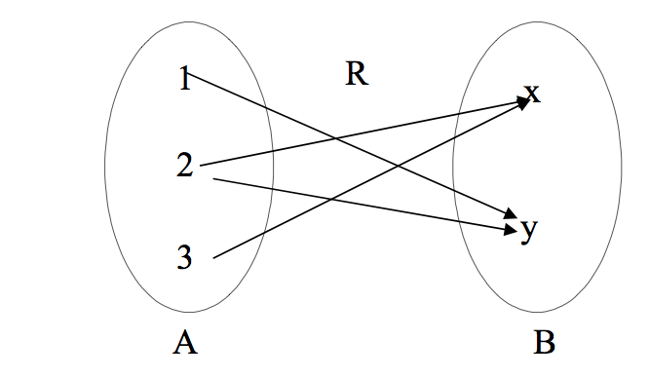
Continued…
Arrow Diagram of a Relation
Let A = {1, 2, 3}, B = {x, y} then
R = {1,y), (2,x), (2,y), (3,x)} be a relation from A to B.
The arrow diagram of R is

Slide 12
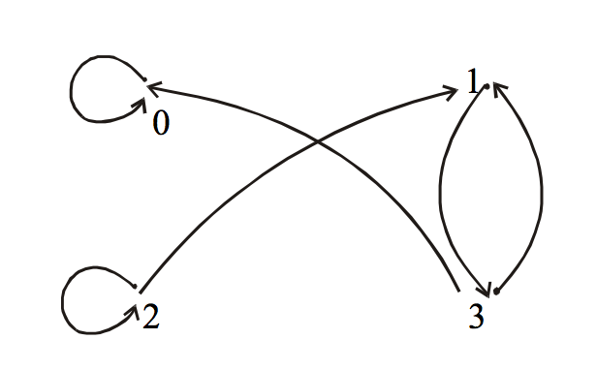
Continued…
Directed graph of a Relation
Let A = {0, 1, 2, 3} and R = {(0,0), (1,3), (2,1), (2,2), (3,0), (3,1)} be a binary relation on A.

Slide 13
Continued…
Reflexive relation
Let R be a relation on a set A. R is reflexive if and only if, for all a∈ A, (a, a) ∈ R That is, each element of A is related to itself.
Exercise
Let A = {1, 2, 3, 4} and define relations R1, R2, R3, R4 on A as follows:
R1 = {(1, 1), (3, 3), (2, 2), (4, 4)}
R2 = {(1, 1), (1, 4), (2, 2), (3, 3), (4, 3)} R3 = {(1, 1), (1, 2), (2, 1), (2, 2), (3, 3), (4, 4)}
R4 = {(1, 3), (2, 2), (2, 4), (3, 1), (4, 4)}

Slide 14
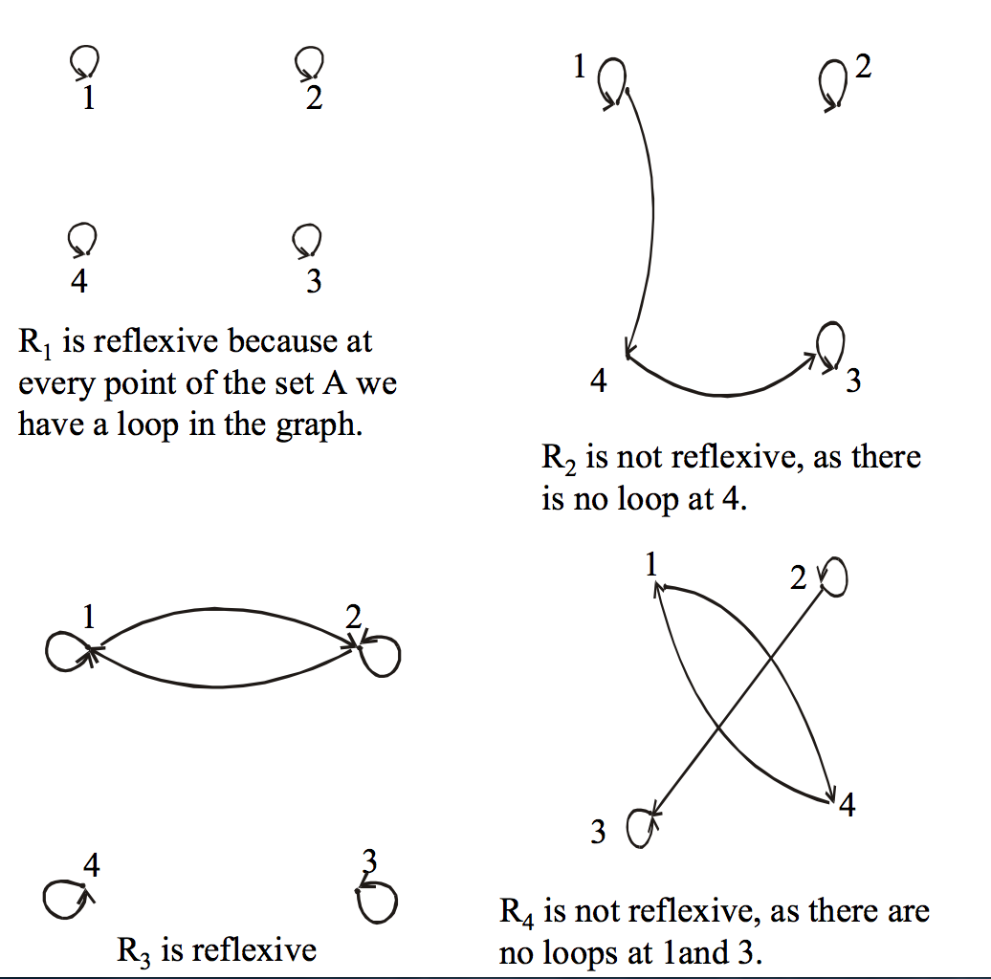
Continued…

Slide 15
Continued…
Symmetric relation
Let R be a relation on a set A. R is symmetric if, and only if, for all a,b∈A, if (a,b) ∈R, then (b,a) ∈R.
R is not symmetric iff there are elements a and b in A such that (a, b) ∈R, but (b, a) ∈R.
Let A = {1, 2, 3, 4} and define relations R1, R2, R3, and R4 on A as follows.
R1 = {(1, 1), (1, 3), (2, 4), (3, 1), (4,2)}
R2 = {(2, 2), (2, 3), (3, 4)} R3 = {(1, 1), (2, 2), (3, 3), (4, 3), (4, 4)}

Slide 16
Continued…
Then R1 is symmetric because for every order pair (a, b) in R1 also have (b, a) in R1. For example, we have (1, 3) in R1 then we have (3, 1) in R1. Similarly all other ordered pairs can be checked.
R2 is not symmetric, because (2,3) ∈ R3 but
(3,2) ∉ R3.
R3 is not symmetric because (4,3) ∈ R4 but
(3,4) ∉ R4.

Slide 17
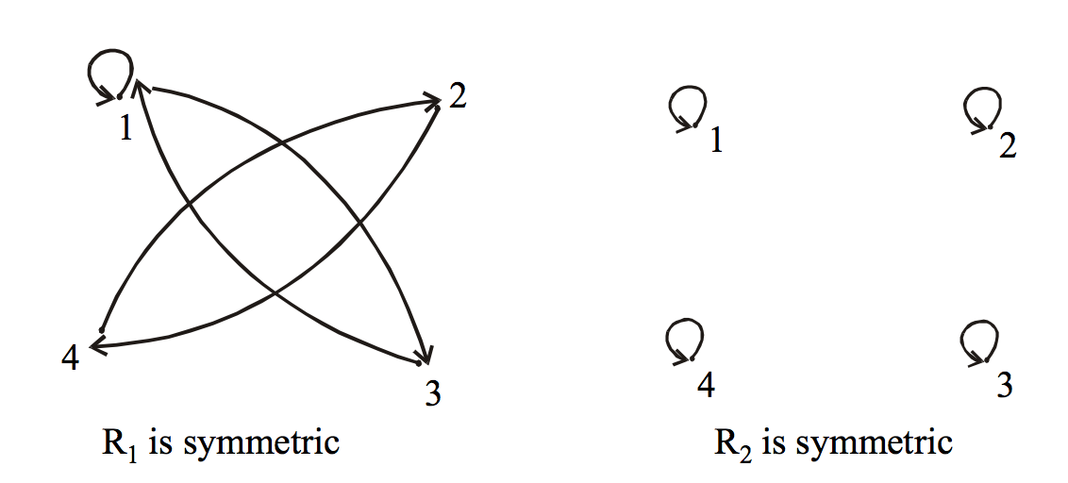
Continued…

Slide 18
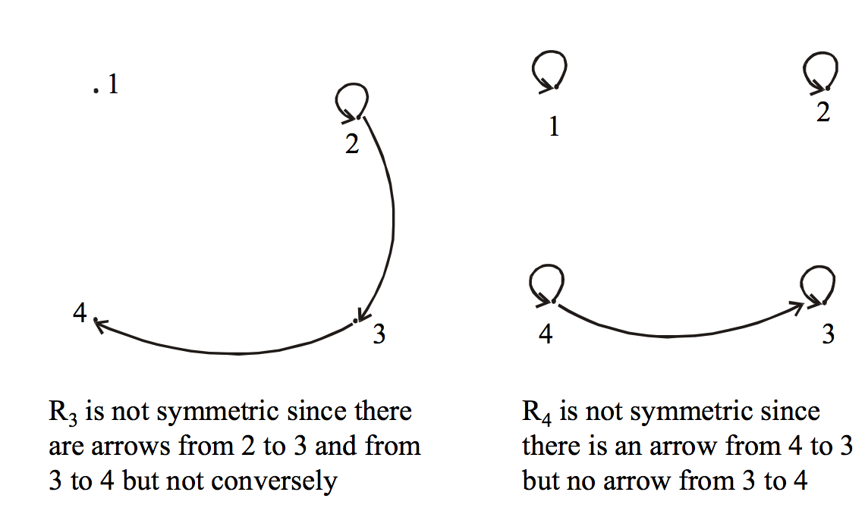
Continued…

Slide 19
Continued…
Transitive relation
Let R be a relation on a set A. R is transitive if and only if for all a, b, c ∈A, if (a,b) ∈R and (b,c) ∈R then (a,c) ∈R.
In words, if any one element is related to a second
and that second element is related to a third, then
the first is related to the third
Note
The “first”, “second” and “third” elements need not to be distinct.
R is not transitive iff there are elements a, b, c in A such that if (a, b) ∈R and (b, c) ∈R but (a, c) ∉ R.

Slide 20
Example
Let A={1,2,3,4} then define relations R1,R2 and R3 on A by the directed graphs.
Solution
R1 = {(1, 2), (2, 3), (1, 3)}
R2 = {(1, 2), (1, 4), (2, 3), (3, 4)}
R3 = {(2, 1), (2, 4), (2, 3), (3,4)}

Slide 21
Function
A function f from a set X to a set Y is a relationship between elements of X and elements of Y such that each element of X is related to a unique element of Y, and is denoted f : X →Y. The set X is called the domain of f and Y is called the co-domain of f.
Note
The unique element y of Y that is related to x by f is denoted f(x) and is called f of x, or the value of f at x, or the image of x under f

Slide 22
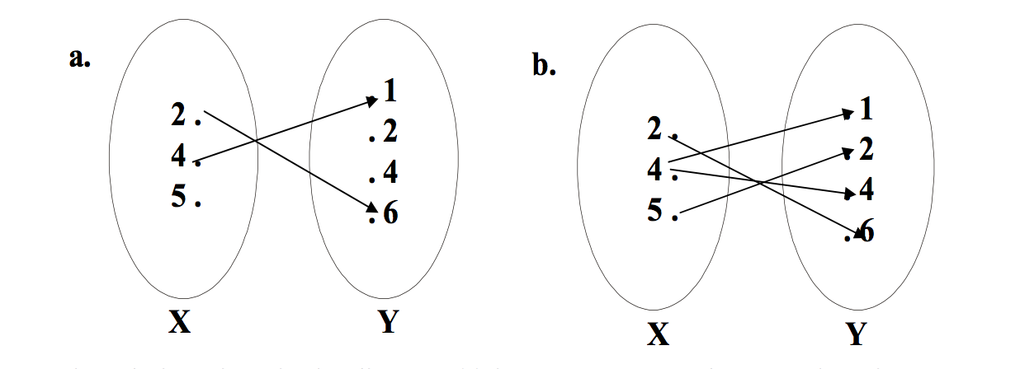
Continued…
Which of the arrow diagrams define functions from
X = {2,4,5} to Y = {1,2,4,6}

Slide 23
Continued…
The relation given in the diagram (a) is Not a function because there is no arrow coming out of 5∈X to any element of Y.
The relation in the diagram (b) is Not a function, because there are two arrows coming out of 4∈X. i.e.,4∈X is not related to a unique element of Y.

Slide 24
Continued…
Range of function
Let f : X →Y. The range of f consists of those elements of Y that are image of elements of X.
Symbolically, Range of f = {y ∈Y| y = f(x), for some x ∈X}

Slide 25
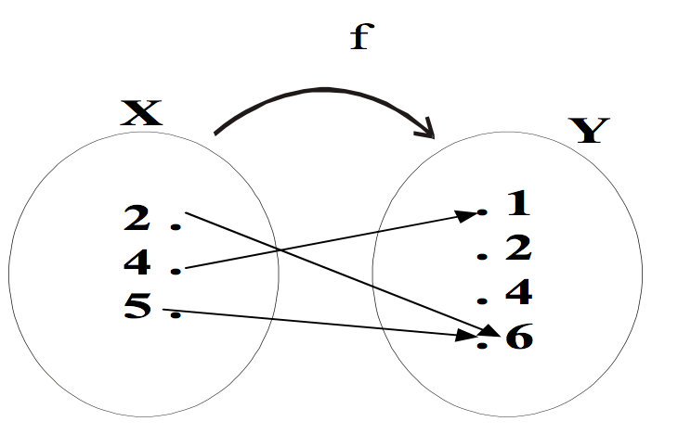
Continued…
Determine the range of the functions f, g, h from X = {2,4,5} to Y = {1,2,4,6} defined as:
g = {(2,6), (4,2), (5,1)}
h(2) = 4,h (4) = 4,h(5)=1

Slide 26
Continued….
Solution
Range of f={1,6} Range of g={1,2,6}
Range of h={1,4}

Slide 27
Continued…
Graph of function
The graph of f is the set of all points (x,y) in the Cartesian coordinate plane with the property that x is in the domain of f and y = f(x).
Example
We have to draw the graph of the function f given by the relation y = x² in order to draw the graph of the function we will first take some elements from the domain will see the image of them and then plot then on the graph as follows Graph of y = x²

Slide 28
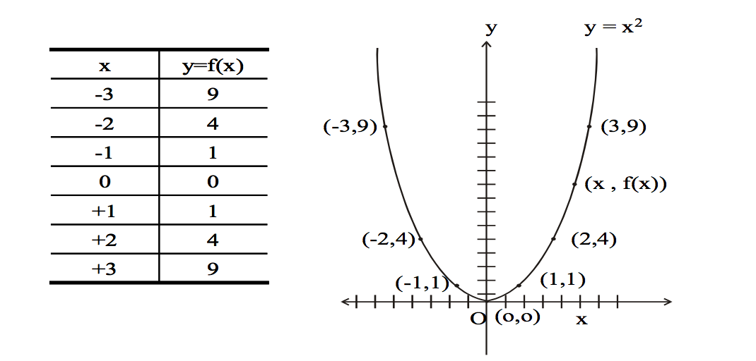
Solution

Slide 29
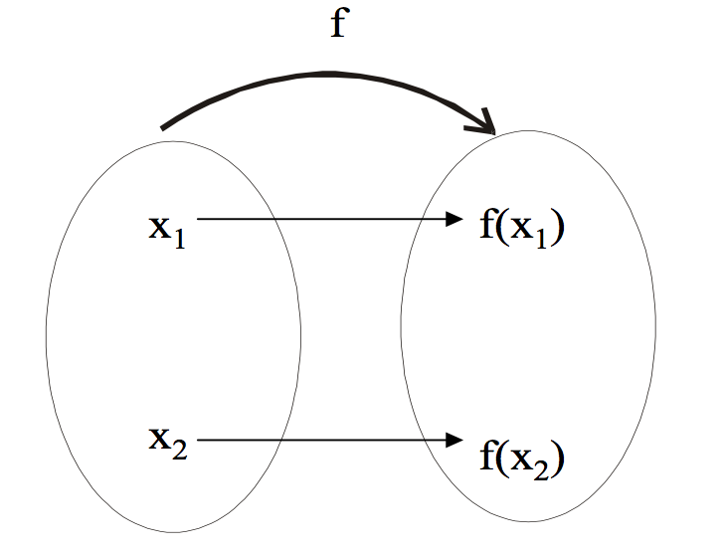
Types of functions
One to one function
Let f : X →Y be a function. f is injective or one-to-one if, and only if, ∀ x1, x2 ∈X, if x1 ≠ x2 then f(x1) ≠ f(x2).That is, f is one-to-one if it maps distinct points of the domain into the distinct points of the co-domain.

Slide 30
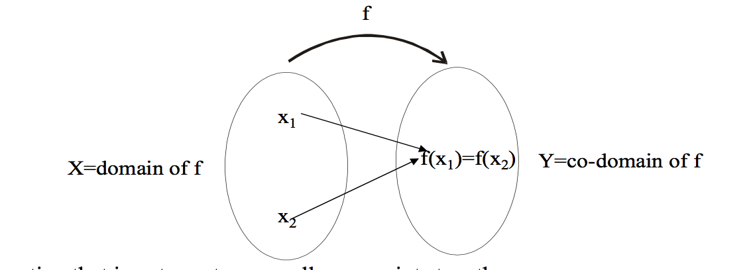
Continued…
Function not One to one
A function f : X →Y is not one-to-one iff there exist elements x1 and x2 in such that x1 ≠ x2 but f(x1) = f(x2).That is, if distinct elements x1 and x2 can found in domain of f that have the same function value.

Slide 31
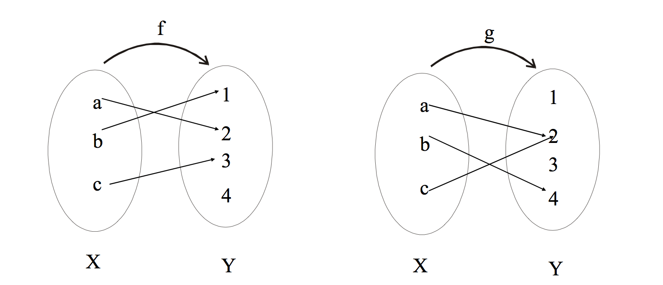
Exercise
Which of the arrow diagrams define one-to-one functions?

Slide 32
Continued…
f is clearly one-to-one function, because no two different elements of X are mapped onto the same element of Y.
g is not one-to-one because the elements a and c are mapped onto the same element 2 of Y.

Slide 33
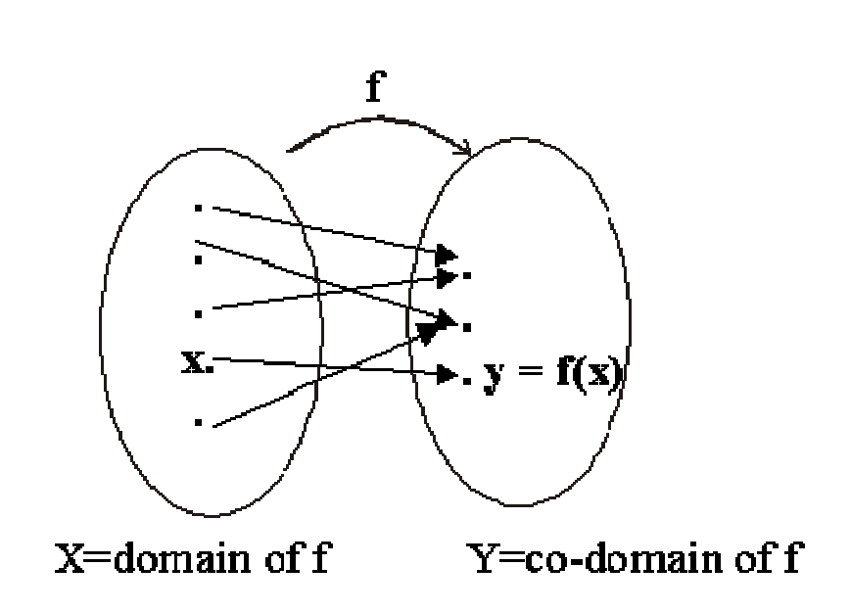
Continued…
Onto function
Let f : X →Y be a function, f is onto if every element of its co-domain is the image of some element(s) of its domain i.e., co-domain of f = range of f.
Each element y in Y equals f(x) for at least one x in X

Slide 34
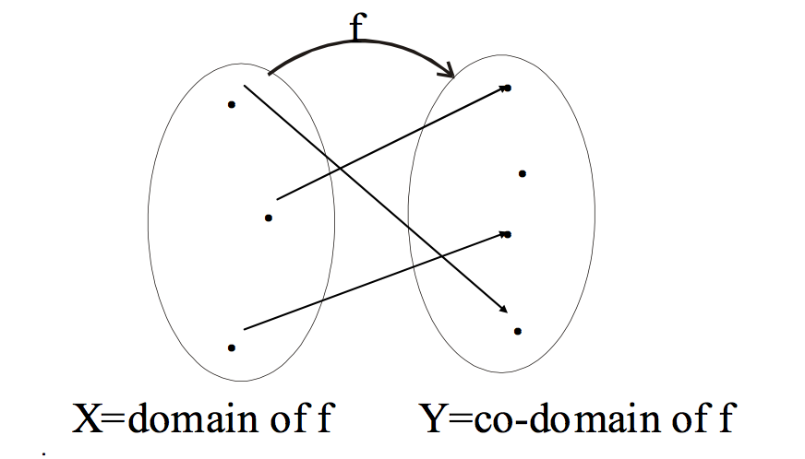
Continued…
Function not Onto
A function f : X →Y is not onto if there is some element in Y that is not the image of any element in X.

Slide 35
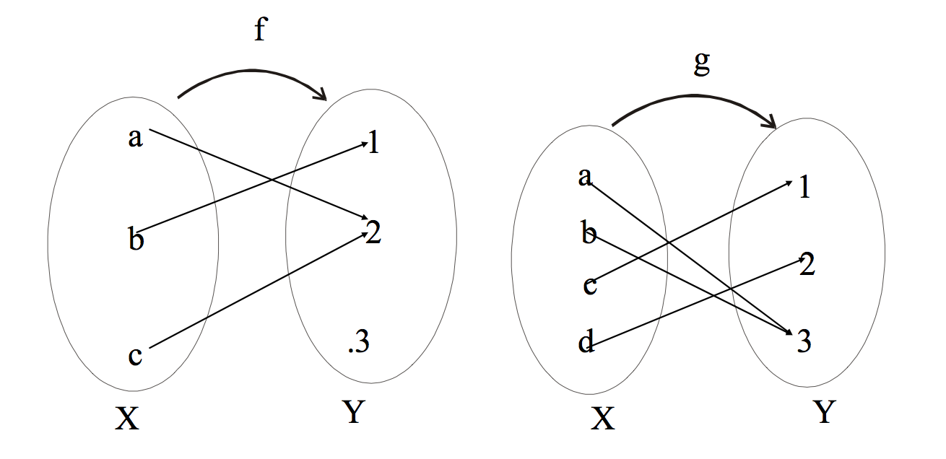
Exercise
Which of the arrow diagrams define onto functions?

Slide 36
Continued…
f is onto.
g is onto because each element of Y equals g(x) for some x in X. as 1 = g(c)
2 = g(d)
3 = g(a) = g(b)

Slide 37
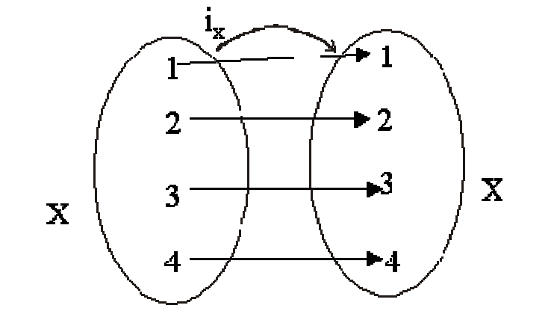
Continued…
Bijective function
A bijection, bijective function, or one-to-one correspondence is a function between the elements of two sets, where each element of one set is paired with exactly one element of the other set, and each element of the other set is paired with exactly one element of the first set

Slide 38
Continued…
There are no unpaired elements. In mathematical terms, a bijective function f: X → Y is a one-to-one (injective) and onto (surjective) mapping of a set X to a set Y.

Slide 39
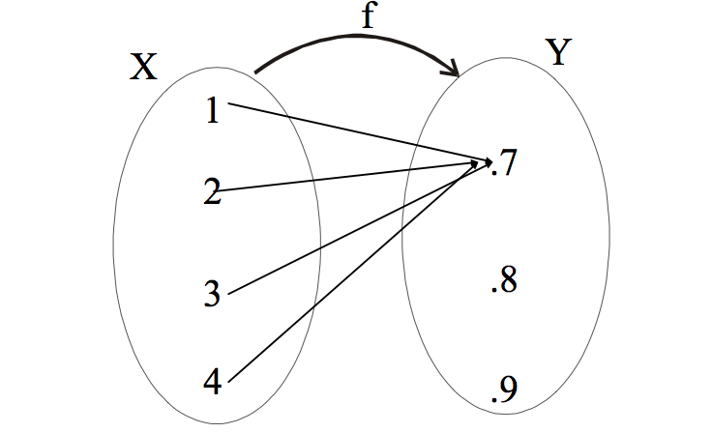
Continued…
Constant function
A function f : X →Y is a constant function if it maps (sends) all elements of X to one element of Y i.e.
∀ x∈X, f(x)=c, for some c∈Y

Slide 40
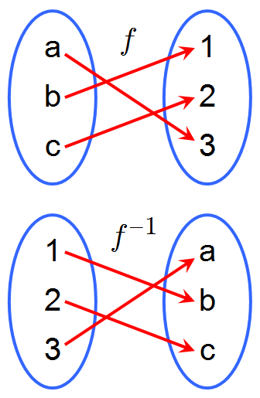
Continued…
Inverse function
An inverse function denoted as f ⁻¹() is a function that reverses another function. That is if f is a function mapping x to y, then the inverse function of f maps y back to x

Slide 41
Example
Let f(x) = y= 4x-1
4x = y + 1
x= y+1/4
f ⁻¹(y) = y+1/4
Hence, f ⁻¹(y) = y +1/4is the inverse of f(x)=4x-1

Slide 42
Composition of Function
The function composition is the point wise application of once function to the result of another to produce a third function
The notation used for composition is fog(x) and is read "f composed with g of x" or "f of g of x".
Example
Given f(x) = 2x + 3 and g(x) = –x² + 5, find ( f o g)(x).

Slide 43
Continued…
( f o g)(x) = f (g(x)) = f (–x² + 5) = 2( ) + 3 ... setting up to insert the input formula = 2(–x² + 5) + 3 = –2x² + 10 + 3 = –2x² + 13
Similarly you can find gof(x), fof(x), gog(x) etc

