Slide 1
Lecture # 05 Discrete Structure
Daud Khan
School of Computer Science
IQRA National University
Peshawar

Slide 2
SETS

Slide 3
Lets take a start

Slide 4
Set
A well defined collection of distinct objects is called a set.
The objects are called the elements or members of the set.
Sets are denoted by capital letters A, B, C ..., X, Y, Z.
The elements of a set are represented by lower case letters a, b, c, ... , x, y, z.
If an object x is a member of a set A, we write x∈A, which reads “x belongs to A”or“x is in A”or“x is an element of A”.

Slide 5
Continued
Otherwise we write x ∉A , which reads “x does not belong to A” or “x is not in A” or “x is not an element of A”.
There are three forms of set as follows
Tabular form
We list all the elements of a set, separated by commas and enclosed within braces or curly brackets {}. For example
In the following examples we write the sets in Tabular Form.(next slide please)

Slide 6
Continued…
Examples
A = {1, 2, 3, 4, 5} is the set of first five Natural Numbers.
B = {2, 4, 6, 8, ..., 50} is the set of Even numbers up to 50.
C = {1, 3, 5, 7, 9, ...} is the set of positive odd numbers.
Note : The symbol “...” is called an ellipsis. It is a short for “and so forth.”

Slide 7
Continued…
Descriptive form
We state the elements of a set in words.
Now we will write the examples discussed in last slides in the Descriptive Form.
A = set of first five Natural Numbers. ( Descriptive Form )
B = set of positive even integers less or equal to fifty.
( Descriptive Form )
C = set of positive odd integers. ( Descriptive Form )

Slide 8
Continued…
Set builder form
We write the common characteristics in symbolic form, shared by all the elements of the set.
Examples
Now we will write the same examples which we write in Tabular as well as Descriptive Form ,in Set Builder Form .
A = {x∈N | x≤5}
B= {x∈E | 0<x≤50}
C = { x ∈O | 0 < x }

Slide 9
Sets of Numbers
Set of Natural Numbers N = {1, 2, 3, ... }
Set of Whole Numbers W = {0, 1, 2, 3, ... }
Set of Integers Z = {..., -3, -2, -1, 0, +1, +2, +3, ...}
Set of Even Integers E = {0, ± 2, ± 4, ± 6, ...}
Set of Odd Integers O = {±1, ± 3, ±5, ...}
Set of Prime Numbers P = {2, 3, 5, 7, 11, 13, 17,…}
Set of Rational Numbers Q={x|x=p/q, p,q ∈Z,q ≠0}

Slide 10
Continued…
Set of Irrational Numbers Q=Q’= { x | x is not rational} For example, √2, √3 etc.
Set of Complex Numbers C={z|z= x+iy; x,y ∈R}

Slide 11
Continued…
Subset
If A & B are two sets, A is called a subset of B, written A ⊆ B, if, and only if, any element of A is also an element of B.
Symbolically its written as A ⊆ B⇔if x ∈ A then x ∈ B
Remark
When A ⊆ B, then B is called a superset of A.
When A is not subset of B, then there exist at least one x ∈ A such that x ∉B.
Every set is a subset of itself.

Slide 12
Continued…
Examples
Let A = {1, 3, 5} B = {1, 2, 3, 4, 5} C = {1, 2, 3, 4}
D = {3, 1, 5} Then
A ⊆ B ( Because every element of A is in B )
C ⊆ B ( Because every element of C is also an element of B )
A ⊆ D ( Because every element of A is also an element of D and also note that every element of D is in A so D ⊆ A ) and A is not subset of  C ( Because there is an element 5 of A which is not in C )

Slide 13
Continued…
Proper subset
Let A and B be sets. A is a proper subset of B, if and only if, every element of A is in B but there is at least one element of B that is not in A, and is denoted as A ⊂ B.
Example
Let A = {1, 3, 5} B = {1, 2, 3, 5} then A⊂B (Because there is an element 2 of B which is not in A).

Slide 14
Continued…
Equal sets
Two sets A and B are equal if, and only if, every element of A is in B and every element of B is in A and is denoted A = B.
Symbolically: A = B iff A ⊆ B and B ⊆ A
Example
Let A = {1, 2, 3, 6} , C = {3, 1, 6, 2}
Then A, C are all equal sets.

Slide 15
Continued…
Null Set
A set which contains no element is called a null set, or an empty set or a void set. It is denoted by the Greek letter ∅ (phi) or { }
Example
A = {x | x is a person taller than 10 feet} = ∅ (Because there does not exist any human being which is taller then 10 feet)
Note: ∅ is regarded as a subset of every set.

Slide 16
Continued…
Universal set
The set of all elements under consideration is called the Universal Set.
The Universal Set is usually denoted by U.
Example
A = { 2, 4, 6 } B = {1, 3, 5 }
Universal set = U = { 1, 2, 3, 4, 5, 6 }

Slide 17
Continued…
Finite and Infinite Set
A set S is said to be finite if it contains exactly m distinct elements where m denotes some non negative integer.
In such case we write |S| = m or n(S) = m
A set is said to be infinite if it is not finite.
Example
The set of letters of English alphabets is finite and The set of positive integers {1, 2, 3,...} is infinite.

Slide 18
Continued…
Determine which of the following sets are finite/infinite.
A = {month in the year} FINITE
B = {even integers} INFINITE
C = {positive integers less than 1} FINITE
D = {animals living on the earth} FINITE
E = {lines parallel to x-axis} INFINITE
F = {x ∈R | x¹⁰⁰ + 29x⁵⁰ – 1 = 0} FINITE
G = {circles through origin} INFINITE

Slide 19
Continued…
The Power Set
Given a set S, the power set of S is the set of all subsets of the set S. The power set of S is denoted by P(S)
Example
What is the power set of A= {0,1,2}??
Solution : The power set P(A) si the set of all subset of A i.e.
P(A)= {∅, {0},{1},{2},{0,1},{0,2},{1,2},{0,1,2}}

Slide 20
Cartesian Product
A Cartesian product is a mathematical operation which returns a set (or product set or simply product) from multiple sets. That is, for sets A and B, the Cartesian product A × B is the set of all ordered pairs (a, b) where a ∈ A and b ∈ B. Products can be specified using set-builder notation, e.g.

Slide 21
Continued…
For example:
A = {1,2} B = {3,4}
A × B = {1,2} × {3,4} = {(1,3), (1,4), (2,3), (2,4)}
B × A = {3,4} × {1,2} = {(3,1), (3,2), (4,1), (4,2)}

Slide 22
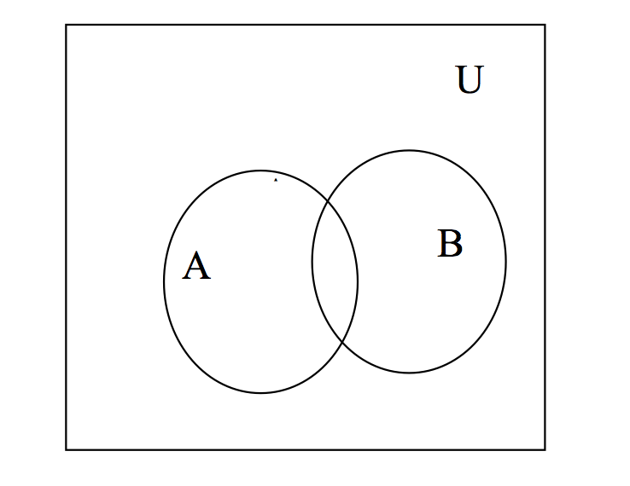
Venn Diagram
A Venn diagram is a graphical representation of sets by regions in the plane. The Universal Set is represented by the interior of a rectangle, and the other sets are represented by disks lying within the rectangle.

Slide 23
Continued…
Union
Let A and B be subsets of a universal set U. The union of sets A and B is the set of all elements in U that belong to A or to B or to both and is denoted as
A ∪ B.
Symbolically: A ∪ B = {x ∈U | x ∈A or x ∈ B}
Example
Let U = {a, b, c, d, e, f, g}
A = {a, c, e, g}, B = {d, e, f, g}
Then A ∪ B = {x ∈U | x ∈A or x ∈ B}
A ∪ B ={a, c, d, e, f, g}

Slide 25
Continued…
Intersection
Let A and B subsets of a universal set U. The intersection of sets A and B is the set of all elements in U that belong to both A and B and is denoted by
A ∩ B.
Symbolically: A ∩ B = {x ∈U | x ∈ A and x ∈B}

Slide 26
Continued…
Let U = {a, b, c, d, e, f, g}
A = {a, c, e, g}, B = {d, e, f, g}
Then A ∩ B = {e, g}

Slide 27
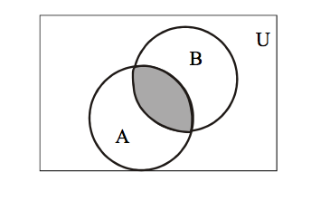
Continued…

Slide 28
Continued….
Difference
Let A and B be subsets of a universal set U. The difference of “A and B” (or relative complement of B in A) is the set of all elements in U that belong to A but not to B, and is denoted A – B or A \ B. Symbolically: A – B = {x ∈U | x ∈ A and x ∈B}
Example
Let U = {a, b, c, d, e, f, g}
A = {a, c, e, g} B = {d, e, f, g}
Then A – B = {a, c}

Slide 29
Continued…

Slide 30
Continued…
Complement
Let A be a subset of universal set U. The complement of A is the set of all element in U that do not belong to A, and is denoted A^{c}
Symbolically: A^{c} ={x ∈U | x ∉ A}
Let U = {a, b, c, d, e, f, g] A = {a, c, e, g}
Then A^{c} = {b, d, f}

Slide 31
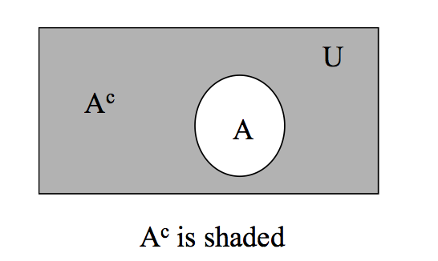
Continued…

Slide 32
Exercise
Let U = {1, 2, 3, …, 10},
X = {1, 2, 3, 4, 5}
Y = {y | y = 2 x, x ∈X},
Z = {z | z² – 9 z + 14 = 0}
Enumérate
X ∩ Y
Y ∪ Z
X – Z
Y^{c}
X^{c} – Z^{c}
(X – Z) ^{c}

Slide 33
Solution
X ∩ Y = {1, 2, 3, 4, 5} ∩ {2, 4, 6, 8, 10}
= {2, 4}
Y ∪ Z = {2, 4, 6, 8, 10} ∪ {2, 7}
= {2, 4, 6, 7, 8, 10}
X – Z = {1, 2, 3, 4, 5} – {2, 7}
= {1, 3, 4, 5}
Y^{c} = U – Y = {1, 2, 3, …, 10} – {2, 4, 6, 8, 10}
= {1, 3, 5, 7, 9
X^{c} – Z^{c} = {6, 7, 8, 9, 10} – {1, 3, 4, 5, 6, 8, 9, 10}
= {7}

Slide 34
Continued…
(X – Z)^{c} = U – (X – Z)
= {1, 2, 3, …, 10} – {1, 3, 4, 5}
= {2, 6, 7, 8, 9, 10}

