Slide 1
Data Mining: Data Processing

Slide 2
Data Preparation
Vital step for data mining (Supervised and Unsupervised)
DM algorithm will always give you a model
Quality of that model depends highly on the quality of the input data
Garbage in -> Garbage out
One major goal of data preparation:
Eliminate “wrong influence” of variables

Slide 3
Data Preparation
Potential Issues:
Missing values
Quantitative data with different scales
Categorical data

Slide 4
Data cleaning
Missing Values
Avoid missing data
Data imputation
Case substitution
Mean Substitution
Mode based substitution
Nearest neighbor imputation

Slide 5
Data Cleaning Cont..
Example | Attribute1 | Attribute2 | Attribute3 | Attribute4
1 | 8 | 2 | 1 | 5
2 | 13 | 8 | 1 | 13
3 | 5 | 8 | 1 | ?
4 | 2 | 5 | 8 | 2

Slide 6
Data Cleaning Cont..
Noisy Data:
Duplication
Incorrect Entry
Incorrect Processing
Outliers

Slide 7
Categorical variable
Non-numeric variable with a finite number of levels
Also called nominal data
E.g. eye colour with values “green”, “grey”, “blue”, “brown”
Some algorithms handle only numeric variables
Solution: 1-to-N coding

Slide 8
1-to-N coding
Color
Brown
Blue
Green
Grey
Brown
Green
blue
green | blue | brown | grey
0 | 0 | 1 | 0
0 | 1 | 0 | 0
1 | 0 | 0 | 0
0 | 0 | 0 | 1
0 | 0 | 1 | 0
1 | 0 | 0 | 0
0 | 1 | 0 | 0

Slide 9
Categorical data: another example
Animal data set
Describes animal by some characteristics
Instances: cow, horse, duck, eagle
Variables
Size
Tiny, small, medium, big
Number of legs
2,4,6,8
 | size | Legs
Bird | Small | 2
Cat | Small | 4
Spider | Tiny | 8
Dog | Med | 4
Cow | Large | 4
Bee | Tiny | 6
monkey | med | 2

Slide 10
1-to-N Coding animal data set
 | size | Legs
Bird | Small | 2
Cat | Small | 4
Spider | Tiny | 8
Dog | Med | 4
Cow | Large | 4
Bee | Tiny | 6
monkey | med | 2
tiny | small | med | large | legs
0 | 1 | 0 | 0 | 2
0 | 1 | 0 | 0 | 0
1 | 0 | 0 | 0 | 8
0 | 0 | 1 | 0 | 4
0 | 0 | 0 | 1 | 4
1 | 0 | 0 | 0 | 6
0 | 0 | 1 | 0 | 2

Slide 11
1-N coding animal data set
Variable “legs”
If considered categorial: defined order-> ordinal data
Can computer similarity: 2 closer to 4 than to 6
Numerical value, can computer distance
Does the number of legs denote similarity?

Slide 12
1-N coding animal data set
Does the number of legs denote similarity?
i.e. is an animal with 2 legs more similar to one with 4, or with 6?
And, is one with 4 equally similar to the one with 2 and 6?
Dog to monkey vs. dog to spider
One with 6 equally similar to one with 4 and 8?
Bee to spider vs. bee to cow

Slide 13
1-N coding animal data set
 | Size | Legs
Bird | Small | 2
Cat | Small | 4
Spider | Tiny | 8
Dog | Med | 2
Cow | Large | 4
Bee | Tiny | 6
Monkey | med | 2
2 legs | 4 legs | 6 legs | 8 legs
1 | 0 | 0 | 0
0 | 1 | 0 | 0
0 | 0 | 0 | 1
1 | 0 | 0 | 0
0 | 1 | 0 | 0
0 | 0 | 1 | 0
1 | 0 | 0 | 0

Slide 14
K-nn: distance function
What to do with categorical data?
1-n coding – then apply any distance function mentioned earlier
Definition of custom distance function

Slide 15
K-nn: distance function
Definition of custom distance functions
Adopt hamming distance
Hamming distance between two strings of equal length is the number of positions at which the corresponding symbols are different
Count number of different nominal values
Define distance for each attribute, aggregate e.g. via sum

Slide 16
Data de-normalisation
First normal form
All attributes must have single value
Second normal form
Must be in first normal form
Every non-key attribute is fully functionally dependent on the primary key
Third normal form
Must be 2nd normal form
Every non-key attribute is dependent on the primary key it implies eliminating attributes which are dependent on a non key attribute

Slide 17
Data transformation
Different variables may exhibit significantly different value ranges
E.g. length variable measured in cm, inch, or meters
Different types of measurements: length, speed, temperature
Different types of measuring devices capturing different value ranges

Slide 18
Data transformation
Scaling/ normalization/Standardisation
Some algorithms rely on measuring the numeric distance between samples
There should be no impact by the value range
Higher values in one attribute/ variable would have unproportinal effect in measure distance
Would dominate distance metric
Might thus dominate learning

Slide 19
Scaling/ normalization/Standardisation
Remove effects of different value ranges in each attribute/variable
Common method in statistics and machine learning
With many different notations
Scaling, Normalization, standardization
Often used interchangley, different for each field

Slide 20
Scaling/ normalization/Standardisation
Smoothing of data
Generalisation of data
Min-Max normalization
Zero-mean normalisation

Slide 21
Scaling/ normalization/Standardisation
Z-score standardization /normalization
Each variable x is converted to have a mean of 0 and a standard deviation of 1
Subtracting the mean
Dividing by standard deviation
z-= $\frac{x−µ}{σ}$

Slide 22
Scaling/ normalization/Standardisation
Z-score standardisation/normalization
What’s the new value range after z-score?
z-= $\frac{x−µ}{σ}$

Slide 23
Scaling/ normalization/Standardisation
Min-Max scaling
-Scale all variables to the same (fixed) range
Often between 0 and 1
Subtract minimum value for each variable
Divide by value range of each variable
$z_{i}=\frac{x_{i}−\min\left(x\right)}{\max\left(x\right)−\min\left(x\right)}$

Slide 24
Scaling/ normalization/Standardisation
Algorithms relying on distances
K-Nearest Neighbours
Scaling not needed for algorithms that don’t use distances, e.g.
Naïve Bayes
Decision trees

Slide 25
Scaling/ normalization/Standardisation
Example: Features (variables) from text documents
Each word (term) =one variable
Values=count of words in a document
 | Word 1 | Word 2 | Word 3 | Word 4 | Word 5 | ……….. | Word n | ϵ
Doc1 | 1 | 0 | 0 | 2 | 3 |  | 0 | 6
Doc2 | 2 | 0 | 0 | 0 | 2 |  | 2 | 6
Doc3 | 1 | 3 | 0 | 0 | 1 |  | 5 | 10
Doc4 | 2 | 0 | 0 | 2 | 0 |  | 2 | 6
Doc5 | 5 | 4 | 0 | 0 | 1 |  | 0
………
Doc6 | 1 | 2 | 1 | 3 | 0 |  | 0 | 7

Slide 26
Scaling/ normalization/Standardisation
Text features
Length (size) of the object described numerically might influence the values
Longer document -> in general higher values
Relative importance of words within a text not higher
Normalise data vectors to the same length
Dividing each vector by its vector length
$z_{j}=\frac{x_{i}}{x}$

Slide 27
Analysis of correlation
Data set might contain input variables that directly depend on each other
Might have unproportioned weight on output predication
Might be better to eliminate such variables
Finding dependencies with (Pair wise) analysis of correlation can important pre-processing step

Slide 28
Output variables
Classification requires categorical output
Continuous output=regression
Classification methods can be applied by binning continuous output
Loss of predication precision
More classes -> higher precision
But also more difficult to learn

Slide 29
Evaluation
Need to measure performance of an algorithm
Train model on (labelled) training data
Test on(labelled) test data
Measure performance
Several different measures

Slide 30
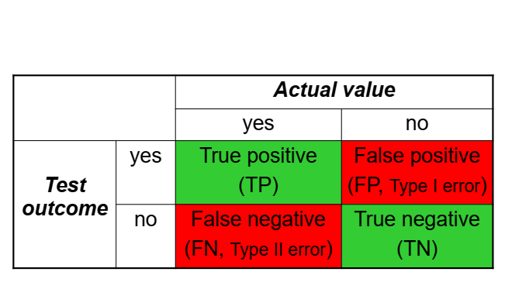
Evaluation

Slide 33
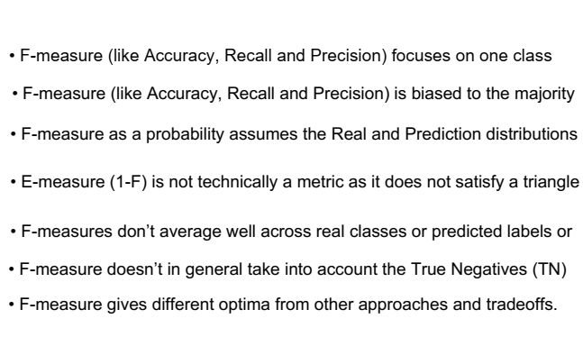
F-measures Drawback

Slide 34
Evaluation
Where to do evaluation on?
The samples used for training ?
Why not?

Slide 35
Training & Test set
Split data into training and test sets
E.g.~80% training, 20% test, 66% -33%
Linear, random
Results can vary a lot according to how the split is done
Cross validation

Slide 36
Cross validation
Split data into 10 parts of equal sizes
This is called 10-fold cross validation
Repeat 10 times
Use 9 parts training
Calculate performance on remaining part
Estimate of performance is average of the validation set performances

Slide 37
Cross validation
Results obtained via cross-validation are generally much more reliable
Parameter of 10 often used
But no theoretical foundation for that
Fewer folds on smaller sample size
Number of folds dramatically increases runtime

Slide 38
Cross validation
Estimate of performance is average of the validation set performances
In addition, computation standard deviation
Indication on how stable the results are in the different folds
Lower standard deviation is better
Standard deviation should be considered when comparing cross-validation performances from different classifiers

Slide 39
Confusion matrix
Matrix of classification results per class
Size (# classes) x (# classes)
For each actual class plot the predicated classes
Shows accuracy for single classes
Indicate which classes are confused

Slide 40
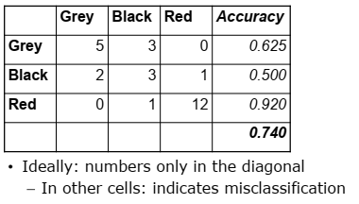
Confusion matrix example

Slide 43
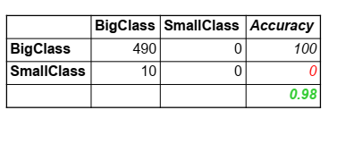

Slide 44
Performance per class
Important to consider when
Imbalance classes
Performance of a particular class is more important
Examples?
Health prediction
Classify sensitive documents
Spam filter

