Slide 1
Fundamentals of Digital Image Processing
Sanaa Jeehan
6th Week

Slide 2
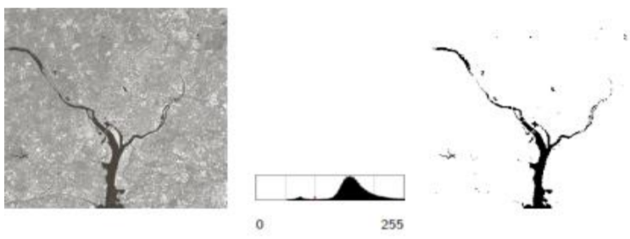
Basic Relationships Between Pixels
The structure of a digital image allows to state some basic relationships between pixels that can be useful in some practical cases.
Some operations consider groups of pixels that share the same features or are related by some peculiar characteristics. Example: estimation of the area covered by the river in the given picture.

Slide 3
Basic Relationships Between Pixels
To do so, we can do the following
identify the pixels which have the color of the river;
select among these the connected pixels;
consider the regions that are “naturally” aligned;
sections of the rivers parted by bridges, necks, or covered.

Slide 4
Basic Relationships Between Pixels
• Neighborhood
• Adjacency
• Connectivity
• Paths
• Regions and boundaries

Slide 5
Neighbors of a Pixel
N₄ - 4-neighbors
N_{D} - diagonal neighbors
N₈ - 8-neighbors (N₄ U N_{D} )

Slide 6
Neighbors of a Pixel
Any pixel p(x, y) has two vertical and two horizontal neighbors, given by
(x+1, y), (x-1, y), (x, y+1), (x, y-1)
This set of pixels are called the 4-neighbors of P, and is denoted by N₄(P).
Each of them are at a unit distance from P.

Slide 7
Neighbors of a Pixel
The four diagonal neighbors of p(x,y) are given by
(x+1, y+1), (x+1, y-1), (x-1, y+1), (x-1 ,y-1)
This set is denoted by N_{D}(P).
Each of them are at Euclidean distance of 1.414 from P.
The points N_{D}(P) and N₄(P) are together known as 8-neighbors of the point P, denoted by N₈(P).
Some of the points in the N₄, N_{D} and N₈ may fall outside image when P lies on the border of image.

Slide 8
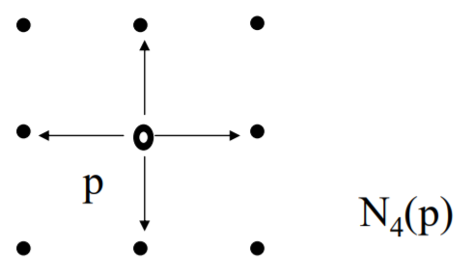
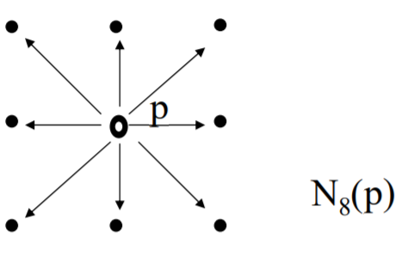
Neighbors of a Pixel
4-neighbors of a pixel p are its vertical and horizontal neighbors denoted by N₄(p)
8-neighbors of a pixel p are its vertical horizontal and 4 diagonal neighbors denoted by N₈(p)

Slide 9
Adjacency
Two pixels are connected if they are neighbors and their gray levels satisfy some specified criterion of similarity.
For example, in a binary image two pixels are connected if they are 4-neighbors and have same value (either 0 or 1).

Slide 10
Adjacency
Let V be set of gray levels values used to define adjacency.
4-adjacency: Two pixels p and q with values from V are 4- adjacent if q is in the set N₄(p).
8-adjacency: Two pixels p and q with values from V are 8- adjacent if q is in the set N₈(p).
m-adjacency: Two pixels p and q with values from V are madjacent if
q is in N₄(p).
q is in N_{D}(p) and the set [N₄(p) ∩ N₄(q)] is empty (has no pixels whose values are from V).

Slide 11
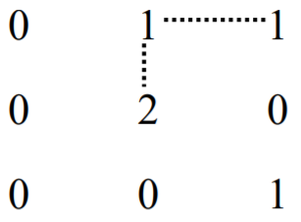
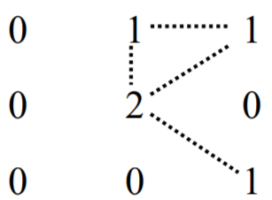
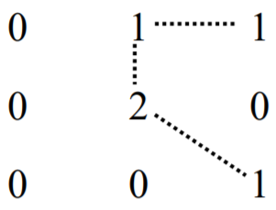
Connectivity : To determine whether the pixels are adjacent in some sense.
Let V be the set of gray-level values used to define connectivity; then Two pixels p, q that have values from the set V ar
4-connected, if q is in the set N4(p)
8-connected, if q is in the set N8(p) \
m-connected, if
q is in N4(p) or
q is in ND(p) and the set [N₄(p) ∩ N₄(q)] is empty
a
b
c

Slide 12
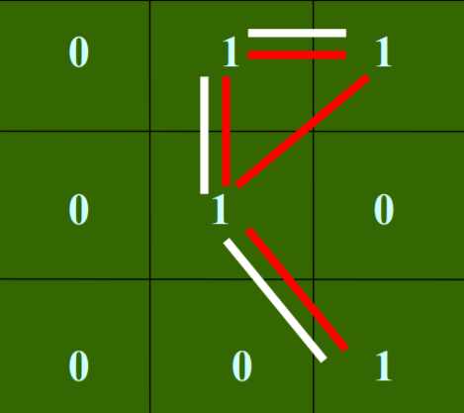
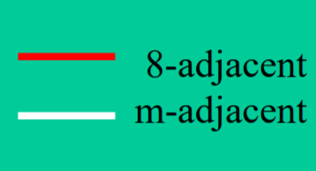
Adjacency / Connectivity

Slide 13
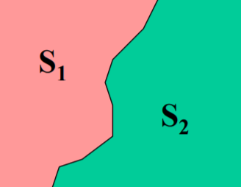
Adjacency
Pixel p is adjacent to pixel q if they are connected.
Two image subsets S₁ and S₂ are adjacent if some pixel in S₁ is adjacent to some pixel in S₂

Slide 14
Path & Path Length
Also called Digital Path.
A path from pixel p with coordinates (x, y) to pixel q with coordinates (s, t) is a sequence of distinct pixels with coordinates:
(x₀, y₀), (x₁, y₁), (x₂, y₂) … (x_{n}, y_{n}),
where (x₀, y₀) = (x, y) and (x_{n}, y_{n}) = (s, t) and
(x_{i}, y_{i} ) is adjacent to (x_{i-1}, y_{i-1})
Here n is the length of the path.
If (x₀,y₀) = (x_{n}, y_{n}), the path is closed.
We can define 4-, 8-, and m-paths based on type of adjacency used.

Slide 15
Path & Path Lengths
Consider the example:
In figure (b) the paths between the top right and bottom right pixels are 8-paths. And the path between the same 2 pixels in figure (c) is m-path
For further clarification, please watch the video on following link:
https://www.youtube.com/watch?v=3rowdu53KrQ&list=PLtX8dW0VRLIeR2J7OhXPryT3bKTRwIBuo&index=7

Slide 16
Connectivity
S: a subset of pixels in an image.
Two pixels p and q are said to be connected in S if there exists a path between them consisting entirely of pixels in S.
For any pixel p in S, the set of pixels that are connected to it in S is called a connected component of S.

Slide 17
Connectivity
Let S be the set of gray-level values used to define connectivity, i.e. all the shades of grey used in the image.
4-connectivity :
2 pixels p and q with values from S are 4-connected if q is in the set N4(p)
8-connectivity :
2 pixels p and q with values from S are 8-connected if q is in the set N8(p)
m-connectivity (mixed connectivity):
2 pixels p and q with values from S are m-connected if
q is in the set N4(p) or
q is in the set ND(p) and the set N4(p) ∩ N4(q) is empty.

Slide 18
Connectivity
Watch the video on the following link for further clarification.
https://www.youtube.com/watch?v=oUUbnfB_Fbs&list=PLtX8dW0VRLIeR2J7OhXPryT3bKTRwIBuo&index=8

