Slide 1
DENTAL CARIES
Dr. Irfan Ali Khan
Resident Oral & Maxillofacial Pathology

Slide 2
DENTAL CARIES
Disease of the calcified tissues of teeth which is characterize by demineralization of the inorganic portion and destruction of the organic substance of the tooth. As a results there will be inflammation of the pulp and later it spreads to periapical tissues.
In 1890, Miller proposed that caries result from decalcification caused by bacterial acid production. Evidence indicates that certain streptococci plays an important role in the initiation of the caries particularly Virridans streptococci. The essenial properties of cariogenic bacteria are
Acidogenic

Slide 3
2. Able to produce a PH low enough to demineralize tooth substance
3. Able to survive and continue to produce acid at low PH
4. Possess attachment mechanism for firm adhesion to smooth tooth surface
5. Able to produce adhesive insoluble plaque polysaccharides(Glucans)
Dental caries develops only at the interface between tooth and dental plaque in stagnation areas. Stagnation areas allow plaque activity to develop and hence the sites of carious attack. The ability of S.mutans to initiate smooth surface caries and form plaque largely depends on its ability to polymerize sucrose into sticky polysaccharides(Glucans)

Slide 4
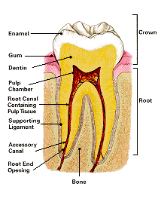

Slide 5
ETIOLOGY OF DENTAL CARIES
There is no universally accepted opinion of the etiology of dental caries however three main theories have evolved
Acidogenic theory
Proteolytic theory
Proteolysis-chelation theory
Essential requirements for the development of dental caries include;
a. Cariogenic bacteria and bacterial plaque
b. Stagnation areas and susceptible tooth surfaces
c. Time for the process to develop
d. Fermentable bacterial substrate( Sugar)

Slide 7
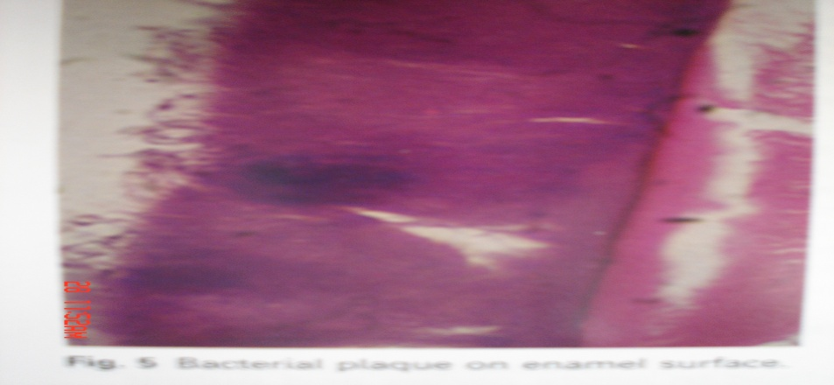
ROLE OF PLAQUE:
Plaque consists of an organic matrix containing a dense concentration of bacteria. In microbiological terms, plaque is known as biofilms. Sucrose diffuses rapidly into plaque and acid production quickly follows, as a result there is fall in PH with in 2-5min, sufficiently low to decalcify the enamel surface. The process of plaque formation starts with deposition of structureless cell free pellicle of salivary glycoproteins which becomes colonised by bacteria particularly s.mutans within 24 min. It is built up by formation of bacterial polysaccarides and progressively colonised by other bacteria.

Slide 8
Some other contributing factors in dental caries are given below.
Tooth
A. Composition
B. Morphologic Characteristic
C. Position
Saliva
A. PH
B. Composition
C. Quantity
D. Viscosity
Diet
A. Carbohydrate content
B. Flouride and Vitamin Content

Slide 9
PATHOLOGY OF ENAMEL CARIES:
Enamel is usual site of the initial lesion unless dentin or cementum becomes exposed by gingival recession. Enamel, the hardest and densest tissue in the body, consists almost entirely of calcium apatite with only a minute organic content. It therefore forms a formidable barrier to bacterial attack. However once the enamel has been breached infection of dentin can spread with relatively little obstruction. The main stages in the enamel caries are:
1. The early lesion
2. Phase of non-bacterial enamel destruction
3. Cavity formation
4. Bacterial invasion of enamel

Slide 10
The earliest visible change appears as a white opaque spot that forms just adjacent to a contact point. Despite the chalky appears the enamel is hard and smooth to the probe. The initial lesion is conical in shape with its apex towards the dentine and consists of four main zones. The first and deepest zone is the translusent zone , the second is the dark zone while the third and fourth zones are body of lesion and surface zone respectively. The translucent zone is the first observable change. Its appearance results from formation of small spaces at prism boundaries and striae of retzius. The dark zone is fractionally superficial to the translucent zone. It has both small and large pores. It appears dark becz the small pores in this zone are filled with air.

Slide 11
The body of the lesion extends from just beneath the surface zone to the dark zone. In the body of the lesion the striae of retzius becomes enlarged. The surface zone represents one of the most important changes in enamel caries in terms of prevention and management of the disease. This area is more heavily mineralized and radiopaque than the deeper zones. It has a pore volume of only 1%.
Once bacteria have penetrated the enamel they reach the amelodentinal junction and spread laterally to undermine the enamel. This has three major effects. Firstly the enamel loses the support of the dentin and is therefore greatly weakened. Secondly it is destroyed from beneath. Third, spread of bacteria along the amelodentinal junction allows them to attack the dentin over a wide area. As undermining of enamel continues, it starts to

Slide 12
Collapse under the stress of mastication and to fragment around the edge of the cavity. By this stage, bacterial attack on the dentin is well established.
PATHOLOGY OF DENTIN CARIES:
The initial lesion forms deep to carious enamel before any cavity has formed. Spread of infection is facilited by the dentinal tubules which form a pathway open to bacteria. Streptococci play the major role in the attack on enamel but lactobacilli may be important in the dentin caries. At first the dentin retains its normal morphology and no bacteria can be seen. Once the amelodentinal junction has been reached, the bacteria extend down the tubules and fill them. Later the tubules walls are destroyed and collection of bacteria in adjacent tubules coalesce to form liquefaction foci. These in turn unite to form more widespread tissue destruction.

Slide 13
Three main zones has been identified in dentin
Zone 1: Zone of fatty degeneration of tomes fibers
Zone 2: Zone of dentinal sclerosis characterized by deposition of calcium salts in dentinal tubules
Zone 3: Zone of decalcification of dentin, a narrow zone, preceding bacterial invasion
The main reactionary changes in the surface of dentine
1. TUBULAR SCLEROSIS:
Peritubular dentin reduces the size of the dentinal tubules, preventing bacterial penetration and generating a more heavily mineralized tissue. Tubular sclerosis usually forms in a band about halfway between the pulp and amelodentinal junction. It forms a translucent zone which may be visible radiographically and is detectable with hand instruments when excavating caries.

Slide 14
2. REGULAR REACTIONARY DENTIN:
Forms at the pulp dentin interface and retains the tubular structure of dentin. Forms in response to mild stimuli and may obliterate pulp horns, increasing the dentin thickness between caries and pulp.
3. IRREGULAR REACTIONARY DENTIN:
Forms in response to moderate or severe insult by caries and correspondingly ranges from dentin with irregular tubules to a disorganized bone-like mineralized tissue
4. DEAD TRACTS:
Formed when odontoblasts die and their tubules become sealed off. If peritubular dentin formation was extensive before odontoblasts death, the dead tract may be sclerotic and inhibits advance of caries. If not, it may allow more rapid progress.

Slide 15
ROLE OF FLUORIDES:
Fluorides from drinking water and other sources are taken up by calcifying tissues during development. When the fluoride content of the water is 1 or more the incidence of a caries declines substantially. Fluoride may affect caries activity by a variety of mechanism.

Slide 16
PREVENTION
Oral hygiene is necessary to prevent cavities. This consists of regular professional cleaning (every 6 months), brushing at least twice a day, and flossing at least daily. X-rays may be taken yearly to detect possible cavity development in high risk areas of the mouth.
Chewy, sticky foods (such as dried fruit or candy) are best if eaten as part of a meal rather than as a snack. If possible, brush the teeth or rinse the mouth with water after eating these foods. Minimize snacking, which creates a constant supply of acid in the mouth. Avoid constant sipping of sugary drinks or frequent sucking on candy and mints.
Dental sealants can prevent some cavities. Sealants are thin plastic-like coating applied to the chewing surfaces of the molars. This coating prevents the accumulation of plaque in the deep grooves on these vulnerable surfaces.

Slide 17
Sealants are usually applied on the teeth of children, shortly after the molars erupt. Older people may also benefit from the use of tooth sealants.
Fluoride is often recommended to protect against dental caries. It has been demonstrated that people who ingest fluoride in their drinking water or by fluoride supplements have fewer dental caries. Fluoride ingested when the teeth are developing is incorporated into the structure of the enamel and protects it against the action of acids.
Topical fluoride is also recommended to protect the surface of the teeth. This may include a fluoride toothpaste or mouthwash. Many dentists include application of topical fluoride solutions (applied to a localized area of the teeth) as part of routine visits.

Slide 18
SYMPTOMS:
There may be no symptoms. If symptoms occur, they may include:
Tooth pain or achy feeling, particularly after sweet, hot, or cold foods and drinks
Visible pits or holes in the teeth

