Slide 1
Advanced Network Security and Cryptography .
Lecture Slides Prepared by
Dr. Sheeraz Ahmed
Iqra National University Peshawar
Pakistan

Slide 2
Modular Mathematics
Most of the public key algorithms are based on modular arithmetic.
Modular arithmetic uses the non-negative integers less than some positive integer n, performs ordinary arithmetic operations such as addition and multiplications, and then replaces the result with its remainder when divided by n.
The result is said to be modulo n or mod n. when we write ‘x mod n’ we mean the remainder of x when divided by n.

Slide 3
Modular Addition
Let’s look at mod 10 addition. 3+5 = 8 just like in regular arithmetic.
The answer is already between 0 and 9. 7+6 = 13 in regular arithmetic, but the method mod 10 answer is 3.
Basically, one can perform mod 10 arithmetic by using the last digit of the answer. For example,
5+5 = 0
3+9 = 2
2+2 = 4
9+9 = 8
Let’s look at the table

Slide 4
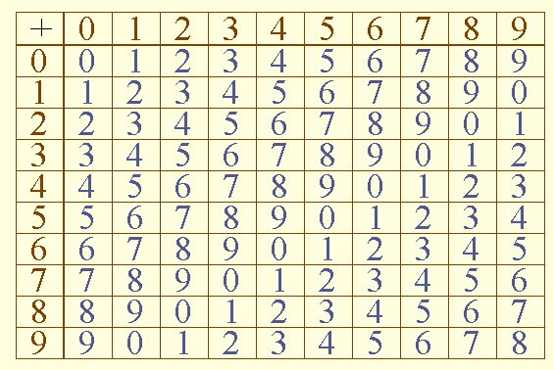
Modular Addition

Slide 5
Modular Addition
Addition of a constant mod 10 can be used as a scheme for encrypting digits, in that it maps each decimal digit to a different decimal digit in a way that is reversible, the constant is our secret key.
It’s not a good cipher, of course, but it is cipher.
Decryption would be done by subtracting the secret key modulo 10, which is an easy operation.
Just do ordinary subtraction and if the result is less than 0, add 10.

Slide 6
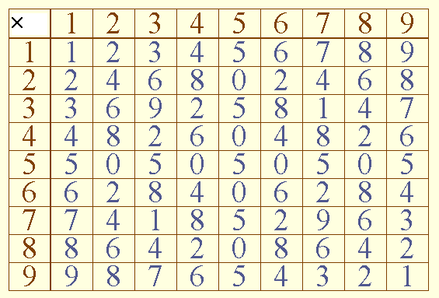
Modular Multiplication

Slide 7
Cont’d
Multiplication by 1,3, 7 or 9 works as a cipher, because it performs a one-to-one subtraction of the digits. But multiplication by any of the other numbers will not work as a cipher.
If we try to encrypt by multiplying by 5, half of the numbers will encrypt to zero, and the other half will encrypt to 5. we loss the information.

Slide 8
Common Factors
The common factor of two integers x and y is an integer d such that d is a factor of both x and y. In other words, d divides x and d divides y.
Example 1:
2 is a common factor of 4 and 6 since 4 = 2 x 2 and 6 = 3 x 2.
Example 2:
12 is a common factor of 144 and 36.
Example 3:
1 is the only common factor of 26 and 51. From example 3, we see that two integers may have no common factors other than the trivial factor 1.

Slide 9
Relative primes
Two integers are relative primes (or termed as relatively prime or as, in some more technical books, co-prime) if they have no common factor other than 1.
Example 4:
26 and 51 are relative primes.
Example 5:
81 and 343 are relative primes.
One can also say that 12, 121, 343 are relatively prime, as the only common factor of 12, 121 and 343 is 1. So the concept of relative primes is not just restricted to a comparison of 2 integers

Slide 10
Relative primes
Now the natural question is: How do I know whether two given integers are relative primes?
To answer this question, we first take the naive approach (but this approach is important as it serves to clarify and internalize this concept.)

Slide 11
Relative primes
1) Naive Approach
Say we have 2 integers: 24 and 77. The only way to check whether 24 and 77 are relative primes is to actually confirm that 1 is the only common factor of 24 and 77. All we need to do is to perform a prime factorization of 24 and 77 respectively: to list out all the prime divisors of 24 and 77, hoping that there is not even one common prime factor. This method would suffice.
To set the picture clear:
24 = 2 x 2 x 2 x 3 = 2^3 x 3
77 = 7 x 11.
As we can see, there is no prime number that divides both 24 and 77. Thus, the only factor of 24 and 77 is 1; in other words, 24 and 77 are relatively prime.

Slide 12
Relative primes
You can try out a few examples:
Example 6:
45 = 3 x 3 x 5 26 = 2 x 13 Therefore 45 and 26 are relative primes.
Example 7:
34 = 2 x 17 99 = 3 x 3 x 11 Therefore 34 and 99 are relative primes.
Example 8:
24 and 56 are not relative primes since 8 is a common factor of 24 and 56. (Of course, 2 is a common factor of 24 and 56. In fact this would suffice to conclude that 24 and 56 are not relative primes.)

Slide 13
Totient Function
The totient function Φ (n) , also called Euler's totient function.
the totient function Φ (n) can be simply defined as the number of totatives of n .
Φ (n) is defined as the number of positive integers<= n that are relatively prime to (i.e., do not contain any factor in common with) n , where 1 is counted as being relatively prime to all numbers. Since a number less than or equal to and relatively prime to a given number is called a totative,
For example, there are eight totatives of 24 (1, 5, 7, 11, 13, 17, 19, and 23), so Φ (24) = 8,

Slide 14
Totient Function
If n is prime, then all the integers
{1, 2, 3, ….., n-1} are relatively prime to n,
so Φ (n) = n-1.
if n is the product of two distinct primes, say p and q, then there are (p-1)(q-1) numbers relatively prime to n,
so Φ (n) = (p-1)(q-1).

Slide 15
Modular Exponentiation
Modular exponentiation is a type of exponentiation performed over a modulus. It is particularly useful in computer science, especially in the field of cryptology.
Doing a "modular exponentiation" means calculating the remainder when dividing by a positive integer m (called the modulus) a positive integer b (called the base) raised to the e-th power (e is called the exponent). In other words, problems take the form where given base b, exponent e, and modulus m, one wishes to calculate c such that:
C = b ^{e} (mod m)
For example, given b = 5, e = 3, and m = 13, the solution c is the remainder of dividing 5³ by 13, namely the rest of the division 125 / 13, which works out to be 8.

Slide 16
END OF 9th WEEK

