Slide 1
Cover Letter

Slide 2
What is a cover letter?
Cover letters are one page documents that you send with your resume when applying for a job. It is meant to:
Introduce yourself to the hiring manager
Argue why you’d be a good fit for the job
Fill in places your resume cannot describe
Further explain other aspects of your resume
By hitting those 4 aspects, your letter can be a convincing and powerful companion to a well-written resume.

Slide 3
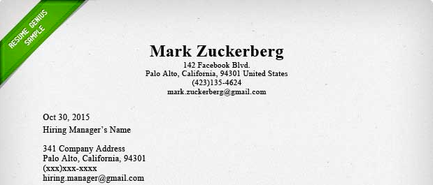
1. Contact Information
To begin, include both the employer’s and your contact information. See the example below:
While the example above demonstrates the information you need to include in the section, there are various ways to format it

Slide 4
2. Introduction
Find out to whom you’re writing
Put yourself in the hiring manager’s shoes for a second. Would you like to be addressed as “Dear Sir or Madame?” or “To whom it may concern?”
“Dear Sir or Madam” makes you sound like you’re from the year 1865, and “to whom it may concern” is very irritating to hiring managers.
You can easily avoid this problem by doing your research. Look through the company’s website, LinkedIn, or even give the company a call to ask for the hiring manager’s name.

Slide 5
Introduce yourself
In the first paragraph, begin by telling the employer the position you are applying for and how you learned about the opportunity.
The rest of this paragraph should briefly present basic info about yourself, including: degree, area of study/expertise, and your career goals in terms of how they align with the goals of the company.

Slide 6
3. Sell Yourself
The second paragraph should respond directly to the job description written by the hiring manager. Describe how your previous job experiences, skills, and abilities will allow you to meet the company’s needs. To make that easier, you can (and should) literally include words and phrases from the job description in your cover letters.
To go the extra mile, do some research about the company, and try to find out what they are doing — and why — given the current state of their industry. In a third paragraph, explain how you can fit into that schema, and help push the company forward and achieve any goals you suspect they may have.

Slide 7
4. Conclusion
The final paragraph is called the “call to action.” Inform them that you’d love to get interviewed. Tell them that you’ll be in contact with them in a week if you don’t hear back. Thank them for spending the time to read your letter.

Slide 8
AIDA Approach
A good way is to mention someone they know by name . Give them a personal connection. If you know who the hiring manager is, or you have met the company owner, or know someone who works within the business , don’t hesitate to use their name in the first line of the letter ;-
“Your colleague, Mary Jones, has great things to say about the organisation and thinks I might fit in well there. “

Slide 9
Then get their interest. Say why you want to work for the company. This shows you have done some research at least. Make it as relevant as you can, look online for snippets of news you can use, or perhaps mention a relevant policy they list on their website.
“ I know they like to promote from within and would love to get in on the ground floor of this exciting company and work my way up to management “

Slide 10
Then encourage them to “buy “ by taking your application to the next level, which is the job of the cover letter. Include interesting and personal information about why you are a good fit for the job.
They are still reading, good!. Now you need them to take action. Sell yourself by briefly mentioning experience, qualifications or qualities you know from the advertisement or job or person description that the recruiter is seeking.

Slide 11
If you follow these four steps you will grab their attention at point 1 with a mutual friend or colleague, got their interest at point 2 with the reasons you want to work for the company, pique their desire with your potential fit for the position , and then encourage them to take action at point 4 with your relevant experience .
That should get you an interview at the very least!

