Slide 1
Conflict and Negotiation

Slide 2
What is conflict
An active disagreement between people with opposing opinions or principles

Slide 4
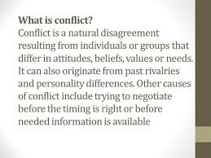

Slide 5
The Causes of Conflict
Insufficient Management
Insufficient resources
Bullying and Harassment
Misunderstandings.
Poor communication.
Lack of planning.
Poor staff selection.
Frustration, stress

Slide 6
Types of conflict
Interpersonal conflict
Intrapersonal conflict
Intragroup conflict
Intergroup conflict

Slide 7
Interpersonal conflict refers to a conflict between two individuals. This occurs typically due to how people are different from one another. We have varied personalities which usually results to incompatible choices and opinions.
Intrapersonal conflict occurs within an individual. The experience takes place in the person’s mind. Hence, it is a type of conflict that is psychological involving the individual’s thoughts, values, principles and emotions
Intragroup conflict is a type of conflict that happens among individuals within a team. The incompatibilities and misunderstandings among these individuals lead to an intragroup conflict.
Intergroup conflict takes place when a misunderstanding arises among different teams within an organization. For instance, the sales department of an organization can come in conflict with the customer support department.

Slide 8
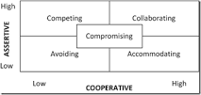
5 Conflict Management Styles

