Slide 1
Computer Networks and Topologies

Slide 2
Computer Network
Two or more computers connected together for sharing data and resources.
Three basic categories
Local Area Network (LAN)
Metropolitan Area Network (MAN)
Wide Area Network (WAN)
Type of network is determined by its size, ownership, distance and its physical architecture.

Slide 3
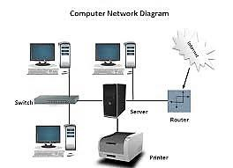
Computer Network

Slide 4
Types of Network: Local Area Network
Links the devices in a single office, building, or campus.
Depending on the needs of an organization and the type of technology used
A LAN can be as simple as two PCs and a printer in someone's home, office, or it can extend throughout a company and include voice, sound, and video peripherals

Slide 5
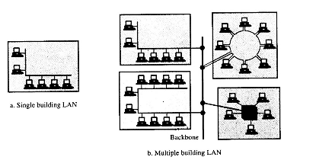
Types of Network
Currently, LAN size is limited to a few kilometers
allow resources to be shared between personal computers or workstations
LANs have data rates in the 4 to 16 Mbps range

Slide 6
Metropolitan Area Network
Designed to extend over a district, council or even an entire city.
It may be a single network such as a cable television network, or it may be a means of connecting a number of LANs into a larger network so that resources may be shared LAN-to-LAN as well as device-to-device.

Slide 7
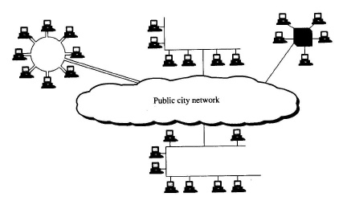
Metropolitan Area Network
For example, a company can use a MAN to connect the LANs in all of its offices throughout a city.

Slide 8
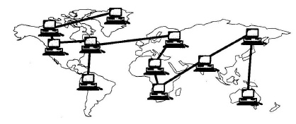
Wide Area Network
provides long-distance transmission of data, voice, image, and video information over large geographical areas that may comprise a country, a continent, or even the whole world.

Slide 9
Network Topologies
They way computers are connected together in a network is called topology of network.
The way a network is laid out, either physically or logically.
The basic topologies are:
BUS Topology
Star Topology
Ring Topology
Mesh Topology

Slide 10
Network Topologies
BUS Topology
One long cable acts as a backbone to link all the devices in the network
Nodes are connected to the bus cable by drop lines and taps.
A drop line is a connection running between the device and the main cable.
A tap is a connector that either splices into the main cable

Slide 11
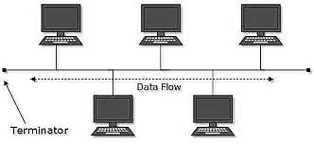
BUS Network

Slide 12
STAR Topology
Each device has a dedicated point-to-point link only to a central controller, usually called a hub.
The devices are not directly linked to each other.
The controller(HUB) acts as an exchange.

Slide 13
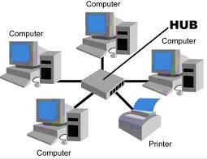
STAR Topology

Slide 14
RING Topology
Each device has a dedicated point-to-point line configuration only with the two devices on either side of it
A signal is passed along the ring in one direction, from device to device, until it reaches its destination.

Slide 15
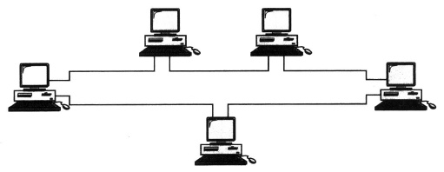
RING Topology

Slide 16
MESH Topology
every device has a dedicated point-to-point link to every other device.
The term dedicated means that the link carries traffic only between the two devices it connects.
Requires n*(n - l)/2 physical channels to link to connect with devices.
For example: if we have 4 computers then
4*(4-1)/2 = 6 links

Slide 17
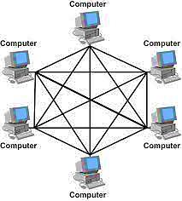
MESH Topology

