Slide 1
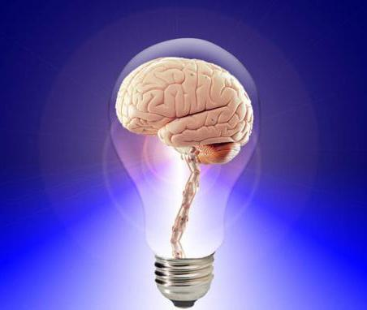
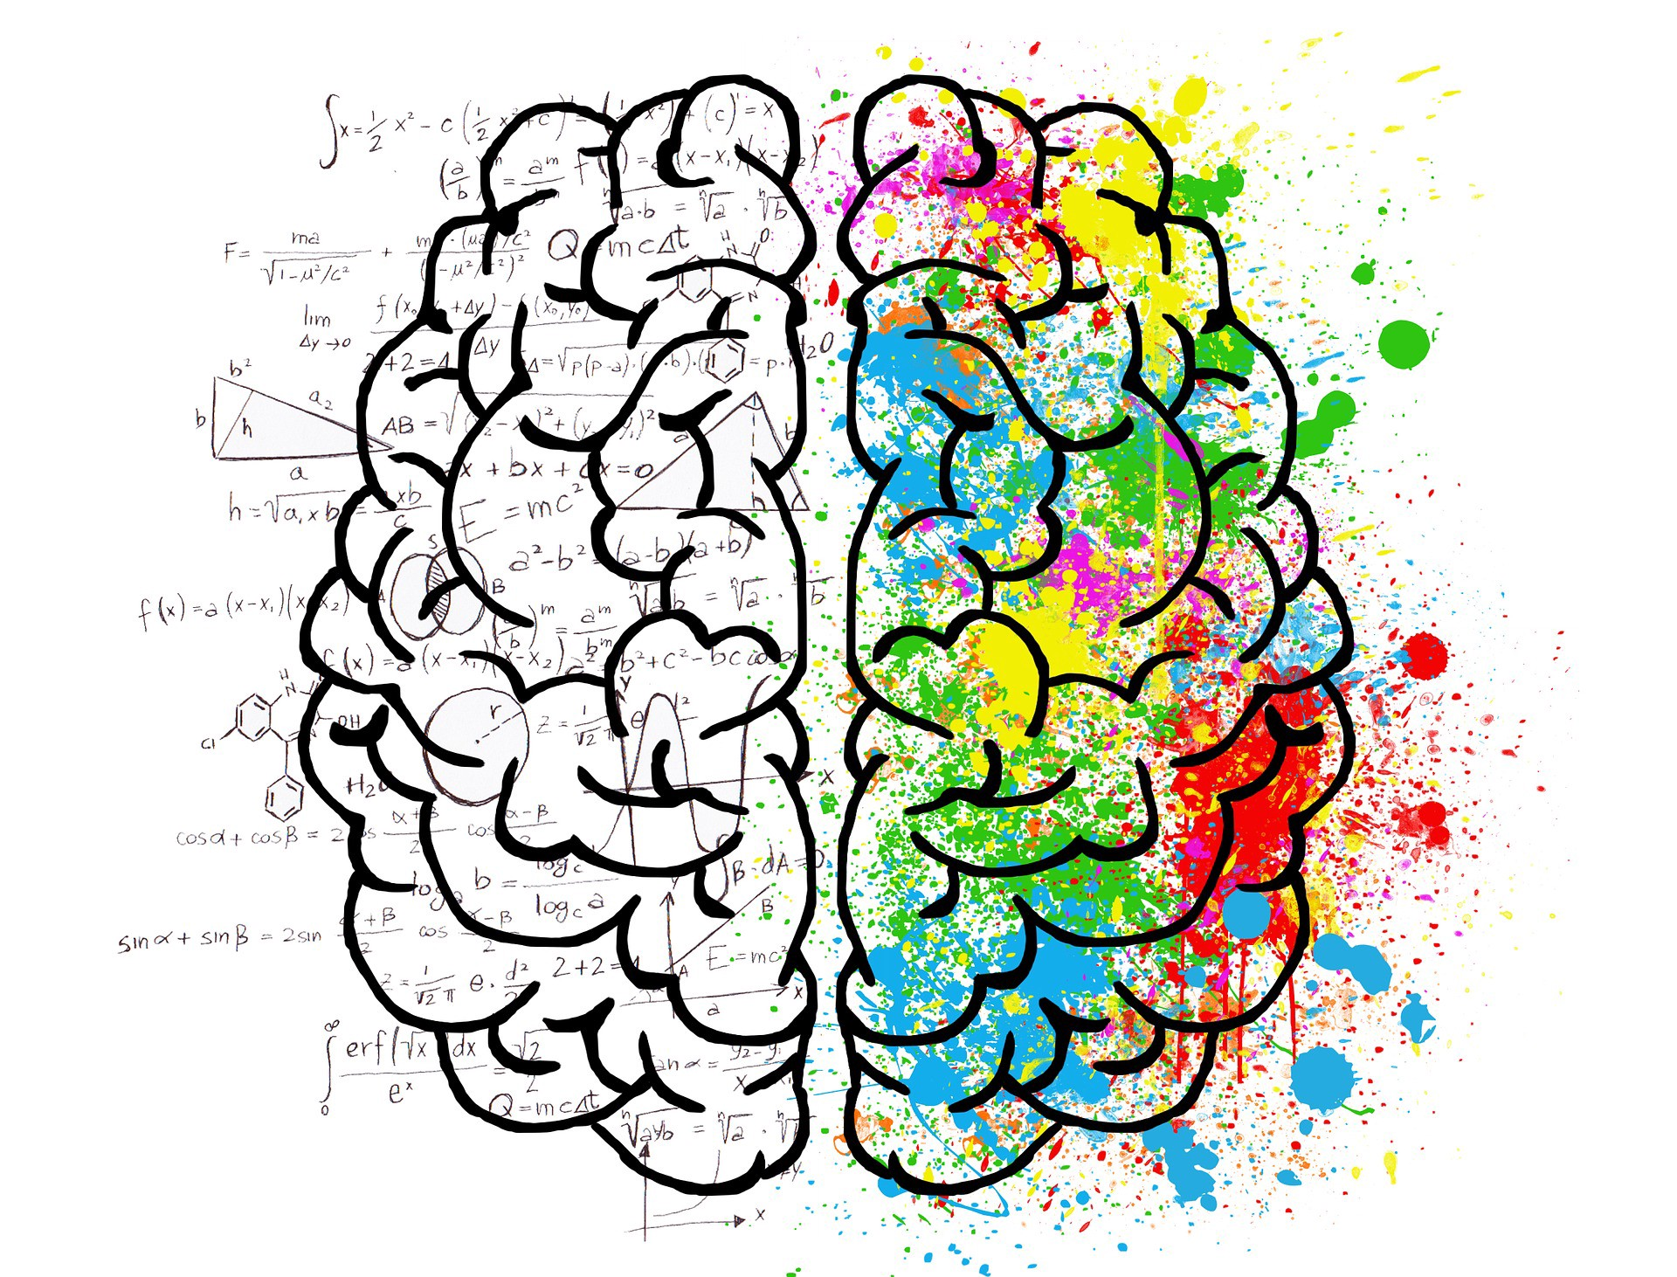
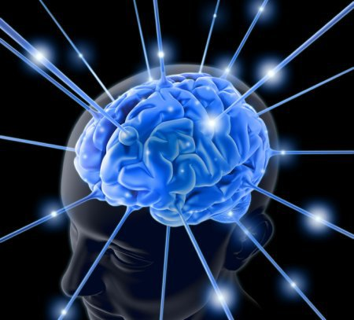
COGNITION
By: Shahzad Anwar

Slide 2
Cognition
The word cognition comes from the Latin verb cognōscō which means ‘to know', 'to conceptualize' or 'to recognize'
The mental action or process of acquiring knowledge and understanding through thought, experience, and the senses.

Slide 3
In science, cognition is a group of mental processes that includes attention, thinking, memory, producing and comprehending language, learning, reasoning, problem solving, and decision making

Slide 4
The mind is a complex machine – an information processing machine
It uses Hardware (the brain)
Software – (mental images or representations)
Information (input) comes to the mind through bottom-up processing (from the sensory system)
Information is processed in the mind by top-down processing through pre-stored information in the memory
Output is in the form of behavior

Slide 5
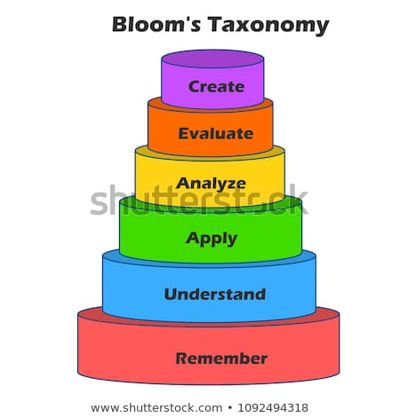
Levels of Cognition
Bloom's Taxonomy of Cognitive Domain:
Benjamin Bloom (1956) identified six levels within the cognitive
domains, from the simple “recall or
remember” of facts, as the lowest
level, through increasingly more
complex and abstract mental
levels, to the highest order which
is classified as to “create”.

Slide 6
1. Remembering is defined as recognizing or recalling facts, terms, basic concepts, or answers without necessarily understanding what they mean.
E.g. name two common varieties of apple (golden/red)
2. Understanding/Comprehension is defined as the ability to grasp the meaning of material or understanding of facts and ideas by organizing, comparing, translating, and interpreting the main ideas.
E.g. Compare the characteristics of Golden apple and Red apple

Slide 7
3. Application refers to the ability to use learned material in problem solving and in new situations
E.g. would apple help in the reduction of vitamin C deficiency?
4. Analysis refers to the ability to break down material or information into its component parts so that its organizational structure may be understood
E.g. List different ways of serving foods made with apple and which one has the highest health benefits

Slide 8
5. Evaluation is concerned with the ability to judge the value of material by presenting and defending opinions.
E.g. which kind of apple is best for making jam, and why? Reasons
6. Create refers to the ability to put parts together to form a new whole.
E.g. preparing apple jam

Slide 9
Decision Making
Definition: The thought process of selecting a logical choice from the available options

Slide 10
Decision Making Strategies
Decision Making Strategies
Need identification
Decision alternatives
Imagination & visualization used to foresee possible future consequences
Information, data gathering, evaluation of solution.

Slide 11
Decision Making Strategies
Assessment of risk & uncertainty & outcome.
Collaboration, communication, cooperation, negotiation & active listening are needed for effective group decision making.
Time & task management needed for successful decision implementation.

Slide 12
Thank You

