Slide 1
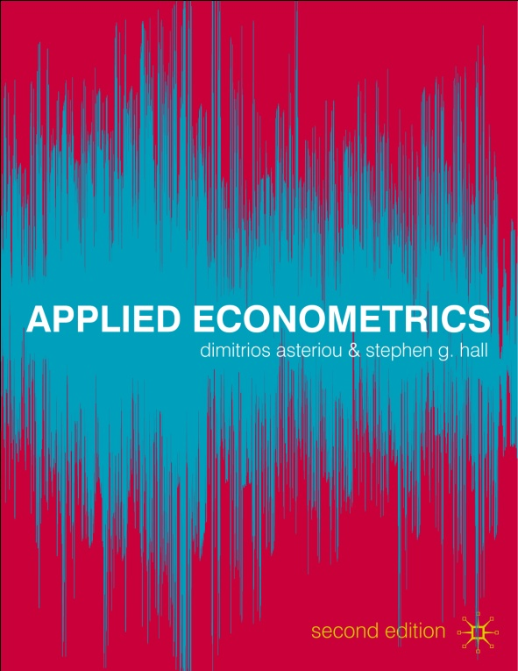
MULTICOLLINEARITY

Slide 2
MULTICOLLINEARITY
1. Perfect Multicollinearity
2. Consequences of Perfect Multicollinearity
3. Imperfect Multicollinearity
4. Consequences of Imperfect Multicollinearity
5. Detecting Multicollinearity
6. Resolving Multicollinearity

Slide 3
Learning Objectives
1. Recognize the problem of multicollinearity in the CLRM.
2. Distinguish between perfect and imperfect multicol-linearity.
3. Understand and appreciate the consequences of perfect and imperfect multicollinearity on OLS estimates.
4. Detect problematic multicollinearity using econometric software.
5. Find ways of resolving problematic multicollinearity.

Slide 4
Multicollinearity
Assumption number 8 of the CLRM requires that there are no exact linear relationships among the sample values of the explanatory variables (the Xs).
So, when the explanatory variables are very highly correlated with each other (correlation coefficients either very close to 1 or to -1) then the problem of multicollinearity occurs.

Slide 5
Perfect Multicollinearity
When there is a perfect linear relationship.
Assume we have the following model:
Y=β₁+β₂X₂+ β₃X₃+e
where the sample values for X₂ and X₃ are:
X₂ | 1 | 2 | 3 | 4 | 5 | 6
X₃ | 2 | 4 | 6 | 8 | 10 | 12

Slide 6
Perfect Multicollinearity
We observe that X₃=2X₂
Therefore, although it seems that there are two explanatory variables in fact it is only one.
This is because X₂ is an exact linear function of X₃ or because X₂ and X₃ are perfectly collinear.

Slide 7
Perfect Multicollinearity
When this occurs then the equation:
δ₁X₁+δ₂X₂=0
can be satisfied for non-zero values of both δ₁ and δ₂.
In our case we have that
(-2)X₁+(1)X₂=0
So δ₁=-2 and δ₂=1.

Slide 8
Perfect Multicollinearity
Obviously if the only solution is
δ₁=δ₂=0
(usually called as the trivial solution) then the two variables are linearly independent and there is no problematic multicollinearity.

Slide 9
Perfect Multicollinearity
In case of more than two explanatory variables the case is that one variable can be expressed as an exact linear function of one or more or even all of the other variables.
So, if we have 5 explanatory variables we have:
δ₁X₁+δ₂X₂ ₊δ₃X₃+δ₄X₄ +δ₅X₅=0
An application to better understand this situation is the Dummy variables trap (explain on board).

Slide 10
Consequences of Perfect Multicollinearity
Under Perfect Multicollinearity, the OLS estimators simply do not exist. (prove on board)
If you try to estimate an equation in Eviews and your equation specifications suffers from perfect multicollinearity Eviews will not give you results but will give you an error message mentioning multicollinearity in it.

Slide 11
Imperfect Multicollinearity
Imperfect multicollinearity (or near multicollinearity) exists when the explanatory variables in an equation are correlated, but this correlation is less than perfect.
This can be expressed as:
X₃=X₂+v
where v is a random variable that can be viewed as the ‘error’ in the exact linear releationship.

Slide 12
Consequences of Imperfect Multicollinearity
In cases of imperfect multicollinearity the OLS estimators can be obtained and they are also BLUE.
However, although linear unbiassed estimators with the minimum variance property to hold, the OLS variances are often larger than those obtained in the absence of multicollinearity.

Slide 13
Consequences of Imperfect Multicollinearity
To explain this consider the expression that gives the variance of the partial slope of variable X_{j}:
where r² is the square of the sample correlation coefficient between X₂ and X₃.

Slide 14
Consequences of Imperfect Multicollinearity
Extending this to more than two explanatory variables, we have:
and therefore, what we call the Variance Inflation Factor (VIF)

Slide 15
The Variance Inflation Factor
R²_{j} | VIF_{j}
0 | 1
0.5 | 2
0.8 | 5
0.9 | 10
0.95 | 20
0.075 | 40
0.99 | 100
0.995 | 200
0.999 | 1000

Slide 16
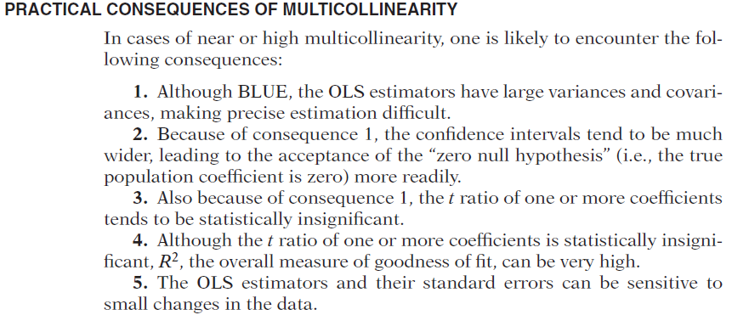

Slide 17
The Variance Inflation Factor
VIF values that exceed 10 are generally viewed as evidence of the existence of problematic multicollinearity.
This happens for R²_{j} >0.9 (explain auxiliary reg)
So large standard errors will lead to large confidence intervals.
Also, we might have t-stats that are totally wrong.

Slide 18
Consequences of Imperfect Multicollinearity (Again)
Concluding when imperfect multicollinearity is present we have:
Estimates of the OLS may be imprecise because of large standard errors.
Affected coefficients may fail to attain statistical significance due to low t-stats.
Sing reversal might exist.
Addition or deletion of few observations may result in substantial changes in the estimated coefficients.

Slide 19
Detecting Multicollinearity
The easiest way to measure the extent of multicollinearity is simply to look at the matrix of correlations between the individual variables.
In cases of more than two explanatory variables we run the auxiliary regressions. If near linear dependency exists, the auxiliary regression will display a small equation standard error, a large R² and statistically significant F-value.

Slide 20
Resolving Multicollinearity
Approaches, such as the ridge regression or the method of principal components. But these usually bring more problems than they solve.
Some econometricians argue that if the model is otherwise OK, just ignore it. Note that you will always have some degree of multicollinearity, especially in time series data.

Slide 21
Resolving Multicollinearity
The easiest ways to “cure” the problems are
drop one of the collinear variables
transform the highly correlated variables into a ratio
go out and collect more data e.g.
a longer run of data
switch to a higher frequency

Slide 22
Examples
We have quarterly data for
Imports (IMP)
Gross Domestic Product (GDP)
Consumer Price Index (CPI) and
Producer Price Index (PPI)

Slide 23
Examples
Correlation Matrix
IMP GDP CPI PPI
IMP 1 0.979 0.916 0.883
GDP 0.979 1 0.910 0.899
CPI 0.916 0.910 1 0.981
PPI 0.883 0.8998 0.981 1

Slide 24
Examples – only CPI
Variable Coefficient Std. Error t-Statistic Prob.
C 0.631870 0.344368 1.834867 0.0761
LOG(GDP) 1.926936 0.168856 11.41172 0.0000
LOG(CPI) 0.274276 0.137400 1.996179 0.0548
R-squared 0.966057 Mean dependent var 10.81363
Adjusted R-squared 0.963867 S.D. dependent var 0.138427
S.E. of regression 0.026313 Akaike info criterion -4.353390
Sum squared resid 0.021464 Schwarz criterion -4.218711
Log likelihood 77.00763 F-statistic 441.1430
Durbin-Watson stat 0.475694 Prob(F-statistic) 0.000000

Slide 25
Examples –CPI with PPI
Variable Coefficient Std. Error t-Statistic Prob.
C 0.213906 0.358425 0.596795 0.5551
LOG(GDP) 1.969713 0.156800 12.56198 0.0000
LOG(CPI) 1.025473 0.323427 3.170645 0.0035
LOG(PPI) -0.770644 0.305218 -2.524894 0.0171
R-squared 0.972006 Mean dependent var 10.81363
Adjusted R-squared 0.969206 S.D. dependent var 0.138427
S.E. of regression 0.024291 Akaike info criterion -4.487253
Sum squared resid 0.017702 Schwarz criterion -4.307682
Log likelihood 80.28331 F-statistic 347.2135
Durbin-Watson stat 0.608648 Prob(F-statistic) 0.000000

Slide 26
Examples – only PPI
Variable Coefficient Std. Error t-Statistic Prob.
C 0.685704 0.370644 1.850031 0.0739
LOG(GDP) 2.093849 0.172585 12.13228 0.0000
LOG(PPI) 0.119566 0.136062 0.878764 0.3863
R-squared 0.962625 Mean dependent var 10.81363
Adjusted R-squared 0.960213 S.D. dependent var 0.138427
S.E. of regression 0.027612 Akaike info criterion -4.257071
Sum squared resid 0.023634 Schwarz criterion -4.122392
Log likelihood 75.37021 F-statistic 399.2113
Durbin-Watson stat 0.448237 Prob(F-statistic) 0.000000

Slide 27
Examples – the auxiliary regression
Variable Coefficient Std. Error t-Statistic Prob.
C -0.542357 0.187073 -2.899177 0.0068
LOG(CPI) 0.974766 0.074641 13.05946 0.0000
LOG(GDP) 0.055509 0.091728 0.605140 0.5495
R-squared 0.967843 Mean dependent var 4.552744
Adjusted R-squared 0.965768 S.D. dependent var 0.077259
S.E. of regression 0.014294 Akaike info criterion -5.573818
Sum squared resid 0.006334 Schwarz criterion -5.439139
Log likelihood 97.75490 F-statistic 466.5105
Durbin-Watson stat 0.332711 Prob(F-statistic) 0.000000

