Slide 1
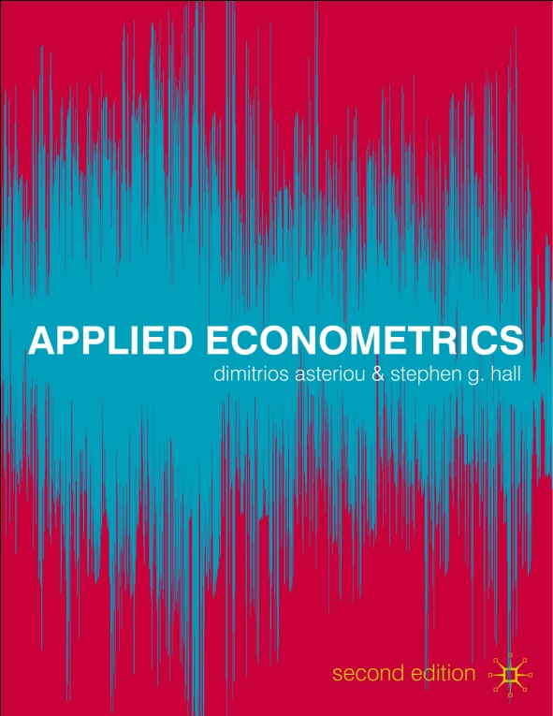
Econometrics
Dimitrios Asteriou and Stephen G. Hall

Slide 2
DUMMY VARIABLES
1. The Nature of Qualitative Information
2. The Use of Dummy Variables
3. Special Cases of Dummy Variables
4. Dummy Variables with Multiple Categories
5. Tests for Structural Stability

Slide 3
Learning Objectives
1. Understand the various forms of possible misspecification in the CLRM.
2. Appreciate the importance and learn the consequences of omitting influential variables in the CLRM.
3. Distinguish among the wide range of functional forms and understand the meaning and interpretation of their coefficients.
4. Understand the importance of measurement errors in the data.
5. Perform misspecification tests using econometric software.
6. Understand the meaning of nested and non-nested models.
7. Be familiar with the concept of data mining and choose an appropriate econometric model.

Slide 4
The Nature of Qualitative Information
Sometimes we can not obtain a set of numerical values for all the variables we want to use in a model.
This is because some variables can not be quantified easily.
Examples:
Gender may play a role in determining salary levels
Different ethnic groups may follow different consumption patterns
Educational levels can affect earnings from employment

Slide 5
The Nature of Qualitative Information
It is easier to have dummies for cross-sectional variables, but sometimes we do have for time series as well.
Examples
Changes in a political regime may affect production
A war can have an impact on economic activities
Certain days in a week or certain months in a year can have different effects in the fluctuation of stock prices
Seasonal effects are often observed in demand of various products

Slide 6
The Use of Dummy Variables
Consider the following cross-sectional model:
Y_{i}=β₁+β₂X_{2i}+ u_{i}
The constant term in this equation measures the mean value of Y_{i} when X_{2i} is equal to zero.
This model assumes that the constant will be the same for all the observations in our data set.
But what if we have two different subgroups (male, female for example)?

Slide 7
The Use of Dummy Variables
The question here is how to quantify the information that comes from the difference in the two groups.
One solution is to create a dummy variable as follows:
1 for male
D =
0 for female
Note that the choice of which of the two different outcomes is to be assigned the value of 1 does not alter the results.

Slide 8
The Use of Dummy Variables
Entering this dummy in the equation we have the following model:
Y_{i}=β₁+β₂X_{2i}+β₃D_{i}+u_{i}
Now we have two cases
D_{i}=0 Y_{i}=β₁+β₂X_{2i}+ β₃(0) +u_{i}
Y_{i}=β₁+β₂X_{2i}+u_{i}
D_{i}=1 Y_{i}=β₁+β₂X_{2i}+β₃(1)+u_{i}
Y_{i}=(β₁+β₃) +β₂X_{2i}+u_{i}

Slide 9
Intercept Dummy Variable
Red Points: Male
Grey Points: Female

Slide 10
Intercept Dummy Variable
β₁+β₃
β₁

Slide 11
Slope Dummy Variable
Consider the same case but now with the dummy affecting the slope
Y_{i}=β₁+β₂X_{2i}+β₃D_{i}X_{2i}+u_{i}
Now we have two cases
D_{i}=0 Y_{i}=β₁+β₂X_{2i}+β₃(0)_{i}X_{2i}+u_{i}
Y_{i}=β₁+β₂X_{2i}+u_{i}
D_{i}=1 Y_{i}=β₁+β₂X_{2i}+β₃(1)_{i}X_{2i}+u_{i}
Y_{i}=β₁+(β₂+β₃)X_{2i}+u_{i}

Slide 12
Slope Dummy Variable

Slide 13
The Combined Effect
Y
Males
λ
δ
Females
β₁ +δ
β₁

Slide 14
Dummies with Multiple Categories
Consider the case of education:
D1= 1 primary; 0 otherwise
D2= 1 if secondary; 0 otherwise
D3= 1 if tertiary; 0 otherwise
D4 = 1 if BSc; 0 otherwise
D5 = 1 if MSc; 0 otherwise

Slide 15
The Plug in Solution
So we estimate:
Y=β₁+β₂X₂+ a₁ D₂+a₂D₃+a₃D₄+a₄D₅+u
Note that one dummy (in this case D1) is excluded from the model in order to avoid dummy variable trap.
Consider various cases,
i.e. D2=1, D3=D4=D5=0 etc.

Slide 16
Multiple Categories

Slide 17
Using More than One Dummy
GENDER (male; female)
EDUC (primary, secondary, tertiary; BSc; MSc)
AGE (less than 30, 30 to 40; more than 40)
OCUP (unskilled, skilled, clerical, self-employed) etc
The interpretation (although it seems more complicated) is the same as before

Slide 18
Seasonal Dummy Variables
Depends on the frequency of the data
Quarterly – 4 dummies – DQ1, DQ2, DQ3, DQ4
Monthly – 12 dummies – one for each month
Daily – 5 dummies – Dmon, Dtue, Dwed etc.
Again we either exclude one and include a constant (always better) or if we use all we never include a constant (dummy variable trap).

Slide 19
The Chow Test for Structural Stability
Step 1: Estimate the basic regression equation.
Y_{i}=β₁+β₂X_{2i}+u_{i}
for three different data sets
whole sample, n;
Period before the shock, n1;
Period after the shock, n2.
Step 2: Obtain the SSR for each of the three subsets and label them SSRN, SSR1 and SSR2 respectively.

Slide 20
The Chow Test for Structural Stability
Step 3: Calculate the F-statistic
F
Step 4: If F-statistical bigger than F-critical F(k,n-2k) then reject the null that the parameters are stable for the whole data set.

Slide 21
The Dummy Variable Test for Structural Stability
The Dummy Variable Test is much better because:
A single equation is used to provide a set of the estimated coefficients for tow or more structures
Only one degree of freedom is lost for every dummy used.
A larger sample is being used for the estimation
It provides us with information regarding the exact nature of the parameter instability.

