Slide 1
Database Management System
Chapter No 1
An Overview of Database Management

Slide 2
Topics in this Chapter
What is a Database System?
What is a Database?
Why Database?
Data Independence
Relational Systems, and Others

Slide 3
Database System
Computerized record-keeping system
Supports operations
Add or delete files to the database
Insert, retrieve, remove, or change data in database
Components
Data, hardware, software, users

Slide 4
Database System - Data
May support single or many users
Many users in organizations
Data is integrated
Data is shared
Different users will require different views

Slide 5
Database System - Hardware
Data is stored on Disk
Direct access to subset portions
Rapid I/O
Data operated on in main memory

Slide 6
Database System - Software
Database manager
Database server
Database management system (DBMS)
DBMS provided by specific vendor

Slide 7
Database System - Software
DBMS is not ( but may come with)
Application Development Tools
Application Software
Activity / Database Monitor
Report Writer
System utilities
Barcode reader
Swipe card
Printer (thermal printer)

Slide 8
Database System - Users
Application programmers
End users
Database Administrators

Slide 9
What is a Database?
Collection of persistent [determined] data
Collection of true propositions [scheme]
Made up of entities, relationships, properties
Implements a data model

Slide 10
What is a Database? - Persistence
Stores enterprise information over time
Outlasts the running of a computer program
Updated and retrieved in operational/production system
Offers decision support via data warehouse

Slide 11
What is a Database? – Entities and Relationships
Entity is a person, place, event or thing, about which we wish to store information
Relationship is a connection between entities, about which we wish to store information
A relationship can be considered a special case of entity

Slide 12
What is a Database? - Properties
Entities have properties
Properties are the characteristics of an entity
Properties can be simple or complex

Slide 13
Data and Data Models
Database is a collection of true propositions [schemes]
Data model is an abstract, self-contained, logical representation
Implementation of the data model on a specific platform
Data model will be specific for a specific enterprise

Slide 14
The three levels of data modeling
Feature | Conceptual | Logical | Physical
Entity Names | ✓ | ✓
Entity Relationships | ✓ | ✓
Attributes |  | ✓
Primary Keys |  | ✓ | ✓
Foreign Keys |  | ✓ | ✓
Table Names |  |  | ✓
Column Names |  |  | ✓
Column Data Types |  |  | ✓

Slide 15
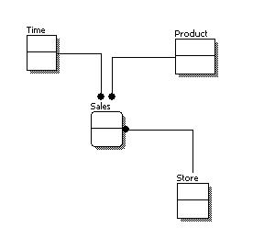
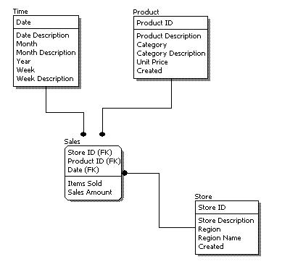
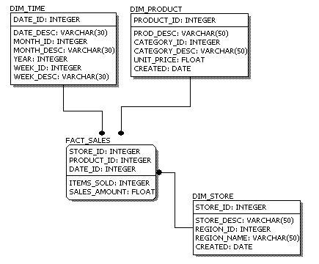
The three levels of data modeling
Conceptual Model Design
Logical Model Design
Physical Model Design

Slide 16
Why Database?
Shared data
Reduced redundancy [no longer needed]
Reduced inconsistent [unreliable] data
Transaction support
Support for data integrity
Security enforcement
Support for standards
Conflicting requirements can be met

Slide 17
Data Independence
Database separates logical and physical representation of data
Allows changes to application programs without changing the structure of the underlying data
And vice versa
It’s a good thing

Slide 18
Materialized Data
Stored fields, collected as…
Stored records, collected as…
Stored files
Old systems, e.g., COBOL applications, directly connect to data formats
Newer database systems offer greater data independence, but could do better

Slide 19
Relational Systems
Most important innovation in database history
Based on logic and mathematics
Data is perceived [real] as tables, only
Operators derive new tables from existing
A table is a “relation,” mathematically
Not pointer based (to the user)

Slide 20
Data Architecture

