Slide 1
Chapter 04
Input / Output Devices
Instructor: Shahab Ul Islam
Email: shahab@inu.ed.pk

Slide 2
In last lecture we discussed about
In this chapter you will learn about:
Memory representation
Memory hierarchy
Internal memory (registers, cache memory, primary memory),
Secondary memory (magnetic disk, optical disk, magnetic tape)
Primary memory
RAM—DRAM, SRAM, memory modules— DIMM, SIMM
ROM—PROM, EPROM, EEPROM, flash memory
Secondary memory
Access types of storage devices—Sequential access devices, direct access devices
Magnetic tape—Working of magnetic tape, features of magnetic tape
Magnetic disk
Floppy disk
Hard disk
Zip disk
Optical disk
CD-R
CD-RW
DVD-R

Slide 3
Learning Objectives
In this chapter you will learn about:
Input devices
Human data entry devices
Keyboard
Pointing devices—Mouse, trackball, joystick, digitizing tablet
Pick devices—Light pen, touch screen
Source data entry devices
Audio input device (microphone, sound card, speech recognition)
Video input device (video camera, digital camera)
Optical input devices—Scanner (hand held, flat bed), OCR, MICR, OMR, barcode reader
Output devices
Hard copy devices
Printer—Impact printers (dot matrix, daisy wheel, drum), non-impact printers (ink-jet, laser)
Plotter—Drum plotter, flatbed plotter
Soft copy devices
Monitor
I/O port— Parallel port , serial port, USB port, firewire port

Slide 4
INPUT-OUTPUT UNIT
The I/O devices that are attached, externally, to the computer machine are also called peripheral devices.

Slide 5
INPUT-OUTPUT UNIT
Input Unit
The input unit gets the data and programs from various input devices and makes them available for processing to other units of the computer
Output Unit
The output unit gets the processed data from the computer and sends it to output devices to make them available to the user of computer

Slide 6
INPUT DEVICES
Input devices allow users and other applications to input data into the computer, for processing
The data input to a computer can be in the form of text, audio, video, etc
Human data entry devices
Keyboard
Pointing devices—mouse, trackball, joystick, digitizing tablet
Pick devices—light pen, touch screen
Source data entry devices
Audio input—speech recognition
Video input—digital camera
Scanner—hand-held scanner, flat-bed scanner
Optical Scanner—OCR, OMR, MICR, barcode reader

Slide 7
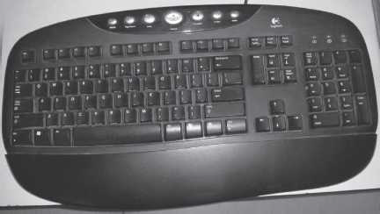
Keyboard
A common input device easy to use.
The design of a keyboard is similar to a standard typewriter
The modern keyboards are QWERTY keyboard key board has five sections
Typing keys , Numeric keypad , Function keys , Control keys , Special-purpose keys

Slide 8
Working of Keyboard
When a key is pressed, keyboard interacts with a keyboard controller and keyboard buffer
The keyboard controller stores the code of pressed key in keyboard buffer and informs the computer software
The computer software reads the keyboard buffer and passes the code system software
Keyboard buffer is designed to store many keystrokes together.

Slide 9
Pointing Devices
Pointing devices are used for providing the input to computer by moving the device to point to a location on computer monitor
Operations like move, click and drag can be performed using the pointing devices
Examples:
Mouse
Trackball
Joystick
Digitizing tablet

Slide 10
Mouse
Most common pointing input device
A small hand-held device having two or three buttons on its upper side
Also has a small wheel between the buttons
Data is entered by pointing the mouse to a location on the computer screen
Also used to move an object by dragging, or select an object by clicking
Provides an easy way to select commands from menus, dialog boxes, icons, etc
Wheel of the mouse is used for the up and down movement

Slide 11
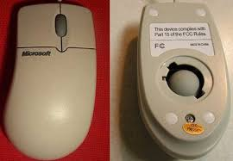
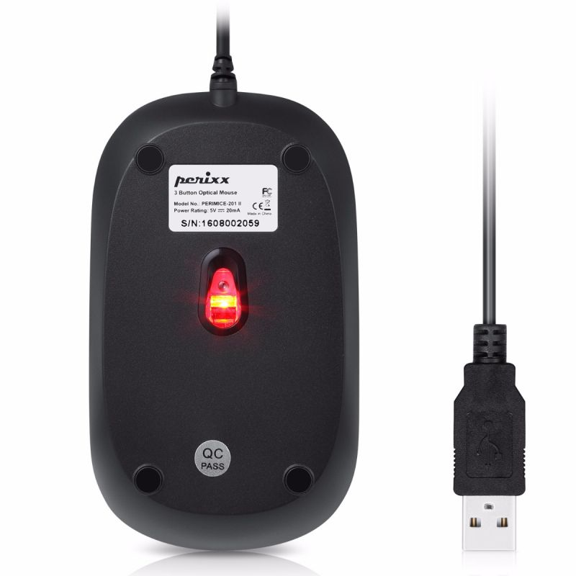
Physical mouse or optical mouse
Physical Mouse
It has a rubber ball on the bottom side
It requires a smooth, dust free surface, such as a mouse pad, on which it is rolled
Optical Mouse
Optical mouse was introduced by Microsoft in 1999
Uses a Light Emitting Diode (LED) and a sensor to detect the movement of mouse
Physical Mouse
Optical Mouse

Slide 12
Working of Mouse
Physical Mouse
Rollers and sensors are used to sense the direction
When the ball of mouse moves, the rollers sense the horizontal and vertical movement
Sensors sense the speed of movement and information is passed to computer via the mouse chord.
Optical Mouse
When an optical mouse is moved, a beam of light is reflected from its underside
These pulses of light determine the direction and information is sent to computer via the mouse chord
The mouse can be used in five different ways
Pointing
Left Click
Right Click
Double Click
Drag and Drop

Slide 13
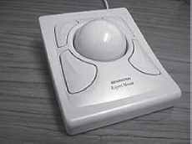
TrackBall
A device that is a variant of the mouse but has the functionality of mouse
It is easy to use and takes less space than a mouse
Generally built in laptops since there is no space for the mouse to move on the lap
Trackball works in the same way as a physical mouse

Slide 14
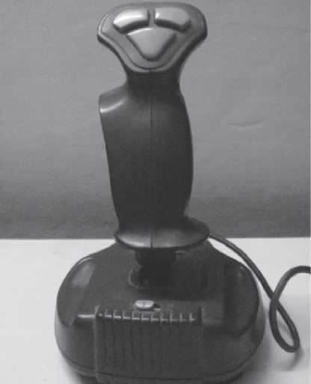
Joystick
A stick with its base attached to a flexible rubber sheath inside a plastic cover
The plastic cover contains the circuit that detects the movement of stick and sends the information to computer
Commonly used for playing video games
Mainly used to control the speed of the cursor

Slide 15
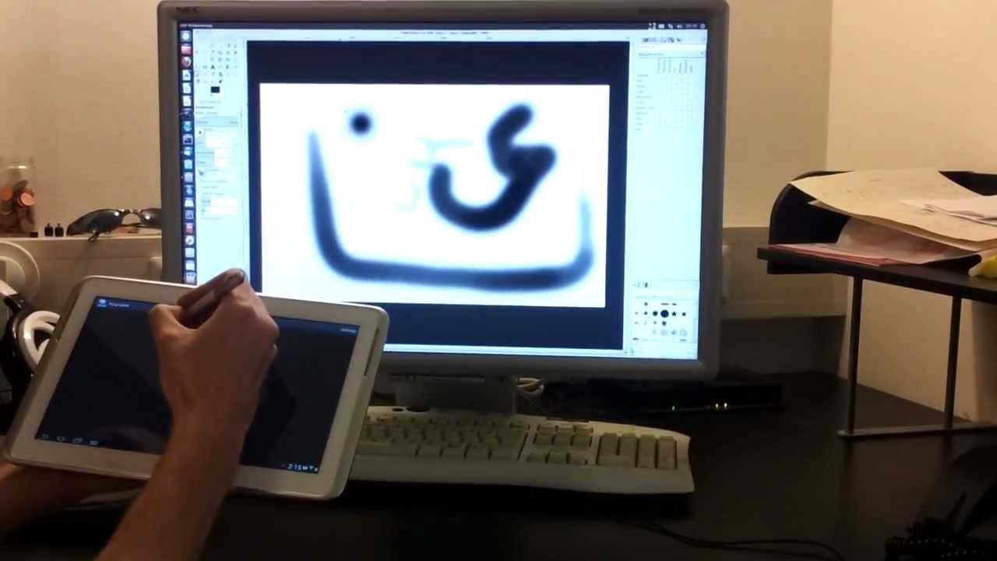
Digitizing Tablet
An input device used primarily to input drawings, sketches, etc
Digitizing tablet is used for Computer Aided Design (CAD)
Consists of two parts—electronic tablet and pen
Electronic tablet is a flat bed tablet
Pen looks like a ball pen but has an electronic head
Drawings can be made on the tablet using a pen
Tablet contains circuit that can detect the movement of pen on the tablet
Convert the movements into digital signals and send the digital signal to the computer

Slide 16
Pick Devices
Pick devices are used for providing input to the computer by pointing to a location on the computer monitor
Data is not typed; the data is entered by pointing the pick device directly on the computer screen
Light pen and touch screen are some common pick devices

Slide 17
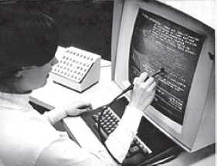
Light Pen
It is a light sensitive pen-like input device
Used to select objects directly on the computer screen
Used for making drawing, graphics and for menu selection
Pen contains a photocell in a small tube
When the pen is moved on the screen, light from the screen at the location of pen causes the photocell to respond
The electric response is transmitted to the computer that can identify the position on screen at which the light pen is pointing
Notes:
Photocells are sensors that allow you to detect light

Slide 18
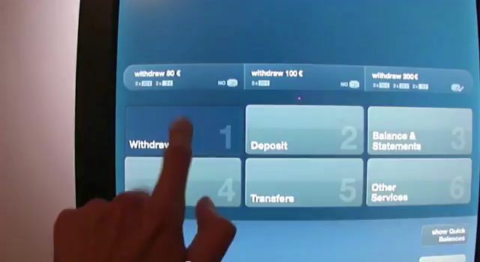
Touch Screen
An input device that accepts input when the user places a fingertip on the computer screen
Consists of a clear glass panel with sensors that is placed over the view area of computer screen
The computer selects the option from the menu of screen to which the finger points
Generally used in applications like Automated Teller Machine (ATM) etc

Slide 19
SOURCE DATA ENTRY DEVICES
Source data entry devices are used for audio input, video input and to enter the source document directly to the computer
Do not require data to be typed-in, keyed-in or pointed to a particular location
Examples:
Audio input—speech recognition
Video input—digital camera
Scanner—hand-held scanner, flat-bed scanner
Optical Scanner—OCR, OMR, MICR, barcode reader

Slide 20
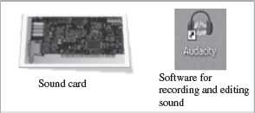
Audio Input Device
Audio input can be provided to the computer using human voice or speech
A sound card translates analog audio signals from microphone into digital codes that the computer can store and process
Translating spoken words into text is known as speech recognition or voice recognition
Used for making telephone calls, audio and video conferencing over Internet, to record voice, to create audio files etc

Slide 21
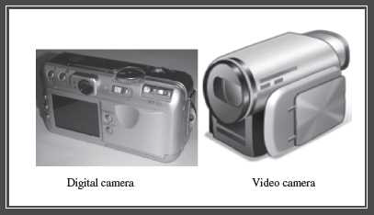
Video Input Device
Video input is provided to the computer using video camera and digital camera
A video capture card allows the user to connect video devices like camcorders to the computer
Webcam is a common video camera device
Digital camera works like video camera but can capture still images

Slide 22
Optical Input Devices
Optical input devices allow computers to use light as a source of input
Example:
Scanner
Optical Character Recognition (OCR)
Optical Mark Recognition (OMR)
Magnetic Ink Character Recognition (MICR)
Barcode Reader

Slide 23
Scanner
Scanner is an input device that accepts paper document as an input
The input data to be scanned can be a picture, a text or a mark on a paper
An optical input device that uses light as an input source to convert an image into an electronic form that can be stored on the computer
The quality of scan increases with the increase in resolution
Hand-held scanner
Portable and are placed over the document to be scanned
Consist of light emitting diodes
To be moved at a constant speed to get good quality scans
Used for low volume of documents, small pictures or photos , price tags, label and ISBN number on books
Flat-bed Scanners
Provide high quality scan in a single pass
A box shaped machine similar to a photocopy machine and has a glass top and a lid that covers the glass

Slide 24
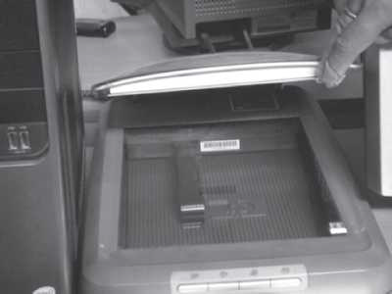
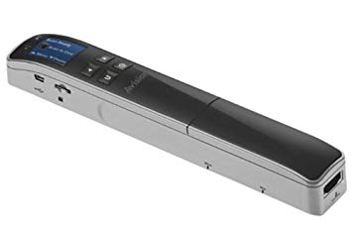
Scanner Examples
Flat Bed Scanner
Handheld Scanner

Slide 25
Optical Character Recognition (OCR)
A technique for the scanning of a printed page, translating it, and then using the OCR software to recognize the image as ASCII text that is editable
Stores the scanned image as bitmap image which is a grid of dots
The OCR software translates the array of dots into text that the computer can interpret as words and letters

Slide 26
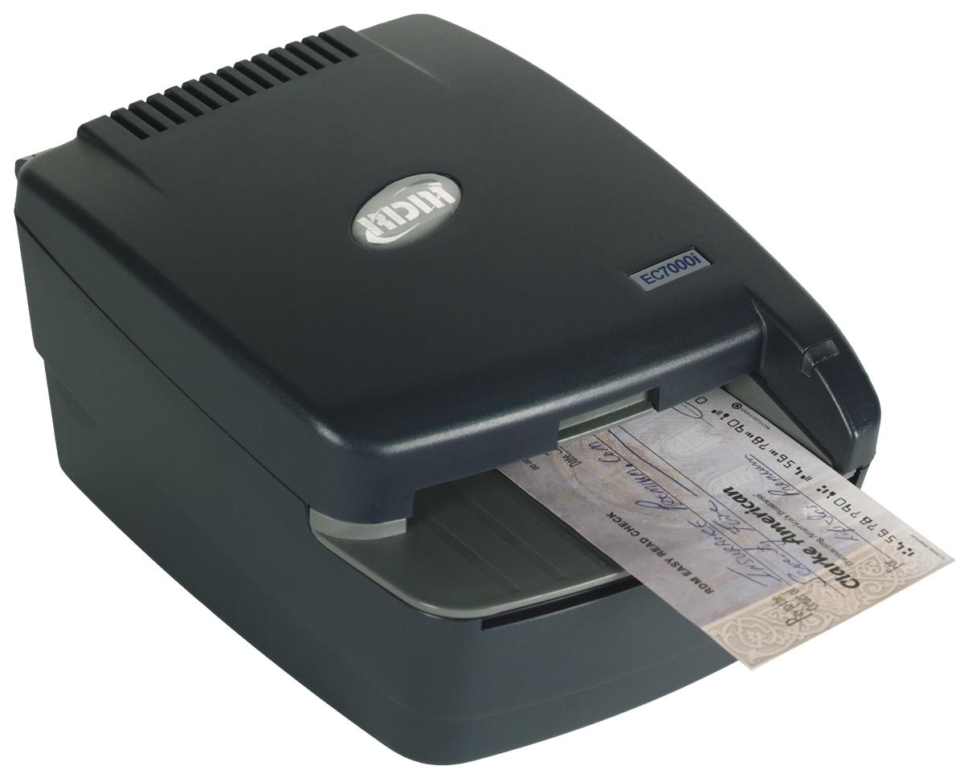
Magnetic Ink Character Recognition (MICR)
Used in banks to process large volumes of cheques
It is used for recognizing the magnetic encoding numbers printed at the bottom of a cheque
These numbers are magnetized
MICR uses magnetic ink character reader for character recognition
The reading speed of MICR is faster than OCR

Slide 27
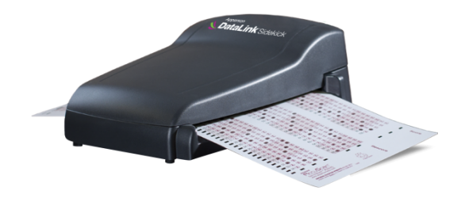
Optical Mark Recognition (OMR)
Used to detect marks on a paper which are recognized by their darkness
OMR reader scans the forms, detects the mark by using beam of light that is positioned reflected on the paper with marks, to capture presence and absence of marks
OMR then passes this information to the computer for processing by application software
OMR is widely used to read answers of objective type tests

Slide 28
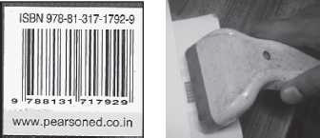
Barcode Reader
Barcodes are adjacent vertical lines of different width that are machine readable
Barcodes are read using reflective light by barcode readers
Barcode readers are fast and accurate
Generally used in departmental stores to read the labels, and in libraries to read labels on books
Barcode and Barcode Reader

Slide 29
OUTPUT DEVICES
Output devices provide output to the user, which is generated after processing the input data
It can be text, graphics, audio or video
Hard Copy Devices
Printer
Plotter
Soft Copy Devices
Monitor

Slide 30
Hard Copy Devices
The devices that generate hard copy output are called hard copy devices
The output obtained in a tangible form on a paper or any surface is called hard copy output
Hard copy can be stored permanently and is portable
Examples:
Printer
Plotter

Slide 31
Printer
A printer prints the output information from the computer onto a paper
Printers are generally used to print textual information as well as graphical information
Its quality is determined by the resolution of the printer
Resolution is measured in dots per inch (dpi)
Printers with a high resolution (more dpi) provide better quality output
Printers are classified into two categories:
Impact printer
Non-impact printer

Slide 32
Impact printers
Use the typewriter approach of physically striking a typeface against the paper and inked ribbon
Can print a character or an entire line at a time
Low-cost printers useful for bulk printing
Examples:
Dot matrix printers
Daisy wheel printers
Drum printers

Slide 33
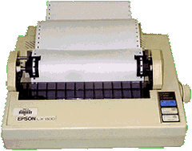
Dot Matrix Printers
Print one character at a time
The speed of dot matrix printer lies between 200 and 600 characters per second (cps)
Resolution ranges from 72 to 360 dpi
Can print only in black and white
Dot matrix printers are commonly used for printing in applications like payroll and accounting

Slide 34
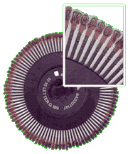
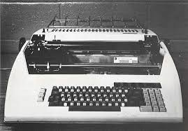
Daisy Wheel Printers
Print one character at a time
Produce letter quality document which is better than a document printed by a dot matrix printer
Speed of daisy wheel printers is about 100 cps
Can only print text (not graphics)
Slow and are costly in comparison to dot matrix printers
Daisy wheel printers are used where high quality printing is needed and no graphics is needed

Slide 35
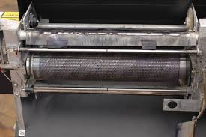
Drum Printers are line printers
Expensive and faster than character printers but produce a low quality output
Can print 200–2500 lines per minute
Drum printers are generally used for voluminous print outputs

Slide 36
Non-Impact
Printers do not hit or impact a ribbon to print
They use electro-static chemicals and ink-jet technologies
Faster and quieter than impact printers
Used for printing text and graphics both in black and white, and color
Ink-jet printers and laser printers are non-impact printers

Slide 37
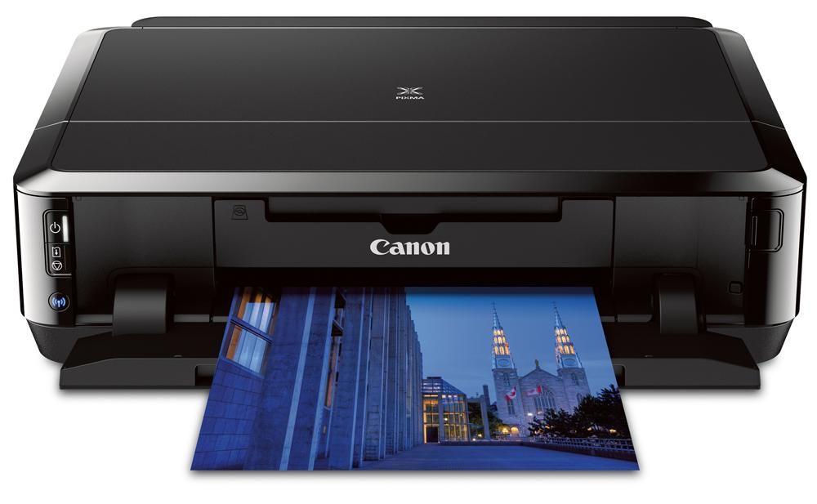
Ink-jet Printers
Spray ink drops directly on the paper like a jet
Resolution is more than 500 dpi
Produce high quality graphics and text
Ink-jet printers are commonly found in homes and offices

Slide 38
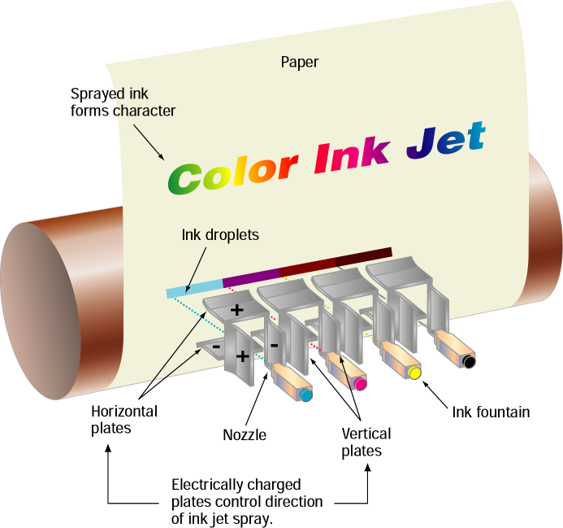
How Inkjet Printer works?
Print head having four ink cartridges moves
Software instructs where to apply dots of ink, which color and what quantity to use
Electrical pulses are sent to the resistors behind each nozzle
Vapor bubbles of ink are formed by resistors and the ink is forced to the paper through nozzles
A matrix of dots forms characters and pictures
Notes:
Electric pulse is a change of short duration in voltage.

Slide 39
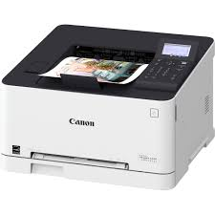
Laser Printers
Provide highest quality of text and graphics printing
Laser printers process and store the entire page before printing and are also known as page printers
Can print 5–24 pages of text per minute
Resolution ranges from 400 to 1200 dpi
Faster and expensive than impact printers
Laser printers are used in applications requiring high quality voluminous printing

Slide 40
How Laser printer Works?
Paper is fed and the drum rotates
A laser beam conveys information from the computer to a rotating mirror and thus an image is created on the drum
The charges on the drum are ionized and the toner sticks to the drum
Toner is transferred from drum to paper
Heat is applied to fuse the toner on the paper

Slide 41
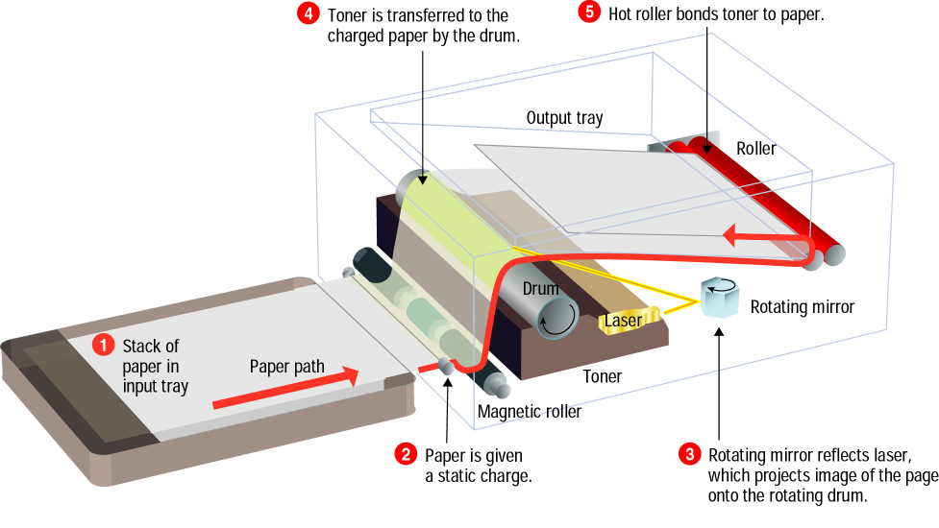
Laser Printer (Cont’d)

Slide 42
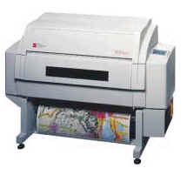
Plotter
A plotter is Used for vector graphics output to draw graphs, maps, blueprints of ships, buildings, etc
Plotters use pens of different colors (cyan, magenta, yellow and black) for drawing
A slow output device and is expensive
Two types of plotters are:
Drum Plotter
Flatbed Plotter

Slide 43
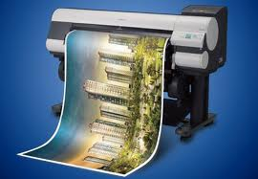
Drum Plotter
A drum plotter is a pen plotter that wraps the paper around a drum
The drum then rotates the paper as pens move across it and draw the image
It was the first output device used to print graphics and large engineering drawings.

Slide 44
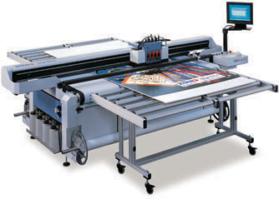
Flatbed Plotter
A flat-bed plotter is a mechanical drafting device used with many CAD programs for designers
The paper remains stationary on a flat surface while a pen moves across it horizontally and vertically
This plotter may use several different pen colors to create the graphics

Slide 45
Soft Copy Devices
The output obtained in an intangible form on a visual display, audio unit or video unit is called soft copy output
The devices that generate soft copy output are called soft copy devices
Example of Soft Copy Devices
Monitor

Slide 46
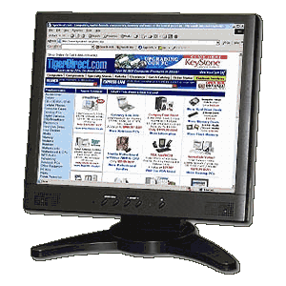
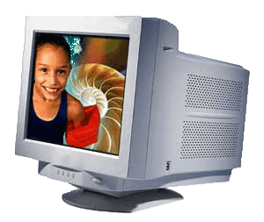
Monitors
A monitor is a peripheral device which displays computer output on a screen
Used to generate soft copy of the output
Monitors are categorized by the technology they use:
Cathode ray tube (CRT) Monitors
Flat-panel displays
CRT Monitors
Flat Panel Display

Slide 47
CRT (Cathode Ray Tube)
A CRT is a large, sealed glass tube, the front of a tube is a screen
Electron gun shoots a stream of electrons at a specially phosphor-coated screen
An electron beam moves back & forth across the back of the screen
This causes the dots on the front of the screen
The dots are grouped into pixels, which glow when struck by electrons
In color CRTs, each pixel contains a red, green, and blue dot
These glow at varying intensities to produce color images
CRT monitors for desktop computers are available in various size, with the more common being 15, 17, 19, 21 inches etc …
Notes:
Phosphor coating is thin coating of aluminum phosphate or lanthanum(III) phosphate.

Slide 48
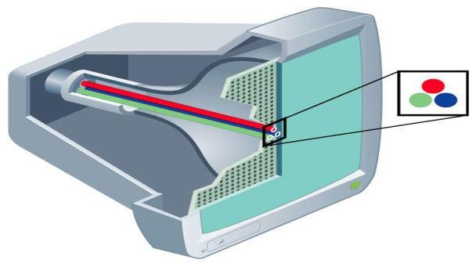
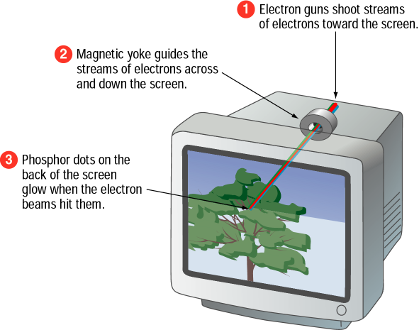
Monitors (Cont’d)
The CRT electron gun “shoots” 3 electrons at the screen representing the amount of red, green and blue for the pixel
PixEL (Picture Element)
smallest unit of an image, basically a single dot on the screen
Resolution
Number of pixels in the image
Common resolution size is 1024x768

Slide 49
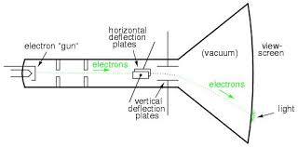
CRT Working

Slide 50
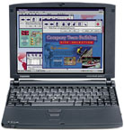
LCD Flat-Panel Display
A flat-Panel Display Device with a shallow depth that does not use CRT technology
LCD uses a liquid crystal to produce a visible image
Forms output by solidifying crystals and “backlighting” the image with a light source
TV sets are CRTs and many desktop monitors use this technology
LCD is primarily used for laptops and other portable devices
Notes:
Liquid crystal( liquid crystals are actually small thin rod like molecules) displays do not emit light. They only control whether light gets through them or not.

Slide 51
Input/Output Ports
The external interface used to connect I/O devices
The different port are
Parallel port
Serial port
USB port
Firewire

Slide 52
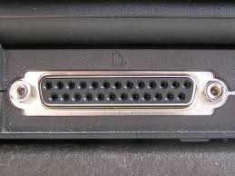
Parallel Port
An interface for connecting 8 or more data wires
Transmits 8 bits of data parallel
Provides high speed data transmission
Eg: Used to connect printers

Slide 53
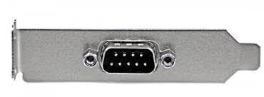
Serial Port
Transmits 1 bit of data through a single wire
Slow speed data transmission
Used to connect modem , barcode reader etc.

Slide 54
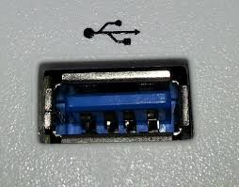
USB Port
Allows different devices to be connected to computers without requiring rebooting
Plug and play

Slide 55
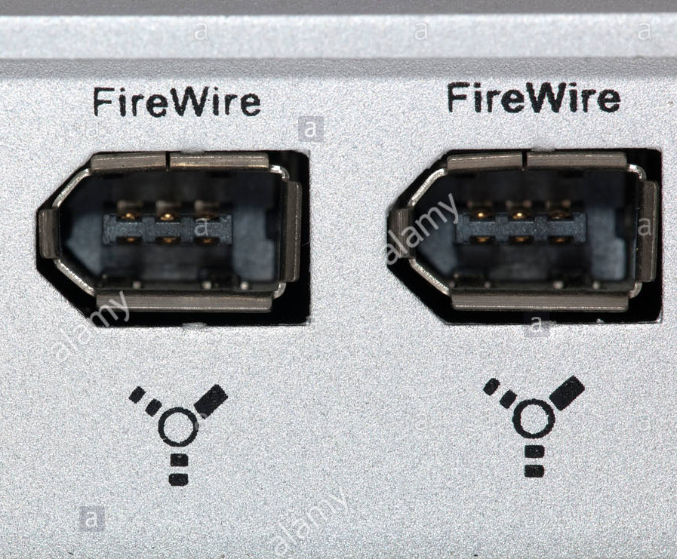
Firewire
Used to connect audio and video multimedia device like video camera
Expensive
Used for large data movement
Connect HDD and DVD drive

Slide 56
Summary
Input devices
Human data entry devices
Keyboard
Pointing devices—Mouse, trackball, joystick, digitizing tablet
Pick devices—Light pen, touch screen
Source data entry devices
Audio input device (microphone, sound card, speech recognition)
Video input device (video camera, digital camera)
Optical input devices—Scanner (hand held, flat bed), OCR, MICR, OMR, barcode reader
Output devices
Hard copy devices
Printer—Impact printers (dot matrix, daisy wheel, drum), non-impact printers (ink-jet, laser)
Plotter—Drum plotter, flatbed plotter
Soft copy devices
Monitor
I/O port— Parallel port , serial port, USB port, firewire port

