Slide 1
Chapter 01
Introduction to Computers
Instructor: Shahab Ul Islam
Email: shahab@inu.ed.pk

Slide 2
A Nice Saying
I keep 6 honest serving men.
They taught me all I knew.
Their names are:
WHAT and WHY and WHEN and HOW and WHERE and WHO.
(R. Kipling)
And believe me,
on the road of learning,
these are your best companions.

Slide 3
Let start the Course…..

Slide 4
Learning Objectives
In this chapter you will learn about:
Computer
Data processing
Characteristic features of computers
Computers’ evolution to their present form
Computer generations
Characteristic features of each computer generation
Classification of Computers
Application of Computers

Slide 5
Computer
The word computer comes from the word “compute”, which means, “to calculate”
Thereby, a computer is an electronic device that can perform arithmetic operations at high speed
A computer is also called a data processor because it can store, process, and retrieve data whenever desired

Slide 6
Data Processing
The activity of processing data using a computer is called
data processing
Data
Capture Data
Manipulate Data
Output Results
Information
Data is raw material used as input and information is processed data obtained as output of data processing

Slide 7
DIGITAL AND ANALOG COMPUTERS
Digital Computers
A digital computer uses distinct values to represent the data internally
All information are represented using the digits Os and 1s
Example:
Computers at our homes and offices
Analog Computers
The earliest computers
A computer that represents data as variable across a continuous range of values
Example:
Used for measuring of parameters that vary continuously in real time such as temperature, pressure and voltage

Slide 8
Characteristics of Computers
1) Automatic: Given a job, computer can automatically without human interventions
work
on it
Speed: Computer can perform data processing jobs very fast, usually measured in microseconds (10⁻⁶), nanoseconds (10⁻⁹), and picoseconds (10⁻¹²)
Accuracy: Accuracy of a computer is consistently high and the degree of its accuracy depends upon its design. Computer errors caused due to incorrect input data or unreliable programs are often referred to as Garbage- In-Garbage-Out (GIGO)

Slide 9
Characteristics of Computers
Diligence: Computer is free from monotony, tiredness, and lack of concentration. It can continuously work for hours without creating any error and without grumbling
Versatility: Computer is capable of performing almost any task, if the task can be reduced to a finite series of logical steps
6) Power of
recall any
Remembering:
Computer can store and
amount of information because of its
secondary storage capability. It forgets or looses certain information only when it is asked to do so

Slide 10
Characteristics of Computers
No I.Q.: A computer does only what it is programmed to do. It cannot take its own decision in this regard
No Feelings: Computers are devoid of emotions. Their judgement is based on the instructions given to them in the form of programs that are written by us (human beings)

Slide 11
Evolution of Computers
Abacus was the first mechanical calculating device
Blaise Pascal invented the first mechanical adding machine in 1642
Baron Gottfried Wilhelm von Leibniz invented the first
calculator for multiplication in 1671
Keyboard machines originated in the United States around 1880
Around 1880, Herman Hollerith came up with the concept of punched cards that were extensively used as input media until late 1970s

Slide 12
Evolution of Computers
Charles Babbage is considered to be the father of modern digital computers
He designed “Difference Engine” in 1822
He designed a fully automatic analytical engine in 1842 for performing basic arithmetic functions
His efforts established a number of principles that are fundamental to the design of any digital computer

Slide 13
Some Well Known Early Computers
The Mark I Computer (1937-44)
The Atanasoff-Berry Computer (1939-42)
The ENIAC (1943-46)
The EDVAC (1946-52)
The EDSAC (1947-49)
Manchester Mark I (1948)
The UNIVAC I (1951)
Notes:
Electronic Numerical Integrator and Computer
Electronic Discrete Variable Automatic Computer
Electronic Delay Storage Automatic Calculator
Universal Automatic Computer

Slide 14
Computer Generations
“Generation” in computer talk is a step in technology. It provides a framework for the growth of computer industry
Originally it was used to distinguish between various hardware technologies, but now it has been extended to include both hardware and software
We will discuss the generation of computer in terms of:
the technology used by them (hardware and software),
computing characteristics (speed, i.e., number of instructions executed per second),
physical appearance, and
their applications.
Till today, there are five computer generations

Slide 15
First Generation (1940 to 1956): Using Vacuum Tubes
Hardware Technology
Used vacuum tubes for circuitry and magnetic drums for memory
Input to the computer was through punched cards
The output was displayed as printouts
Software Technology
Instructions were written in machine language
First generation computers could solve one problem at a time
Computing Characteristics
Computation time was in milliseconds
Physical Appearance
These computers were enormous in size and required a large room for installation

Slide 16
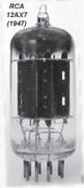
First Generation (cont…)
Application
Used for scientific applications as they were the fastest computing device of their time
Examples
Universal Automatic Computer (UNIVAC)
Electronic Numerical Integrator And Calculator (ENIAC)
Electronic Discrete Variable Automatic Computer (EDVAC).
Vacuum Tube

Slide 17
Second Generation (1956 to 1963): Using Transistors
Hardware Technology
Transistors replaced the vacuum tubes of the first generation of computers.
Used magnetic core technology for primary memory
Used magnetic tapes and magnetic disks for secondary storage
Input was still through punched cards and the output using printouts.
Concept of a stored program
Software Technology
Instructions were written using the assembly language.
Computing Characteristics
Computation time was in microseconds

Slide 18
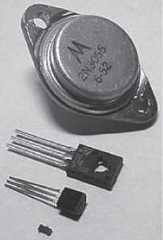
Second Generation (Cont…)
Physical Appearance
Due to the transistors, the size of computer was reduced as compare to first generation
Application
Cost was low as compared to the first generation
Transistors had to be assembled manually in second generation computers
Examples
PDP-8, IBM 1401 and CDC 1604
Transistor

Slide 19
Third Generation (1964 to 1971): Using Integrated Circuits
Hardware Technology
Used the Integrated Circuit (IC) Chips
An IC chip, multiple transistors are placed on a silicon chip
Use of IC chip increased the speed and the efficiency of computer
keyboard and monitor were used for Interaction instead of punch cards
Software Technology
Keyboard and the monitor were interfaced through the operating system
High-level languages were used extensively for programming
Computing Characteristics
Computation time was in nanoseconds

Slide 20
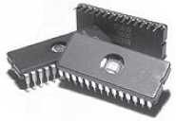
Third Generation (Cont…)
Physical Appearance
Small as compared to second generation
Application
Computers became accessible to mass audience
Examples
IBM 370, PDP 11
Integrated Circuits

Slide 21
Fourth Generation (1971 to present): Using Microprocessor
Hardware Technology
Used the LSI and VLSI technology
Microprocessor is a chip containing millions of transistors and components
Linking of computers is another key development of this era
Development of pointing devices like mouse, and handheld devices.
Software Technology
New operating systems like the MS-DOS and MS Windows developed
Support Graphical User Interface (GUI)
High-level programming languages are used for the writing of programs.
Computing Characteristics
Computation time was in picoseconds

Slide 22
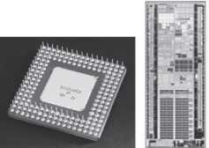
Fourth Generation (Cont…)
Physical Appearance
Smaller than previous generation
Applications
Widely available for commercial purposes
Personal computers became available to the home user
Examples
Intel 4004 chip was the first microprocessor
Microprocessor

Slide 23
Fifth Generation(Present to Next): Using Artificial Intelligence
Use Super Large Scale Integrated (SLSI) chips able to store millions of components on a single chip
Large memory requirements
Uses parallel processing (results in faster processing)
Artificial Intelligence includes areas like
Expert System (ES), Natural Language Processing (NLP), speech recognition, voice recognition, robotics, etc.

Slide 24
Classification of Computers
The digital computer are broadly classified into four categories:
Microcomputers
Minicomputers
Mainframe computers
Supercomputer
Classification of computers is based on size and type

Slide 25
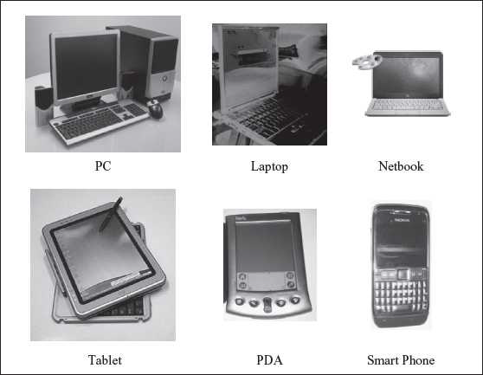
Micro Computers
Microcomputers are small, low-cost and single-user digital computer
consist of CPU, input unit, output unit, storage unit and the software
Examples:
Microcomputers include:
Desktop computers
Notebook computers
Laptop
Tablet computer
Handheld computer
Smart phones
Netbook

Slide 26
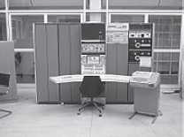
Mini Computers
Generally used in multi-user systems
High processing speed and high storage capacity than the microcomputers
Can support 4–200 users simultaneously
Users can access the minicomputer through their PCs or terminal
Used for real-time applications in industries, research centers, etc
Examples:
PDP
11, IBM (8000 series)

Slide 27
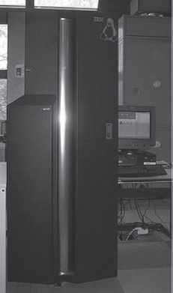
Mainframe Computers
Multi-user, multi-programming and high performance computers
Operate at a very high speed, have very large storage capacity
Generally used in centralized databases
User accesses the mainframe computer via a terminal
Used in organizations like banks or companies where
many people require frequent access to the same data
Examples:
CDC 6600 and IBM
ES000 series.

Slide 28
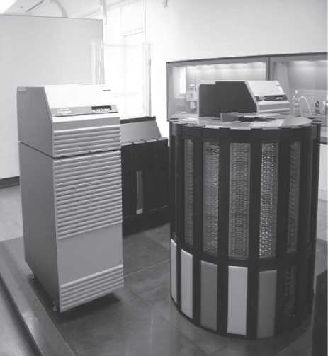
Super Computers
The fastest and the most expensive machines
Having high processing speed compared to other computers
Speed is generally measured in FLOPS (Floating point Operations Per Second)
Can perform trillions of calculations per second
Used for highly calculation-intensive tasks, such as, weather forecasting,
climate research (global warming), biological research, nuclear research and aircraft design.
Examples:
IBM Roadrunner
IBM Blue gene and
Intel ASCI red

Slide 29
Applications of Computer
Computers have proliferated into various areas of our lives
Education:
To prepare notes and presentations of their lectures
To provide distance education using the e-learning software
To conduct online examinations
Researchers use computers to get easy access to conference and journal

Slide 30
Applications of Computer (Cont…)
Entertainment:
User can download and view movies, play games, chat
Use multimedia for making movies, incorporate visual and sound effects
The users can also listen to music, download , create and share music
Medical:
Ultrasound, CT scan and MRI scan
Also provide assistance to the medical surgeons during critical surgery
Science and Engineering
Scientists and engineers use computers for performing complex scientific calculations
For designing and making drawings (CAD/CAM applications)

Slide 31
Applications of Computer (Cont…)
Government
E-governance
Different government departments provide information to the users through websites
Income tax return, paying taxes, online submission of water and electricity bills, for the access of land record details, etc
Police department uses computers to search for criminals using fingerprint matching etc

Slide 32
Summary
Computer
Data processing
Characteristic features of computers
Computers’ evolution to their present form
Computer generations
Characteristic features of each computer generation
Classification of Computers
Application of Computers

Slide 33
Key Words/Phrases
Computer
Computer generations
Computer Supported Cooperative Working (CSCW)
Data
Data processing
Data processor
First-generation computers
Fourth-generation computers
Garbage-in-garbage-out (GIGO)
Graphical User Interface (GUI)
Groupware
Information
Integrated Circuit (IC)
Large Scale Integration (VLSI)
Medium Scale Integration (MSI)
Microprocessor
Personal Computer (PC)
Second-generation computers
Small Scale Integration (SSI)
Stored program concept
Third-generation computers
Transistor
Ultra Large Scale Integration (ULSI)
Vacuum tubes

