Slide 1
IEEE 802.11
Wireless LAN

Slide 5
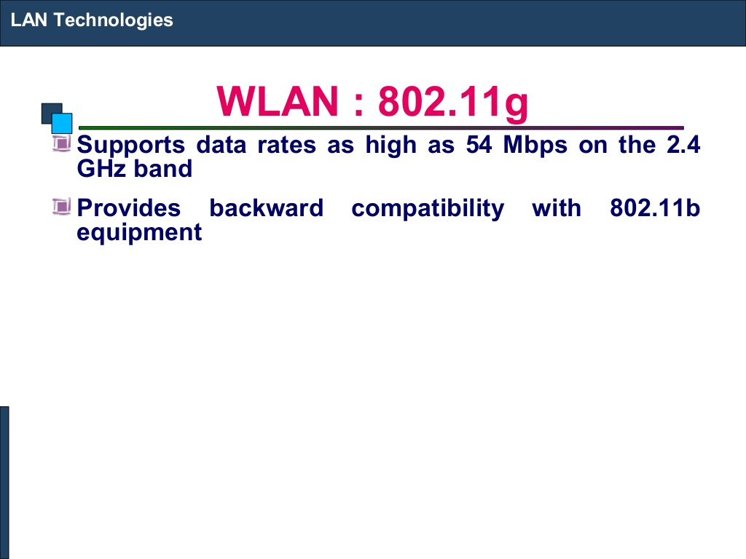

Slide 8
Topics to be covered
Physical Layer (PHY)
Medium Access Control Layer (MAC)
RTS/CTS
Authentication & Encryption
Operation Modes

Slide 9
Physical Layers (802.11)
IEEE 802.11 uses variety of PHY layers to increase the aggregate throughput of the network.
Three PHY layers:
1. FHSS (Frequency Hopping Spread Spectrum)
2. DSSS (Direct Sequence Spread Spectrum)
3. IR (Infrared)

Slide 10
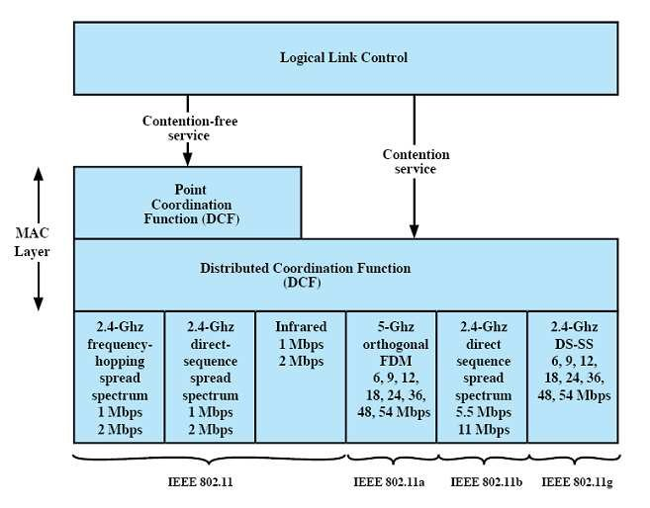

Slide 11
Medium Access Control Layer
MAC layer uses two techniques for communication.
Distributed Co-ordinated Function (DCF)
STA linked with AP, scans air for interface.
Collision can occur when multiple STA send data to AP, Carrier Sense Multiple Access/Collision Avoidance avoid collision.
Point Co-ordinated Function (PCF)
AP scans all STA in round robin fashion, see any STA wants to send packet.
Polling mechanism decreases throughput of IEEE 802.11

Slide 12
Request to Send/Clear to Send
In DCF while avoiding collision CSMA/CA get incorrect medium information called Hidden Node Problem.
If any of two STAs can’t directly communicate AP invoke RTS/CTS. Source STA issue RTS then destination STA issue CTS after that STA start data transmission.

Slide 13
Authentication & Encryption
Security is also handled in MAC layer.
WPA is an encryption mechanism used for unauthorized access from other STAs.
IEEE enhanced WPA with authentication methods e.g open standard, key authentication.
Management Frame
To manage and control 802.11 standard defines “Frames”
Security can be enhanced by providing data confidentiality of management frames.

Slide 14
Operating Modes
Supports two operating modes
Infrastructure Operating Mode
STAs communicate through AP, STA must be connected to AP in network
Independent Operating Mode
In Ad Hoc mode STA communicate directly with each other. Source STA link directly with destination STA.

Slide 15
IEEE 802.11n
IEEE 802.11o
IEEE 802.11p
IEEE 802.11r
IEEE 802.11s
IEEE 802.11t
IEEE 802.11u
IEEE 802.11v

