Slide 1
Graphics Hardware
Sanaa Jeehan
March 30th, 2020
7th Week

Slide 2
Colour Display Hardware - Raster
Each pixel composed of 3 phosphors
glow red, green, and blue
3 electron guns shoot their beams through a shadow mask
so beams hit the sensitive phosphors
Intensity of 3 beams determines how bright each phosphor glows
Human eye detects an additive color mix
e.g., max red, green, & blue perceived as white

Slide 3
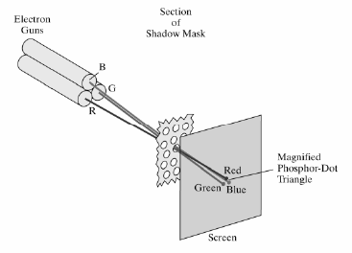
Colour Display Hardware - Raster

Slide 4
Direct Colour System
Frame buffer divided into bit planes
A bit plane contributes one bit to the color of each pixel on the screen
If resolution of the screen is W x H pixels:
a bit plane is a W x H x 1 bit memory
Bit planes can be organized into 3 sets
Each called a color channel: (R, G, B)
Bit planes of a color channel provide the intensity values fed to that channel’s electron gun
A system with N bit planes per color channel:
2^N red, 2^N green, & 2^N blue shades
2^3N different colors displayable simultaneously

Slide 5
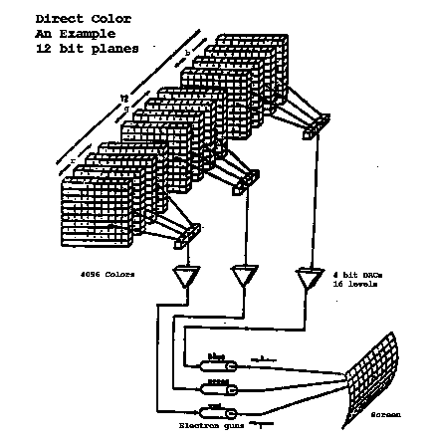

Slide 6
True Colour & High Colour Systems
True color: direct color system with: N=8
so 2^24 = 16,777,216 different colors possible for each pixel on screen
More colors than discernable by human eye
High color: direct color system with: Nr=5, Ng=6, Nb=5
2^16 = 65, 536 different colors possible

Slide 7
Indirect Colour System
Values stored in bit planes are indices into one or more color lookup tables (CLUTs)
CLUT stores R, G, B intensity values
# of bit planes determines # of colors displayable simultaneously on screen
width of CLUTs determines # of possible colors.

Slide 8
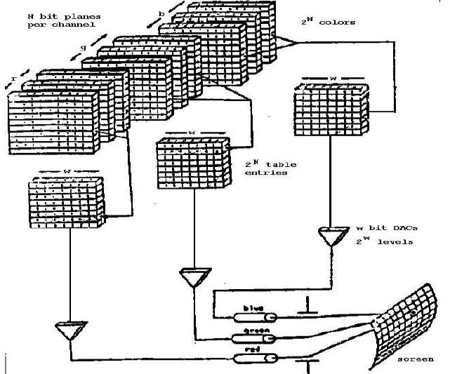

Slide 9
Indirect Colour System
If system has N bit planes per color channel
And each set of bit planes indexes a CLUT of width w,
Then number of entries in each CLUT = 2N
We say there are 23N colors displayable chosen from a total of 23w possible colors
Each set of 23N colors often called a palette
CLUTs often called palette registers

Slide 10
Indirect Colour System - Advantages
Wide CLUTs (large w) ==>huge number of possible colors
Modest # of bitplanes (small N) ==> VRAM not excessive in size
Also, number CLUT entries is modest
So we get lots of possible colors with relatively little memory expense
Fast animation for certain effects
just change contents of CLUTS

Slide 11
Indirect Colour System - Disadvantages
Ultimately number of colors on screen at any one time is limited by number of bit planes (N)
Even if there’s a large number of possible colors (large CLUT w), only a small fraction of them are usable at one time
So graphics applications must set up CLUTs with values corresponding to most frequently occurring colors in scene
Different scenes might require different combinations of colors in the CLUTs
Can be slower: 2nd memory access

Slide 12
Colour Graphics on a PC
Graphics capabilities depend on display adapter (video card) in the system
Historical development:
CGA (Color Graphics Adapter)
EGA (Enhanced Graphics Adapter)
VGA (Video Graphics Array)
Many different types of SVGA cards
Each display adapter can function in many different text and graphics modes
Backwards compatibility

Slide 13
Questions ???

