Slide 1
Graphics Hardware
Sanaa Jeehan
November 9th, 2020
6th Week

Slide 2
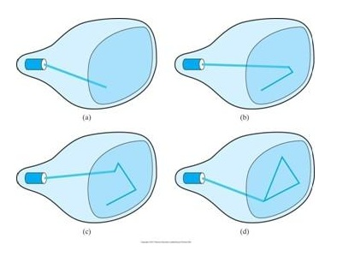
Vector Display
Also called random, stroke, calligraphic displays
Draw object by electron beam, beam can move in any direction

Slide 3
Vector Display
Early computer displays: basically an oscilloscope –Control X,Y with vertical/horizontal plate voltage
Often used intensity as Z
Refresh Buffer stores plotting commands
So Frame Buffer often called "Display File”
provides DPU with needed endpoint coordinates
Pixel size independent of frame buffer, provides very high resolution

Slide 4
Advantages of Vector Display
High resolution (good for detailed line drawings)
Crisp lines (no "jaggies")
High contrast (beam can dwell on a single point for some time ==> very bright)
Selective erase (remove commands from display file)
Animation (change line endpoints slightly after each refresh)

Slide 5
Disadvantages of Vector Display
Complex drawings can have flicker
Many lines
so if time to draw > refresh time ==> flicker
High cost--very fast deflection system needed
Hard to get colors
No area fill
so it’s difficult to use for realistic (shaded) images
1960s Technology, only used for special purpose stuff today

Slide 6
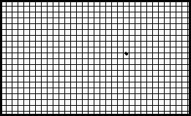
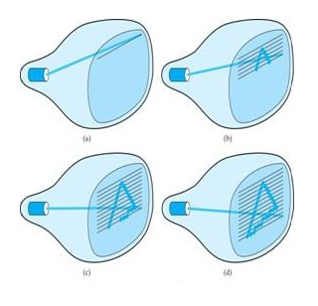
Raster Display
The screen is divided into lines, and each lines has many dots. The beam scans each line, the beam intensity is creased at a light dot
Raster: A rectangular array of points or dots
Scan line: A row of pixels
Resolution: number of pixels per scan line times the number of scan lines e.g. 640 X 480, 1024 X 768
Each Pixel on screen visited during each scan
Scan rate must be >= 30Hz to avoid flicker

Slide 7
Raster Display
Simplest system: one bit per pixel
frame buffer called a bitmap
Gray Scale: N bits/pixel
2^N intensities possible
memory intensive
Example:1000 X 1000 X 256 shades of gray ==> 8 Mbits

Slide 8
Advantages of Raster Display
Low cost (TV technology)
Area fill (entire screen painted on each scan)
Colors
Selective erase (just change contents of frame buffer)
Bright display, good contrast
but not as good as vector scan can be:
can’t make beam dwell on a pixel

Slide 9
Disadvantages of Raster Display
Large memory requirement for high resolution
(but cost of VRAM has decreased a lot!)
Aliasing (due to finite size of frame buffer)
Finite pixel size
Jagged lines (staircase effect)
Moire patterns, scintillation, "creep" in animations
Raster scan is the principal “now” technology for graphics displays!

Slide 10
Tektronix Direct View Storage Tube
1st "inexpensive" graphics display device
Extension of vector scan technique
Two electron guns
writing gun
flood gun

Slide 11
Tektronix Direct View Storage Tube
Writing gun beam knocks electrons out leaves + charges behind (constitute image)
Flood gun supplies continuous source of unfocused electrons
migrate toward the + charges on grid
pass through grid and strike screen phosphors
lighted dots
electrons continue to hit + charges
continuous light (Up to an hour)

Slide 12
Erasing a DVST Image
TWO Options
Plus charge applied to entire grid
Attracts electrons to entire grid
Entire screen flashes (Image gone)
Minus charge applied to entire grid
Provides electrons that can be knocked out by writing gun
Ready to draw next image with writing gun

Slide 13
Advantages of DVST
No refresh needed
unlimited image complexity possible
High resolution
Crisp lines
Low cost
no fast refresh circuitry needed

Slide 14
Disadvantages of DVST
No selective erase
whole image or nothing
No animation
Low light output
poor contrast
must use in subdued light
No color
No area fill

Slide 15
Interlaced Displays
All even then all odd screen lines scanned
Typically 1/60 second each
Same image presented twice in 1/30 second
Image changed at 1/2 non-interlaced frequency
less demands on image generation system
can be less expensive
30 Hz is borderline for flicker
lower quality image (seeing half the image at a time)

Slide 16
Colour Display Hardware - Raster
Each pixel composed of 3 phosphors
Red, green, and blue
All of them together form the required colour
3 electron guns shoot their beams through a shadow mask
so beams hit the sensitive phosphors
Intensity of 3 beams determines how bright each phosphor glows
Human eye detects an additive color mix
e.g., max red, green, & blue perceived as white

Slide 17
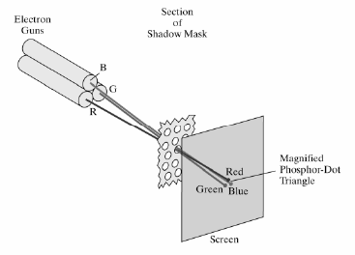
Colour Display Hardware - Raster

Slide 18
True Colour & High Colour Systems
True color: direct color system with 8 bits per colour (N=8)
so 2^24 = 16,777,216 different colors possible for each pixel on screen
More colors than discernable by human eye
High color: direct color system with: Nr=5, Ng=6, Nb=5
2^16 = 65, 536 different colors possible

Slide 19
Colour Graphics on a PC
Graphics capabilities depend on display adapter (video card) in the system
Historical development:
CGA (Color Graphics Adapter)
EGA (Enhanced Graphics Adapter)
VGA (Video Graphics Array)
Many different types of SVGA cards
Each display adapter can function in many different text and graphics modes
Backwards compatibility

