Slide 1
Computer Graphics
Sanaa Jeehan
October 12th, 2020
2nd Week

Slide 2
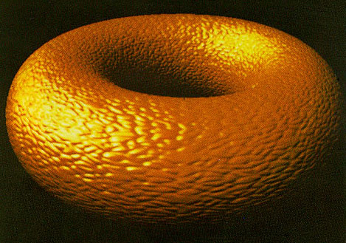
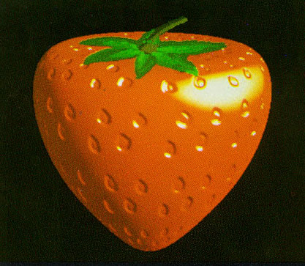
Early CG Techniques
Bump Mapping
Bump maps achieve this effect by changing how an illuminated surface reacts to light, without modifying the size or shape of the surface.
Early bump-mapped images (Blinn 1978)

Slide 3
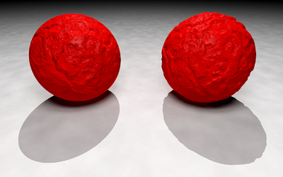
Techniques
Bump Mapping Drawback
Bump mapping is limited in that it does not modify the shape of the underlying object. On the left, a mathematical function defining a bump map simulates a crumbling surface on a sphere, but the object's outline and shadow remain those of a perfect sphere. On the right, the same function is used to modify the surface of a sphere by generating an isosurface. This models a sphere with a bumpy surface with the result that both its outline and its shadow are rendered realistically.

Slide 4
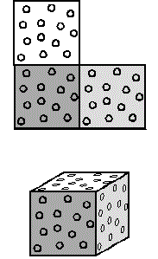
Texture Mapping
2-D surface, the texture map, is "wrapped around" a 3-D object, so the 3-D object acquires a surface texture similar to that of the 2-D surface. Texture mapping is the electronic equivalent of applying wallpaper, paint, or veneer to a real object.

Slide 5
Texture Mapping

Slide 6
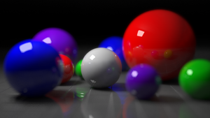
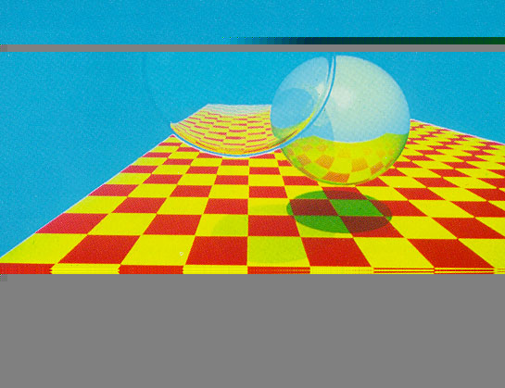
Ray Tracing
A technique for generating image by tracing the path of light as pixels in an image plane and simulating the effects of its encounters with virtual objects.
First ray traced image (Whitted 1980)

Slide 7
Graphics Applications
User Interfaces
Layout and Design
Scientific Visualization and Analysis
Art and Design
Medicine and Virtual Surgery
Layout Design & Architectural Simulations
History and cultural heritage
Entertainment
Simulations
Games

