Slide 1
Cloud Computing
Lecture 7

Slide 2
Today’s Lecture
Business Deployment Models
Services available for the customers
4 Models
Legal Aspects of Cloud
Security & Privacy

Slide 3
Available Services at the Cloud
There are four general types of service that are currently available from leading cloud providers
Elastic compute clusters which include a set of virtual instances that run a customer’s application code
Persistent storage services in which application or other data can be stored in a cluster
Intracloud networks, which connect an application’s components
Wide-area networks (WANs) connect the cloud data centres, where the application is hosted, with end hosts on the Internet

Slide 4
Available Services at the Cloud
So which type of Model should be chosen?
Can be decided only when we know our demand, and the delivered – in metrics
Performance, costs and availability might be some of the metrics for measuring the service provider’s solution of our demand

Slide 5
Deployment Models
There are four primary cloud deployment models :
Public Cloud
Private Cloud
Community Cloud
Hybrid Cloud

Slide 6
Public Cloud
By Definition
The cloud infrastructure is made available
to the general public or a large industry group
And is owned by an organisation selling cloud services
(Mell and Grance 2011)

Slide 7
Public Cloud
Group can be of any size
Key element: services are offered by the resource owner (the service provider) to anyone who wants to make use of that service (IaaS, PaaS or SaaS)
The service provider may charge, usually on a utility basis, but sometimes on a termly basis, or may give the service for free and earn revenue from other income streams, such as advertising
Basic characteristics :
Homogeneous infrastructure
Shared resources and multi-tenant
Leased or rented infrastructure

Slide 8
Public Cloud
Who is using Public Cloud?
Millions of people, including Us
Even if one uses Email only, when offered some other free services, who would say No!!!
We deduce that public cloud -based services are here to stay.
In 2011, a research was carried out to find whether corporations makes use of Public Cloud which said:
87% of the respondents indicated that they had no plans to use the public cloud for storageas-a-service . Only 10% said that they would use it.

Slide 9
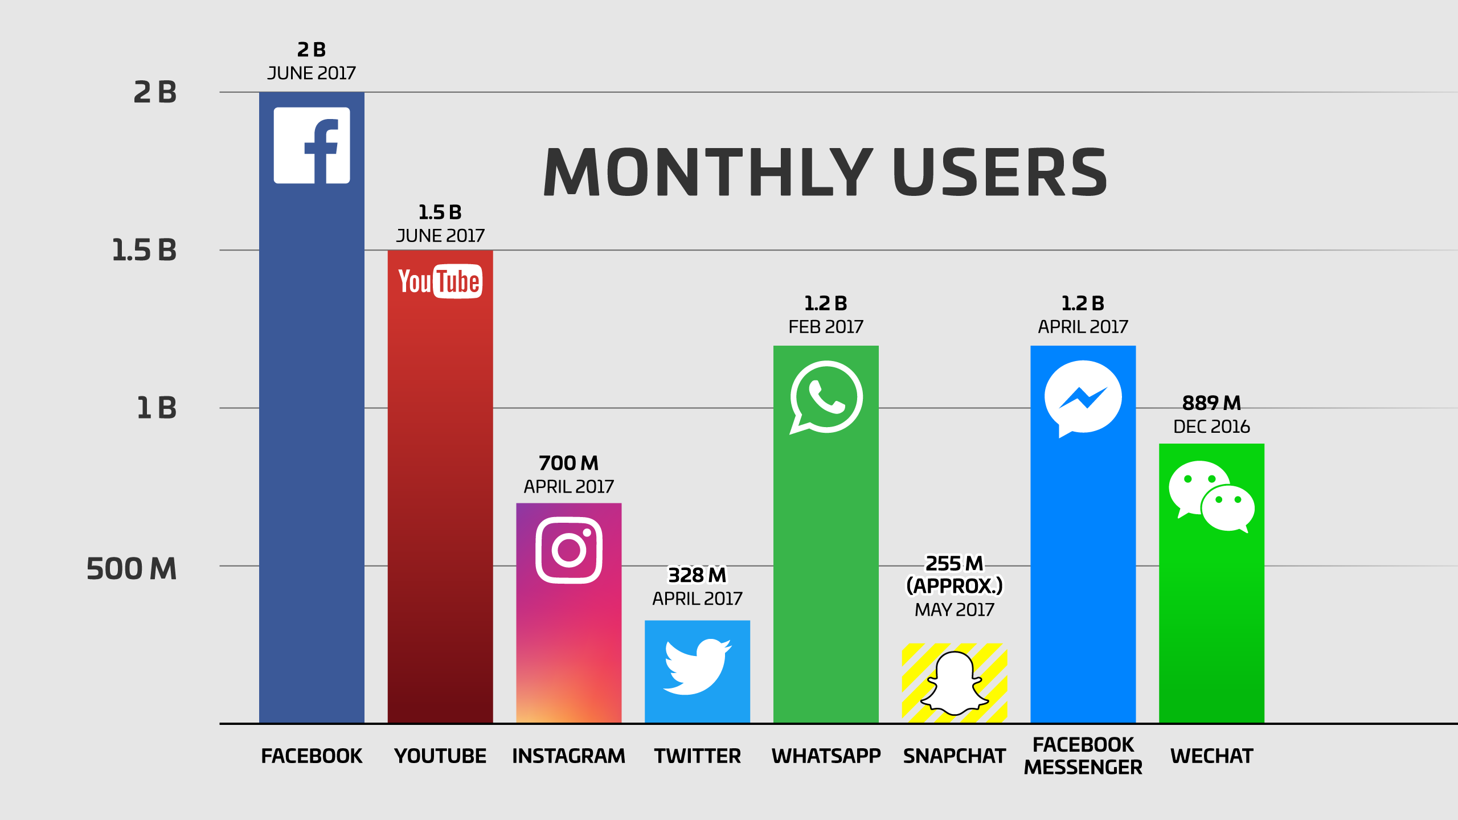

Slide 10
Public Cloud
Large corporations might not be interested because
They already have IT infrastructure installed
They might already have all the technical staff available
They might be very keen about the security and ownership issues of their data
Generally, Small to Medium Enterprises (SME) are interested in Public Cloud Usage
SME generally pays less attention to Disaster Recovery
Occasional Backup, long recovery process is normal
On Cloud, this Disaster Recovery can be very much easy and speedy
Automatic Backups, few fast speed data recovery steps

Slide 11
Private Cloud
Defined as
The cloud infrastructure is operated solely for an organisation. It may be managed by the organisation or a third party and may exist on premise or off premise
Also referred to as internal cloud or on-premise cloud, a private cloud intentionally limits access to its resources to service consumers that belong to the same organization that owns the cloud.
Basic characteristics :
Heterogeneous infrastructure
Dedicated resources
In-house infrastructure

Slide 12
Community Cloud
Community cloud definition
The cloud infrastructure is shared by several organizations and supports a specific community that has shared concerns (e.g., mission, security requirements).

Slide 13
Hybrid Cloud
Hybrid cloud definition
The cloud infrastructure is a composition of two or more clouds (private, community, or public) that remain unique entities
but are bound together by standardized or proprietary technology that enables data and application portability (e.g., cloud bursting for load-balancing between clouds).

Slide 14
Public Cloud Service Providers
Oracle
IBM
AT&T
Fujitsu,
Microsoft
HP
Rackspace
And many more !!!
Simply type private cloud supplier in a Google search, and (at the time of writing) 95 million hits are reported. There can be no doubt that the cloud market is well and truly active!

Slide 15
Legal Aspects of Cloud Computing
A Worldwide Issue
data may reside anywhere in the world
One suggestion is that international treaties allow the free movement of information across borders
Policing is difficult when the cybercrime is so international in nature
Currently, all we can be assure of are the following:
Availability of the service
Minimum performance benchmarks
Minimum help-desk response time

Slide 16
Security and Privacy
Suppliers of cloud infrastructure and services are not going to allow a perceived lack of security to prevent them from maximising profits.
McAfee ‘s Cloud Security Platform
Symantec’s Symantec.Cloud

