Slide 1
Basics of Circulatory System
By
Dr. Irfan Ali Khan

Slide 2
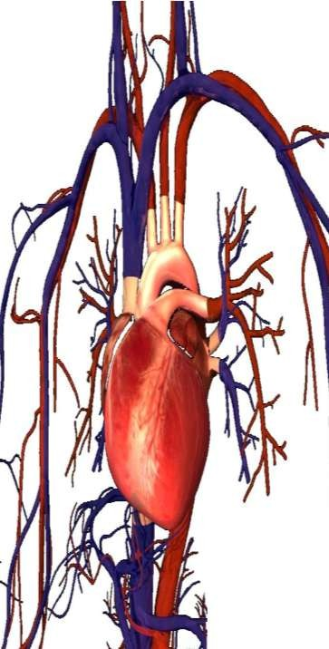
The Circulatory System is responsible for transporting materials throughout the entire body.
It transports nutrients, water, and oxygen to your billions of body cells and carries away wastes such as carbon dioxide that body cells produce.
It is an amazing highway that travels through your entire body connecting all your body cells.

Slide 3
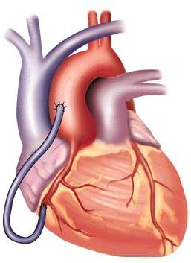
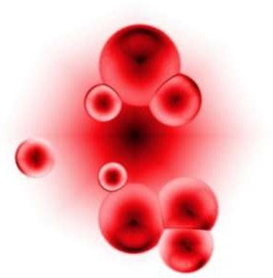
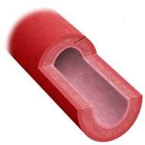
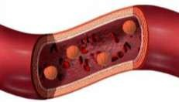
Components
Heart
Blood
Vessels
Arteries
Veins
Capillaries
Blood
Heart
Veins
Arteries

Slide 4
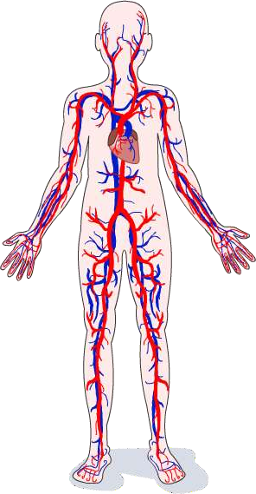
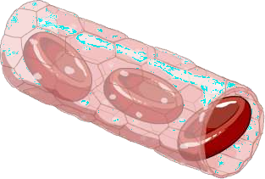
◻ Which gases are transported to and from the body’s cells by the blood flowing in the circulatory system?
carbon dioxide
oxygen
Oxygen is the gas needed for respiration and is
transported to the body’s cells.

Slide 5
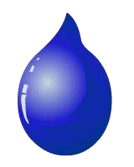
Oxygen-rich blood
◻ The circulatory system carries two types of blood
Oxygen-poor blood
Blood travelling to the body cells
High oxygen content
Low carbon dioxide content
Blood travelling
away from the body cells
Low oxygen content
High carbon dioxide content
◻ Arrangement of the circulatory system means that these two types of blood do not mix.

