Slide 1
Vessels,Arteries & Veins (Basics of Circulatory System).
By
Dr. Irfan Ali Khan

Slide 2
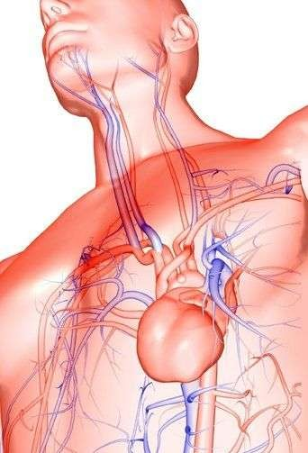
◻ As blood moves through the circulatory system it moves through 3 types of blood vessels:
Arteries: Carry blood away from the heart .
Capillaries: Link arterioles to veins.
Veins: Carry blood towards the heart

Slide 3
Arteries
❑ Large vessels
Carry blood from heart to tissues of body.
Carry oxygen rich blood, with the exception of pulmonary arteries.
Thick walls-need to withstand pressure produced when heart pushes blood into them.
Capillaries
Smallest blood vessels
Walls are only one cell thick and very narrow.
Important for bringing nutrients and oxygen to tissues and absorbing CO₂ and other waste products.

Slide 4
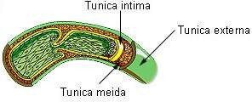
Once blood has passed through the capillary systems it must be returned to the heart. Done by veins
Walls contains connective tissue and smooth muscle.
Largest veins contain one way valves that keep blood flowing toward heart.
Many found near skeletal muscles. When muscles contract, blood is forced through veins.

Slide 5
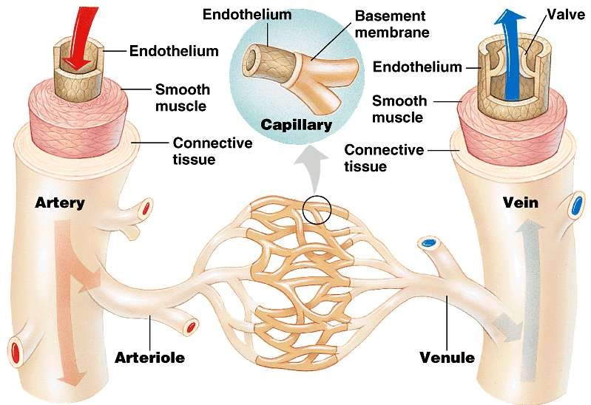

Slide 6
THE END

