Slide 1
Group Members: Muhammad Meelad Siddiqi (12753),Muhammad Tahsin Fida(6807)
Submitted To: Sir Zain Shaukat
Class: BS (SE)
Subject: Data Mining
Date: 12/05/2019
Topic: Association Rule Mining

Slide 2
In today’s topic we are going to discuss
Association Rule Mining
Applications Of association rule mining
Measures of Effectiveness of the Rule
Example Dataset

Slide 3
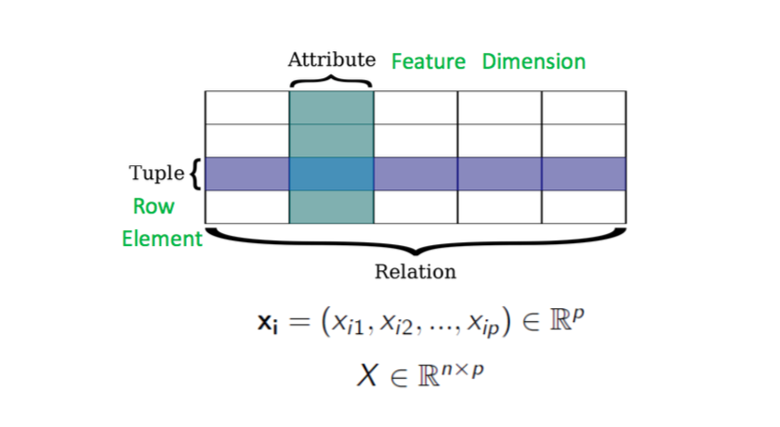
The data that we are going to deal with looks like this:

Slide 4
Association Rule Mining
Association Rule Mining is one of the ways to find patterns in data.
It finds:
features (dimensions) which occur together
features (dimensions) which are “correlated”
What does the value of one feature tell us about the value of another feature? For example, people who buy diapers are likely to buy baby powder. Or we can rephrase the statement by saying: If (people buy diaper), then (they buy baby powder). Note the if, then rule. This does not necessarily mean that if people buy baby powder, they buy diaper. In General, we can say that if condition A tends to B it does not necessarily mean that B tends to A. Watch the directionality!

Slide 5
Applications Of association rule mining
We can use Association Rules in any dataset where features take only two values i.e., 0/1. Some examples are listed below:
Market Basket Analysis is a popular application of Association Rules.
People who visit webpage X are likely to visit webpage Y
People who have age-group [30,40] & income [>$100k] are likely to own home
Notes:
Market Basket Analysis is a modelling technique based upon the theory that if you buy a certain group of items, you are more (or less) likely to buy another group of items.

Slide 6
Measures of Effectiveness of the Rule
The measures of effectiveness of the rule are as Follows:
Support
Confidence
Lift
Others: Affinity, Leverage
We are going to discuss Support and Confidence in more detail using an example dataset.

Slide 7
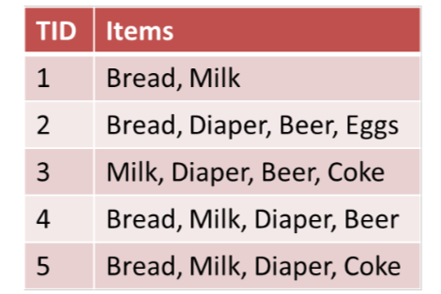
Example Dataset

Slide 8
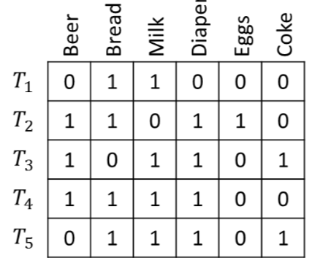
The previous dataset can also be represented like this:

Slide 9
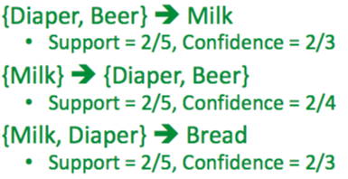
Support means how much a certain item occurs in a dataset and Confidence is an indication of how often the rule has been found to be true.
Support can be calculated as the as the proportion of transactions in the dataset which contains the item set
Among rows containing A, Confidence is the fraction of rows containing B or conditional probability of B given A. With respect to a set of transactions it is the proportion of the transactions that contains the item set which also contains the successor item.

Slide 10
Lift is the ratio Confidence is to Support. If the lift is < 1, then A and B are negatively correlated else if the lift is > 1, then positively correlated and if it is equal to 1 it is not correlated.
Lift = Confidence : Support
= Confidence/Support

Slide 11
Thank You!
Any Questions?

