Slide 1
Agile Methodology
Name:- Sharoon Jan
Subject:- SDA
ID:- 12779

Slide 2
Content:-
Definition.
What is Agile.
Principals.
Characteristics.
Why Organizations Implement Agile.

Slide 3
1
Definition:-
Agile is a software development methodology to build software incrementally using short iterations of 1 to 4 weeks so that development
is aligned with the changing business needs.
Notes:
Incrementall :- little parts are added each time
Iteration: - divided into smaller chunks short iteration 1 to 4 weeks.

Slide 4
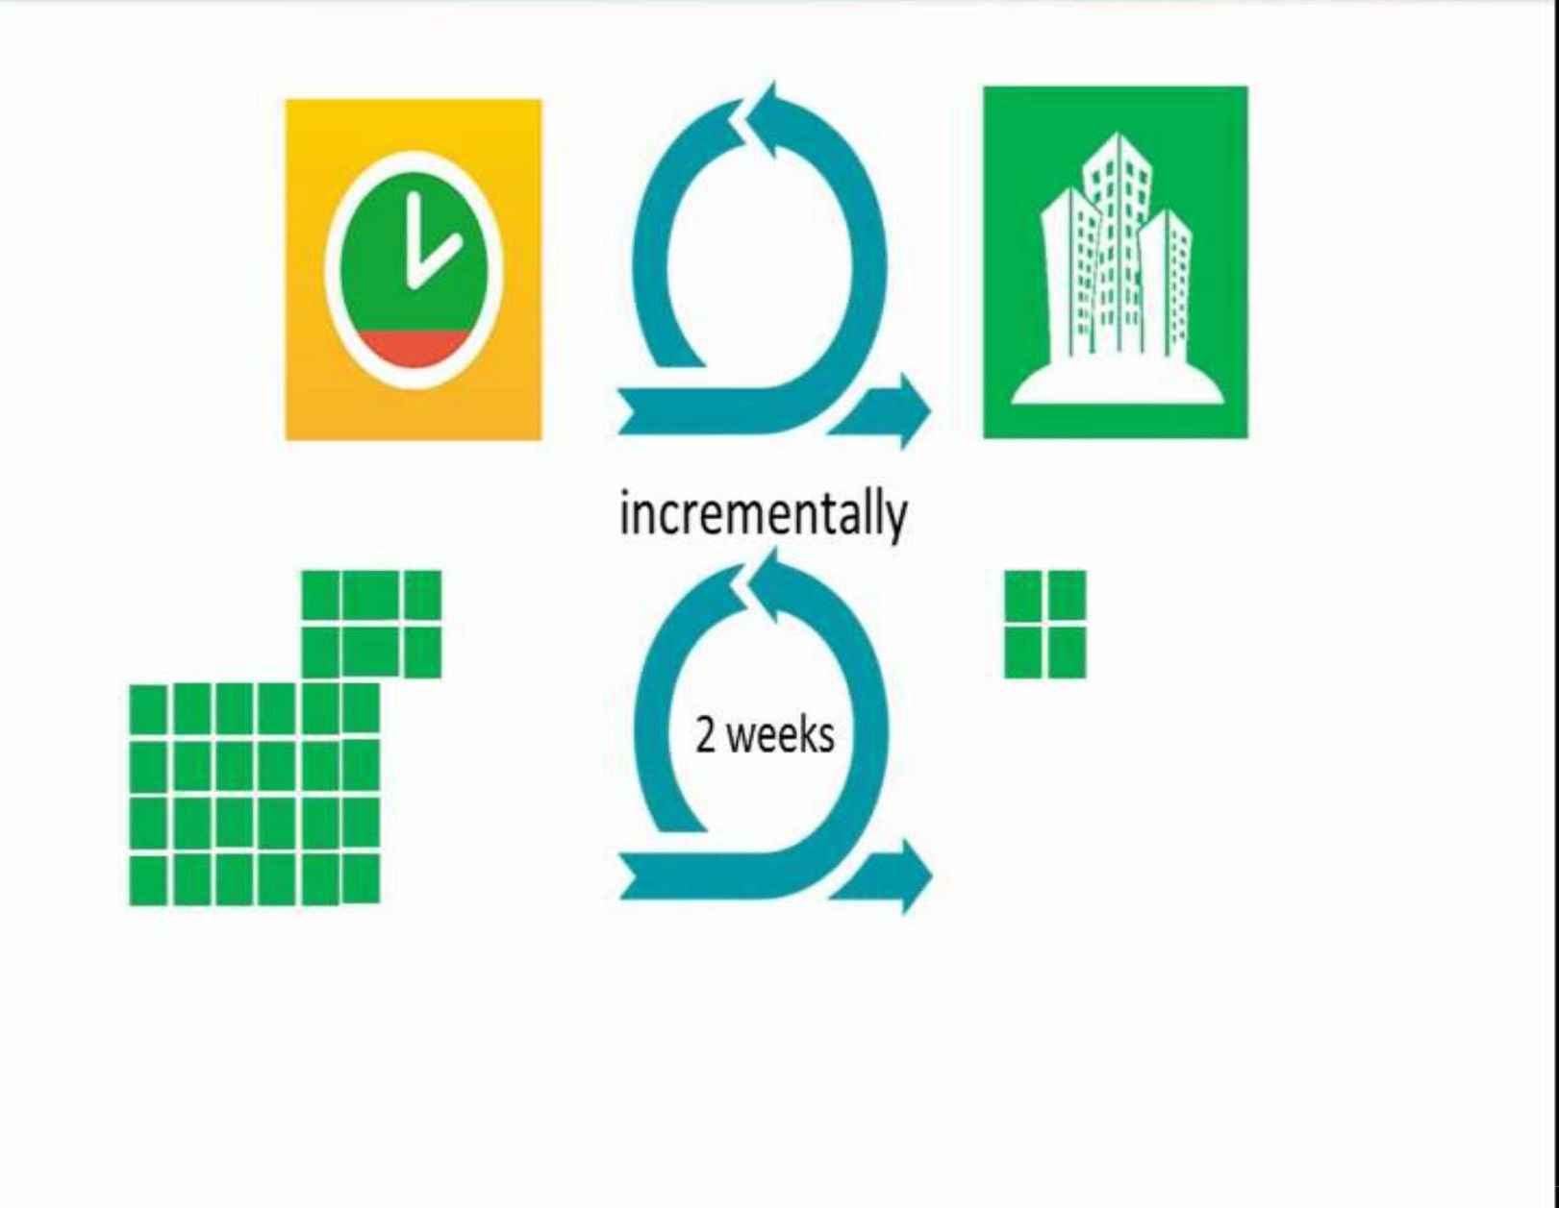
2
What is Agile?

Slide 5
3

Slide 6
4

Slide 7
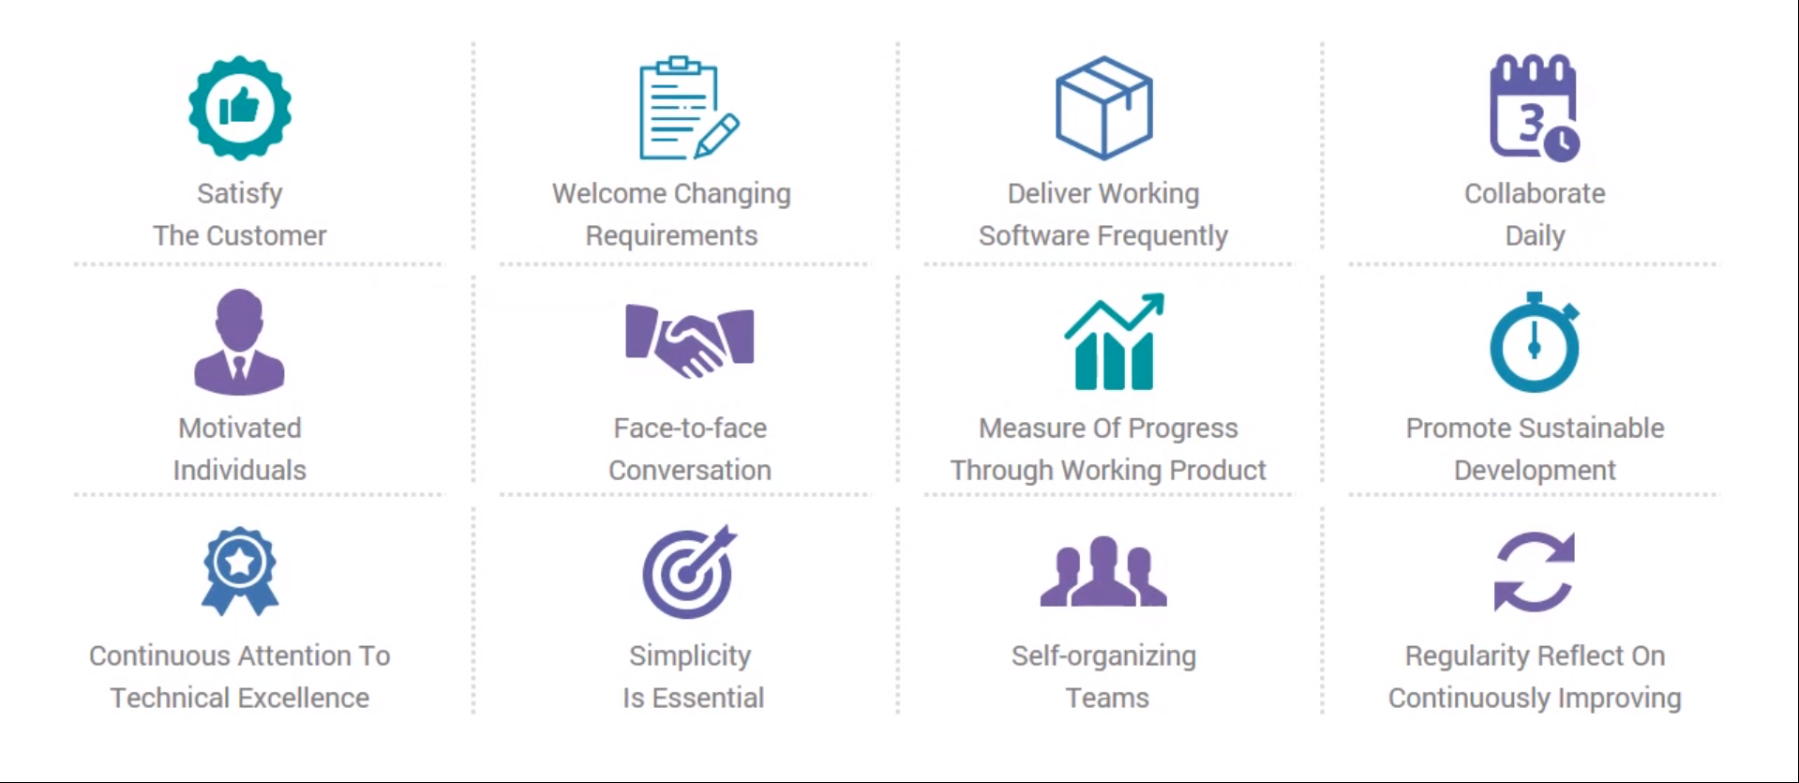
5
Principals

Slide 8
6
Characteristics
Light Weighted methodology
Small to medium sized teams
Changing requirements
Changing techniques
Simple design
Minimal system into production

Slide 9
7

Slide 10
Any Questions?
.

Slide 11
.
THANKYOU

