Slide 1
Lecture 12 Artificial Intelligence (CSC-320)
Muhammad Arshad, Ph. D
Assistant Professor, Dept of Computer Sciences, CUSIT

Slide 2
In Previous Lecture
Reasoning
Intro to Expert Systems (ES)

Slide 3
In today’s Lecture
Expert System (ES)

Slide 4
Miscellaneous Applications
Weather Forecasting
Aircraft identification
Battlefield Management
And much more

Slide 5
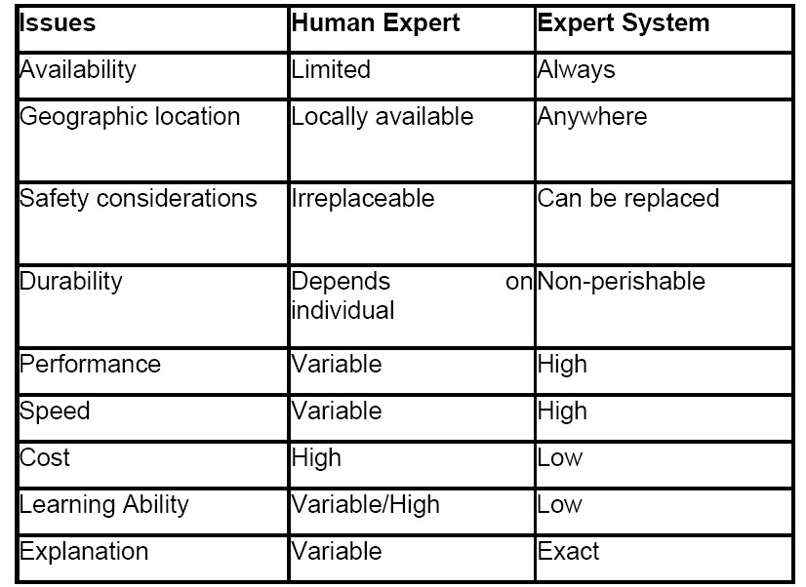
Human versus Computer ES

Slide 6
Benefits of Expert Systems
Assist non experts to use the experience of experts
Improve productivity
Save time by accomplishing tasks more fast and efficiently
Simplify operations
Automate repetitive, tedious and complex tasks

Slide 7
Benefits over conventional software
Permits new kinds of problems to be solved thereby making the computer more useful
Independent of expert
Sometimes it is more economical

Slide 8
A look on downside
ES development is an uphill
They are expansive
Hardware requirement is expansive
They are not 100 % reliable

Slide 9
Standalone vs. Embedded systems
In standalone systems the computer is only dedicated to the Expert system running on it
In embedded systems Expert system is just a portion of another larger program

Slide 10
USER
USER
INTERFACE
Working of ES
INFERENCE ENGINE
Rule Interpreter
Control Strategy
KNOWLEDGE
BASE
Rules or
Frames or
Semantic Nets
DATABASE
System Status
Initial States
Present state
Facts

Slide 11
The Knowledge base
Heart of an ES
Part of the expert system that contain domain knowledge and that domain knowledge may be.
Problem Facts, Rules
Concepts.
Relationship
The person who will develop the knowledge base are called as knowledge engineer.
We have to get knowledge from the experts and encode it in the knowledge base.
One way of knowledge encoding is in the form of IF-THEN rules and is used for reasoning purpose.
Also referred as Long Term Memory.

Slide 12
Working memory
Part of the experts system that contains the problem facts that are discovered during session. For example in medical expert system one patient consultation (session) will be stored in short term memory or in working memory.

Slide 13
Expert System
Production rules are flexible
Parts of a rule are premise and conclusion
When if part holds true rule is said to be triggered
If then is executed rule is said to be fired

Slide 14
An example of production rules
IF the animal lives in water
AND the animal breather water
THEN animal is a fish, CF 1.0
Other representations
Key benefit of rules
IF the patient has frequent headaches
AND the patient has blurred distance vision
THEN the patient needs glasses, CF .8
IF the client is losing more than 20% of gross income to taxes
OR the client is looking for a tax free investment
THEN the client should have tax shelter, CF .9

Slide 15
The Data Base
Sometimes called global database
It keeps track of the current status of the problem being solved
The status of the database keeps on updating as the rules are fired

Slide 16
The Inference Engine
The Inference Engine work with the Knowledge base and the working memory and draw on both to add new fact to working memory.
Select/Pick the rule and match with facts.
It implements a search and pattern matching operation using different Algorithms.
Also called rule interpreter, inside Long Term Memory rules are present.
Is also a controlling mechanism between the facts and the knowledge base and is working in repetitive order.
The aim of IE is hypothesis proving as shown in next slide example.

Slide 17
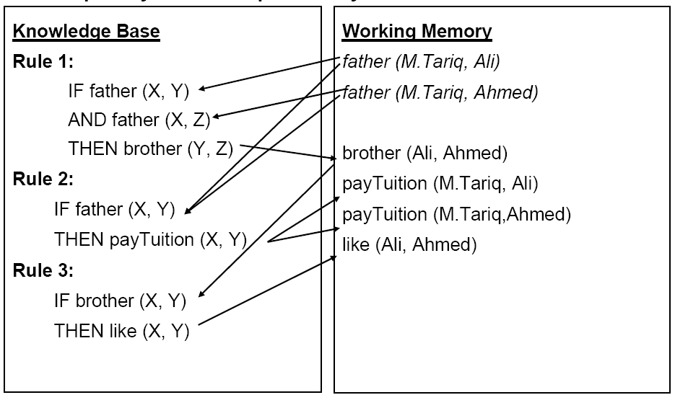

Slide 18
Example Explanation
Inference Engine has add new rule in working memory i.e. brother (Ali, Ahmed) e.t.c. generated from already present rules/facts.

Slide 19
Explanation Facility
Module of an Expert System that allows Transparency of operation, by providing an explanation of how the Inference Engine reached the conclusion.

Slide 20
End of Today’s Lecture

