Slide 1
Lecture 5 Artificial Intelligence (CSC-320)

Slide 2
Beam Search
You just saw how hill climbing procedure works through the search space of a tree. Another procedure called beam search proceeds in a similar manner. Out of n possible choices at any level, beam search follows only the best k of them; k is the parameter which we set and the procedure considers only those many nodes at each level.
The following sequence of diagrams will show you how Beam Search works in a search tree.
We start with a search tree with L as goal state and k=2, that is at every level we will only consider the best 2 nodes. When standing on S we observe that the only
two nodes available are A and B so we explore both of them as shown below.

Slide 3
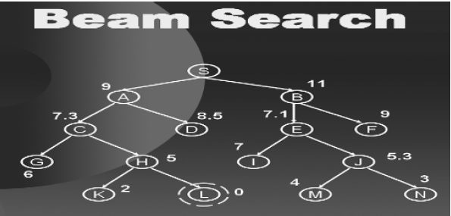
Beam Search

Slide 4
Best First Search
Just as beam search considers best k nodes at every level, best first search considers all the open nodes so far and selects the best amongst them.
Best first search is a greedy approach will looks for the best amongst the available options and hence can sometimes reduce the searching time.
All these heuristically informed procedures are considered better but they do not guarantee the optimal solution, as they are dependent on the quality of heuristic being used.

Slide 5
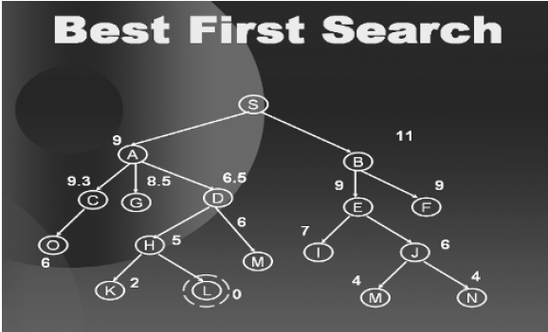
Best First Search

Slide 6
Optimal Searches
So far we have looked at uninformed and informed searches. Both have their advantages and disadvantages. But one thing that lacks in both is that whenever they find a solution they immediately stop.
They never consider that their might be more than one solution to the problem and the solution that they have ignored might be the optimal one.
A simplest approach to find the optimal solution is this; find all the possible solutions using either an uninformed search or informed search and once you have searched the whole search space and no other solution exists, then choose the most optimal amongst the solutions found.
This approach is analogous to the brute force method and is also called the British museum procedure.

Slide 7
Optimal Searches
But in reality, exploring the entire search space is never feasible and at times is not even possible, for instance, if we just consider the tree corresponding to a game of chess (we will learn about game trees later), the effective branching factor is 16 and the effective depth is 100. The number of branches in an exhaustive survey would be on the order of 10¹²⁰.
Hence a huge amount of computation power and time is required in solving the optimal search problems in a brute force manner.

Slide 8
Branch and Bound
In order to solve our problem of optimal search without using a brute force technique, people have come up with different procedures. One such procedure is called branch-and-bound method.

Slide 9
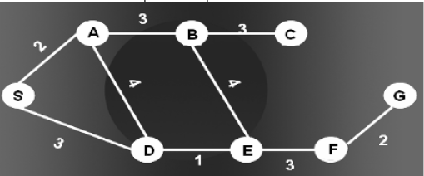
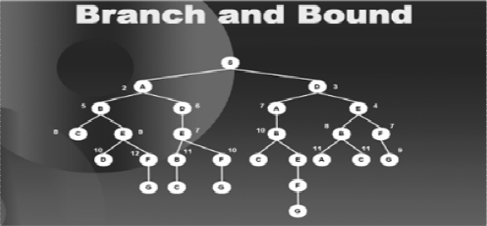
Branch and Bound

Slide 10
Improvements in Branch and Bound
The above procedure can be improved in many different ways. We will discuss the two most famous ways to improve it.
1. Estimates
2. Dynamic Programming
The idea of estimates is that we can travel in the solution space using a heuristic estimate. By using “guesses” about remaining distance as well as facts about distance already accumulated we will be able to travel in the solution space more efficiently. Hence we use the estimates of the remaining distance. A problem here is that if we go with an overestimate of the remaining distance then we might loose a solution that is somewhere nearby. Hence we always travel with underestimates of the remaining distance.
The second improvement is dynamic programming. The simple idea behind dynamic programming is that if we can reach a specific node through more than one different path then we shall take the path with the minimum cost.

Slide 11
End of Today’s Lecture

