Slide 1
Lecture 5 Artificial Intelligence (CSC-320)

Slide 2
In Previous Lecture
Searching
Tree and Graphs Terminology
Search Strategies
Simple Search Algorithm
Depth First Search
Breadth First Search

Slide 3
In today’s Lecture
Heuristically Informed Searches

Slide 4
Heuristically Informed Searches
So far we have looked into procedures that search the solution space in an uninformed manner. Such procedures are usually costly with respect to either time, space or both.
We now focus on a few techniques that search the solution space in an informed manner using something which is called a heuristic. Such techniques are called heuristic searches.
The basic idea of a heuristic search is that rather than trying all possible search paths, you try and focus on paths that seem to be getting you closer to your goal state using some kind of a “guide”.
Of course, you generally can't be sure that you are really near your goal state. However, we might be able to use a good guess for the purpose.
Heuristics are used to help us make that guess. It must be noted that heuristics don’t always give us the right guess, and hence the correct solutions. In other words educated guesses are not always correct.

Slide 5
Heuristically Informed Searches
Recall the example of the mouse searching for cheese. The smell of cheese guides the mouse in the maze, in other words the strength of the smell informs the mouse that how far is it from the goal state.
Here the smell of cheese is the heuristic and it is quite accurate.
Similarly, consider the diagram below. The graph shows a map in which the numbers on the edges are the distances between cities, for example, the distance between city S and city D is 3 and between B and E is 4.

Slide 6
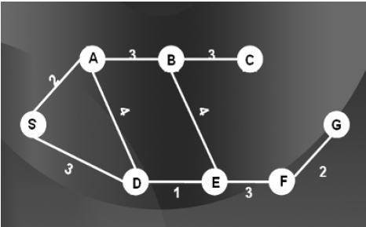
Heuristically Informed Searches

Slide 7
Heuristically Informed Searches
Suppose our goal is to reach city G starting from S. There can be many choices, we might take S, A, D, E, F, G or travel from S, to A, to E, to F, and to G.
At each city, if we were to decide which city to go next, we might be interested in some sort of information which will guide us to travel to the city from which the distance of goal is minimum.
If someone can tell us the straight-line distance of G from each city then it might help us as a heuristic in order to decide our route map.
Consider the graph below. It shows the straight line distances from every city to the goal. Now, cities that are closer to the goal should be our preference.
These straight line distances also known as “as the crow flies distance” shall be our heuristic.

Slide 8
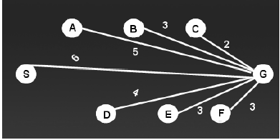
Heuristically Informed Searches

Slide 9
Heuristically Informed Searches
It is important to note that heuristics can sometimes misguide us. In the example we have just discussed, one might try to reach city C as it is closest from the goal according to our heuristic, but in the original map you can see that there is no direct link between city C and city G. Even if someone reaches city C using the heuristic, he won’t be able to travel to G from C directly, hence the heuristic can misguide. The catch here is that crow-flight distances do not tell us that the two cities are directly connected.
Similarly, in the example of mouse and cheese, consider that the maze has fences fixed along some of the paths through which the smell can pass. Our heuristic might guide us on a path which is blocked by a fence, hence again the heuristic is misguiding us.

Slide 10
Heuristically Informed Searches
The conclusion then is that heuristics do help us reduce the search space, but it is not at all guaranteed that we’ll always find a solution. Still many people use them as most of the time they are helpful.
The key lies in the fact that how do we use the heuristic. Consider the notion of a heuristic function. Whenever we choose a heuristic, we come up with a heuristic function which takes as input the heuristic and gives us out a number corresponding to that heuristic.
The search will now be guided by the output of the heuristic function.
Depending on our application we might give priority to either larger numbers or smaller numbers. Hence to every node/ state in our graph we will assign a heuristic value, calculated by the heuristic function. We will start with a basic heuristically informed search which is called Hill Climbing.

Slide 11
BREAK

