Slide 1
Lecture 4 Artificial Intelligence (CSC-320)

Slide 2
In Previous Lecture
Applications of AI
Problem Solving
Classical Approach in Problem Solving
Generate and Test
Problem Representation

Slide 3
In today’s Lecture
Searching
Tree and Graphs Terminology
Search Strategies
Simple Search Algorithm
Depth First Search
Breadth First Search

Slide 4
Searching
All the problems that we have looked at can be converted to a form where we have to start from a start state and search for a goal state by traveling through a solution space. Searching is a formal mechanism to explore alternatives.
Most of the solution spaces for problems can be represented in a graph where nodes represent different states and edges represent the operator which takes us from one state to the other. If we can get our grips on algorithms that deal with searching techniques in graphs and trees, we’ll be all set to perform problem solving in an efficient manner.

Slide 5
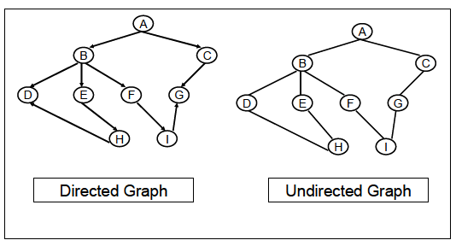
Tree and Graphs Terminology
Before studying the searching techniques defined on trees and graphs let us briefly review some underlying terminology.
The diagram just to refresh your memories on the terminology of a tree. As for graphs, there are undirected and directed graphs which can be seen in the diagram.

Slide 6
Search Strategies
Search strategies and algorithms that we will study are primarily of four types,
blind/uninformed,
informed/heuristic,
any path/non-optimal and
optimal path
search algorithms. We will discuss each of these using the same mouse example.
Suppose the mouse does not know where and how far is the cheese and is totally blind to the configuration of the maze.
The mouse would blindly search the maze without any hints that will help it turning left or right at any junction.
The mouse will purely use a hit and trial approach and will check all combinations till one takes it to the cheese. Such searching is called blind or uninformed searching.

Slide 7
Search Strategies .. Cont’d
Consider now that the cheese is fresh and the smell of cheese is spread through the maze. The mouse will now use this smell as a guide, or heuristic (we will comment on this word in detail later) to guess the position of the cheese and choose the best from the alternative choices. As the smell gets stronger, the mouse knows that the cheese is closer. Hence the mouse is informed about the cheese through the smell and thus performs an informed search in the maze.
For now you might think that the informed search will always give us a better solution and will always solve our problem. This might not be true as you will find out when we discuss the word heuristic in detail later.

Slide 8
Search Strategies .. Cont’d
When solving the maze search problem, we saw that the mouse can reach the cheese from different paths.
In any-path/non optimal searches we are concerned with finding any one solution to our problem. As soon as we find a solution, we stop, without thinking that there might as well be a better way to solve the problem which might take lesser time or fewer operators.
Contrary to this, in optimal path searches we try to find the best solution.
Hence in optimal searches we find solutions that are least costly, where cost of the solution may be different for each problem.

Slide 9
Simple Search Algorithm
Let us now state a simple search algorithm that will try to give you an idea about the sort of data structures that will be used while searching, and the stop criteria for your search.
The strength of the algorithm is such that we will be able to use this algorithm for both Depth First Search (DFS) and Breadth First Search (BFS).

Slide 10
Simple Search Algorithm ... Cont’d
Let S be the start state
1. Initialize Q with the start node Q=(S) as the only entry; set Visited = (S)
2. If Q is empty, fail. Else pick node X from Q
3. If X is a goal, return X, we’ve reached the goal
4. (Otherwise) Remove X from Q
5. Find all the children of state X not in Visited
6. Add these to Q; Add Children of X to Visited
7. Go to Step 2

Slide 11
Simple Search Algorithm ... Cont’d
Here Q represents a priority queue. The algorithm is simple and doesn’t need much explanation. We will use this algorithm to implement blind or uninformed searches.
The algorithm however can be used to implement informed searches as well. The critical step in the Simple Search Algorithm is picking of a node X from Q according to a priority function. Let us call this function P(n). While using this algorithm for any of the techniques, our priority will be to reduce the value of P(n) as much as we can. In other words, the node with the highest priority will have the smallest value of the function P(n) where n is the node referred to as X in the algorithm.

Slide 12
Simple Search Algorithm Applied to Depth First Search
As mentioned previously we will give priority to the element with minimum P(n) hence the node with the largest value of height will be at the maximum priority to be picked from Q. The following sequence of diagrams will show you how DFS works on a tree using the Simple Search Algorithm.

Slide 13
Simple Search Algorithm Applied to Depth First Search
We start with a tree containing nodes S, A, B, C, D, E, F, G, and H, with H as the goal node. In the bottom left table we show the two queues Q and Visited.
According to the Simple Search Algorithm, we initialize Q with the start node S, shown below.

Slide 14
Simple Search Algorithm Applied to Depth First Search
If Q is not empty, pick the node X with the minimum P(n) (in this case S), as it is the only node in Q. Check if X is goal, (in this case X is not the goal). Hence find all the children of X not in Visited and add them to Q and Visited. Go to Step 2.
Again check if Q is not empty, pick the node X with the minimum P(n) (in this case either A or B), as both of them have the same value for P(n). Check if X is goal, (in this case A is not the goal). Hence, find all the children of A not in Visited and add them to Q and Visited. Go to Step 2.
Here, from the 5th row of the table when we remove H and check if it’s the goal, the algorithm says YES and hence we return H as we have reached the goal state. The path followed by the DFS is shown by green arrows at each step. The diagram below also shows that DFS didn’t have to search the entire search space, rather only by traveling in half the tree, the algorithm was able to search the solution.

Slide 15
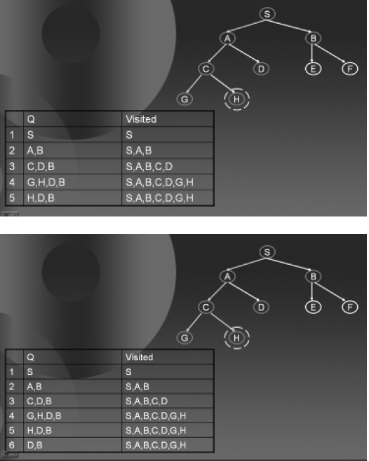
Simple Search Algorithm Applied to Depth First Search

Slide 16
Watch to Understand

Slide 17
Breadth First Search
Do it yourself
In the Form of Assignment

Slide 18
End of Today’s Lecture

