Slide 1
DOCTOR AND PATIENT RELATIONSHIP
Shahzad Anwar

Slide 2
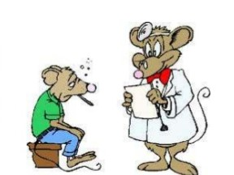
Definition
The interaction established between physician and patient to return to health, relieve patient’s suffering and prevent illness.

Slide 3
Importance
The quality of doctor-patient relationship is important for both parties (physician and patient).
A strong relationship between doctor and patient will lead to collection of maximum and quality information about the patient’s disease and better health care for patient and their family.

Slide 4
Types of DPR
Paternalistic
Default
Consumerist
Mutuality

Slide 5
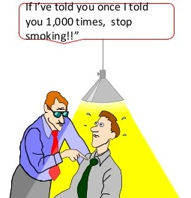
Paternalistic
It refers to the interaction in which decision is taken by the health care professional in order to benefit the patients.
Doctor acts as a father
Patient accepts that paternal role
of doctor and follows his guideline.

Slide 6
Default
That type of DPR in which doctor and patient both are passive
Patient is fearful in adopting a participative role
Lack of sufficient direction in consultation from doctor

Slide 7
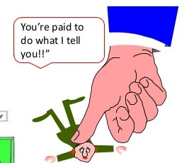
Consumerist
That type of interaction in which patient is active and takes decision, while doctor is passive
Doctor follows the patient’s opinions
Patient reduces doctor’s control

Slide 8
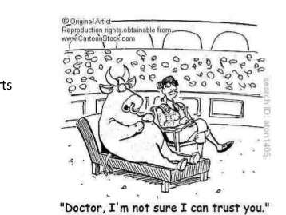
Mutuality
Mutual relation between doctor and patient
Meetings between understanding parties
Both are equal partners
Exchange of ideas

Slide 9
Types of Relationships
Types | Physician control (low) | Physician’s control (high)
Patient control (low) | default | paternalism
Patient’s control (high) | consumerism | mutuality

Slide 10
Doctor’s Expectations
Doctor expects from patient….
Reality / Truth
Trust
Respect
To be listened to
To obey the rules

Slide 11
Patient’s Expectations
Patient expects from doctor…
To be listened to
Acceptance / Sympathy
Honesty
Treatment / Cure
Medication

Slide 12
If patient’s expectations are not met…
Patient may….
Lose trust
Become depressed / angry
Not follow advice
Refuse to take medication or treatment process
Find another doctor

Slide 13
If doctor’s expectations are not met…
Doctor may…
Become annoyed / frustrated
Refuse to see that patient again
Not listen properly or ignores that patient
Refer to another doctor

Slide 14
Boundaries in DPR
Assignment
Boundaries in doctor-patient relationship
Boundaries of doctor
Boundaries of patient

Slide 15
Thank You

