Slide 1
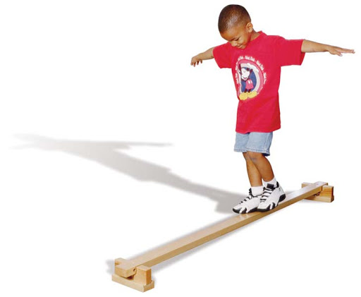
Balance & Coordination
Dr. M.Jaffar PT
Dpt (NCS,KMU)
MSNMPT*(RIU

Slide 2
Lecture Outline
Assessment of Coordination
Balance assessment

Slide 3
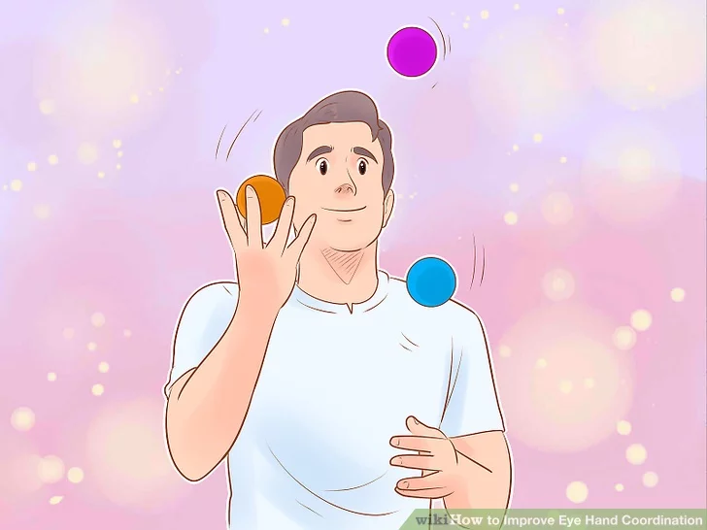
Coordination
“Execute smooth, accurate and controlled motor response”
The ability to use different parts of the body together smoothly and efficiently
The purpose of the coordination examination
Timing , sequence, Speed and Rhythm
Muscle activity
Ability of muscle or group to work together
Level of skills
Ability to initiate , control and
terminate movement
Effects of interventions

Slide 4
Cerebellum
Basal ganglia
Gross motor
Fine motor
Before assessing coordination
Motor control
Sensation

Slide 5
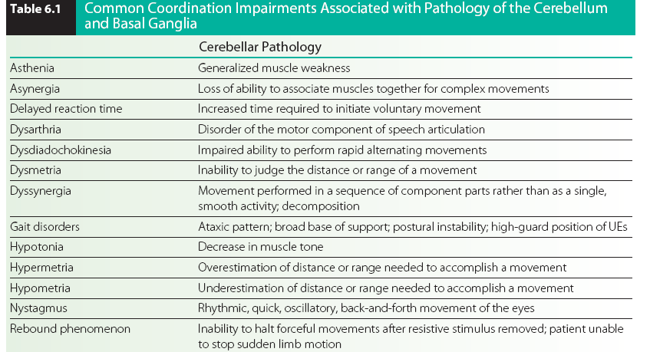

Slide 6
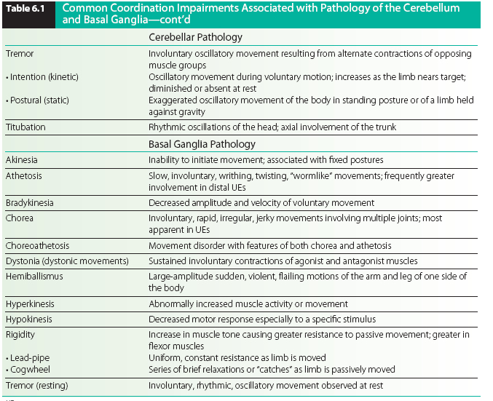

Slide 8
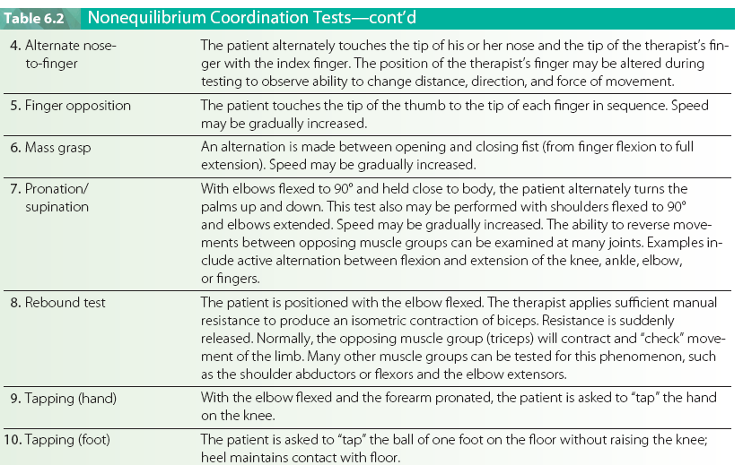

Slide 9
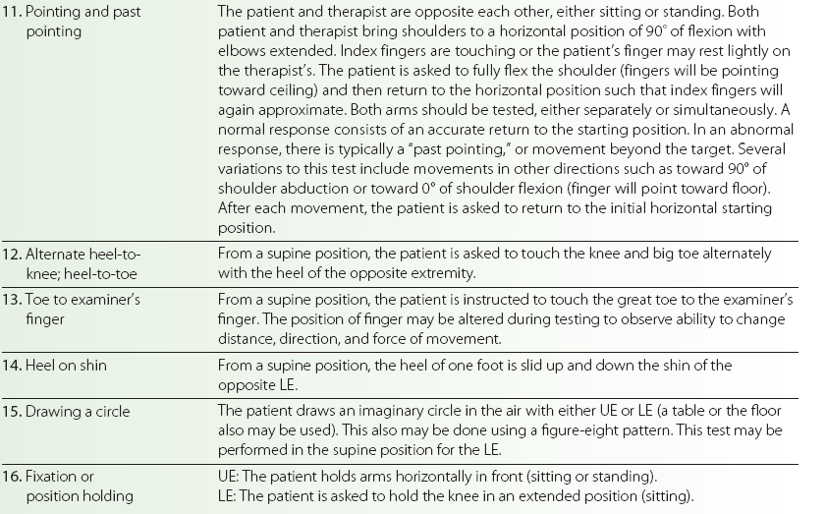

Slide 10
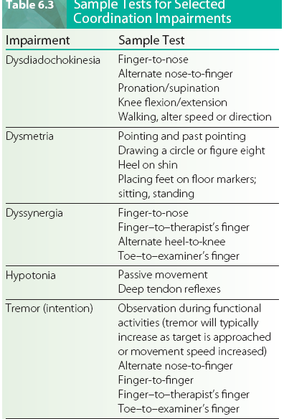

Slide 11
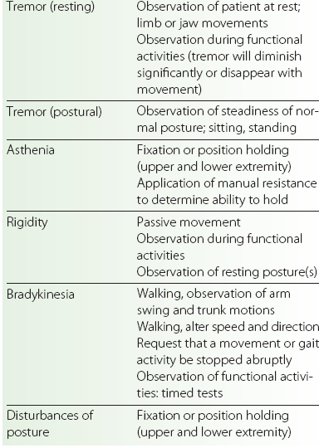

Slide 12
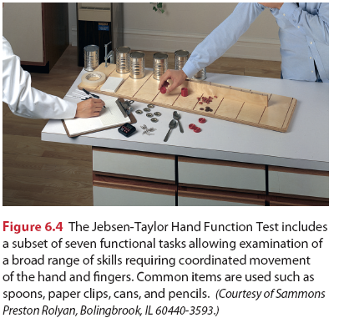
Jebsen-Taylor Hand Function Test
Examines hand and finger coordination using seven subtests of functional
skills: writing; card turning; picking up small objects; simulated feeding; stacking; picking up large, lightweight objects; and picking up large, heavy objects

Slide 13
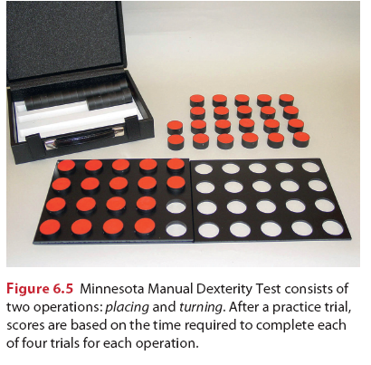
The Minnesota Manual Dexterity Test
was designed to select personnel for semiskilled operations requiring
coordinated arm/hand/finger movements, as well as
eye–hand coordination such as required for handling
small tools or assembly materials that do not require
differentiating size or shape (

Slide 14
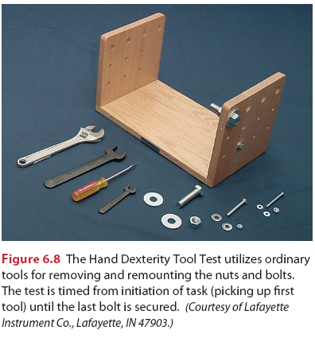
Hand Tool Dexterity Test
Utilizes ordinary tools to examine coordinated movement of arm/ hand/fingers during a functional task.
Flat board to which two side uprights are attached. The test requires disassembly of the nuts and bolts on one upright using the appropriate tools and reassembling them on the opposite upright.

Slide 15
Equilibrium (Balance) test
Static and dynamic
Standing upright
Non Equilibrium test
Static and dynamic in sitting
Fine and Gross movement

Slide 16
Motor task requirements (Arrange in order )
Stability
Skill
Mobility
Controlled mobility
Movement abilities
Alternate or reciprocal
Movement synergy
Movement accuracy
Postural stability

Slide 17
Grading
5= Normal performance
4= minimal impairment slightly less than normal speed, require supervision
3= moderate impairment slow, unsteady , moderate contact guarding
2= severe impairment not complete activity
1= activity impossible

Slide 18
Balance test
Static balance
Rhomberg test
Stroke leg test
Single leg stance test
Dynamic balance
Berg balance test

Slide 19
Anticipatory balance
Functional reach test
Reactive balance
Pastor Day and Marsden Test

Slide 20
THANKS

