Slide 1
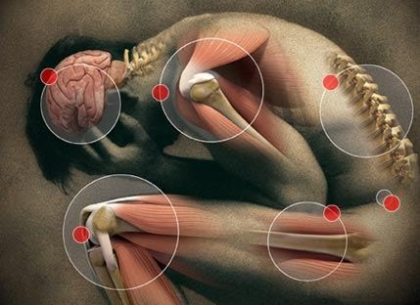
Concept of Pain
Shahzad Anwar

Slide 2
Concept of Pain
Pain is a complex experience consisting of physiological and psychological response to a harmful stimulus
It is primarily associated with injury or threat
Pain is always subjective.

Slide 3
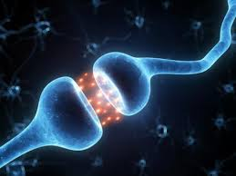
Function of Pain
An important function of pain is to alert the body to potential damage
Pain is a warning mechanism that protects an organism by influencing it to withdraw from harmful stimulus

Slide 4
Types of Pain
There are two types of pain:
1) Acute Pain
2) Chronic Pain

Slide 5
Acute Pain
During acute pain an immediate intense feeling of short duration, sometimes described as a sharp pricking sensation.
It can arise from breaking of bone or touching a hot surface.

Slide 6
Chronic Pain
Pain that lasts longer than 6 months. It can be mild, episodic or continuous.
It is often associated with diseases such as cancer or arthritis, and is more difficult to locate and treat.
If pain can’t be relieved, psychological factors such as depression and anxiety can intensify the condition

Slide 7
Factors Enhancing Pain
Childhood experiences, heredity, psychological factors and gender factors can contribute to the development of each individual’s perception and response to different types of pain
Factors Lowering Pain
Anger or excitement however can lessen pain temporarily

Slide 8
Assessment of Pain
Assessment: It is estimation or analysis.
History and physical examination
Diagnostic testing (Radiography or X-ray, MRI, CT-scan)
Other assessments
Psychological assessment

Slide 9
How to Manage Pain?
Learn deep breathing and meditation to help your body relax and ease pain.
Reduce stress in your life (negative feelings like depression, anxiety, which increases stress, and can make pain more chronic).

Slide 10
Exercise results in pain relief
Eat healthy diet
Find ways to distract your pain and enjoy your life
Physical rehabilitation

Slide 11
Psychological Theories About Pain
Assignment:
Any two psychological theories about pain
How and why do we feel pain..?

