Slide 1
Data mining
Instructor: Muhammad Fahimullah

Slide 2
Disadvantages of Data Mining
A skilled person for Data Mining
Privacy Issues
Security Issues
Additional irrelevant information Gathered
Misuse of information

Slide 3
A skilled person for Data Mining
Generally, tools present for data Mining are very powerful. But, they require a very skilled specialist person to prepare the data and understand the output. As data Mining brings out the different patterns and relationships whose patterns significance and validity must be made by the user. So a skilled person is a must.

Slide 4
Privacy Issues
As data mining collects information about people that are using some market-based techniques and information technology. And these data mining process involves several numbers of factors. But while involving those factors, this system violates the privacy of its user. That is why it lacks in the matters of safety and security of its users. Eventually, it creates miscommunication between people.

Slide 5
Security Issues
As huge data is being collected in data mining systems, some of this data which is very critical might be hacked by hackers as happened with many big companies like Ford Motors, Sony etc.

Slide 6
Additional irrelevant information Gathered
The main functions of the systems create a relevant space for beneficial information. Although, there is a problem with this information collection that the collection of information process can be little overwhelming for all. Therefore, it is very much essential to maintain a minimum level of limit for all the data mining techniques.

Slide 7
Misuse of information
In data mining system, the possibility of safety and security measure are really minimal. And that is why some can misuse this information to harm others in their own way. Therefore, this data mining system needs to change its course of working so that it can reduce the ratio of misuse of information through the mining process.

Slide 8
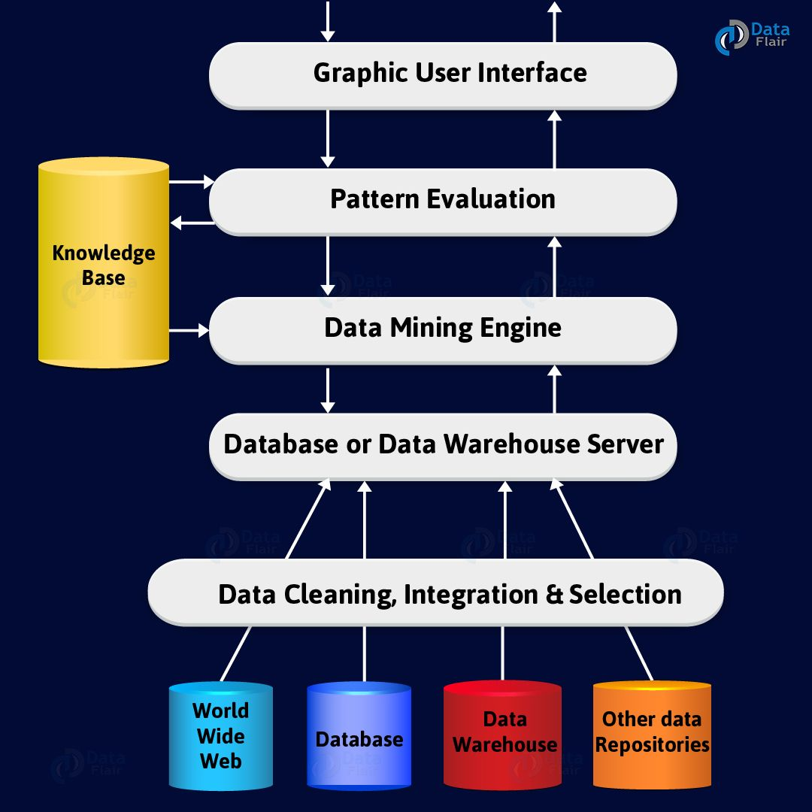
Data mining architecture

Slide 9
Data Sources
There are so many documents present. That is a database, data warehouse, World Wide Web (WWW). That are the actual sources of data. Sometimes, data may reside even in plain text files or spreadsheets. World Wide Web or the Internet is another big source of data.

Slide 10
Database or Data Warehouse Server
The database server contains the actual data that is ready to be processed. Hence, the server handles retrieving the relevant data. That is based on the data mining request of the user.

Slide 11
Data Mining Engine
In data mining system data mining engine is the core component. As It consists a number of modules. That we used to perform data mining tasks. That includes association, classification, characterization, clustering, prediction, etc.

Slide 12
Pattern Evaluation Modules
This module is mainly responsible for the measure of interestingness of the pattern. For this, we use a threshold value. Also, it interacts with the data mining engine. That’s main focus is to search towards interesting patterns.

Slide 13
Graphical User Interface
We use this interface to communicate between the user and the data mining system. Also, this module helps the user use the system easily and efficiently. They don’t know the real complexity of the process. When the user specifies a query, this module interacts with the data mining system. Thus, displays the result in an easily understandable manner.

Slide 14
Knowledge Base
In whole data mining process, the knowledge base is beneficial. We use it to guiding the search for the result patterns. The knowledge base might even contain user beliefs and data from user experiences. That can be useful in the process of data mining. The data mining engine might get inputs from the knowledge. That is the base to make the result more accurate and reliable. The pattern evaluation module interacts with the knowledge base. That is on a regular basis to get inputs and also to update it.

