Slide 1



Slide 2
Physiology of nerve fibers &
Action Potential
By Dr. Irfan Ali Khan
Medical Officer :
Frontier Medical & Dental College, Abbottabad

Slide 3
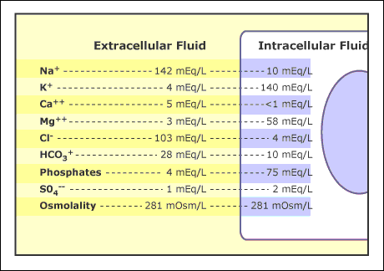

Slide 4
Memberane Potential
The electrical potiential across the cell memberane.
During rest
- positive outside
- negative outside
During activity
-opposite to that of rest

Slide 5
Resting Membrane Potential
Potential difference across cell membrane under resting condition is called RMP.
Means not transmitting signals in resting state.
Contributed by;
1. K+ D.P -94 mV
2. Na+ D.P +61 mV
3. Na+ K+ pump -4 mV
RMP of large nerve fibers is -90mV

Slide 6
Na+ - K+ Pump
This pump continuously pumps
Na+ ions outside the cell.
K+ ions inside the cell.
This pump moves 3 sodium ions to the outside for every 2 potassium ions.
This causes a –ive potential inside the cell membrane.

Slide 7
This pumps creates large concentration gradients for sodium and potassium ions across resting nerve membrane.
Na+ (outside): 142 mEq/L
Na+ (inside): 14 mEq/L
K+ (outside): 4 mEq/L
K+ (inside): 140 mEq/L

Slide 8
Leak channels
These are protein channels through which sodium and potassium ions can leak.
Therefore these are called Na/K leak channels.
These channels are more permeable to potassium as compared to sodium.

Slide 9
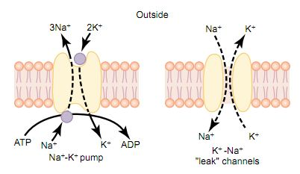

Slide 10
Action potential
These are rapid changes in the membrane potential that spread rapidly along the nerve fiber membrane.
Each A.P begins with a sudden change from a normal resting -ive membrane potential to a +ive potential and then ends with an almost equally rapid change back to the –ive potential.

Slide 11
Stages of Action Potential
Resting stage:
This is the RMP before A.P begins.
The membrane is polarized during this stage because of -90mV negative membrane potential that is present.

Slide 12
2. Depolarization stage:
During this stage, the membrane become highly permeable to sodium ions & large amounts of Na ions move inside the axon.
The polarized state of nerve will neutralize by influx of +ive ions, with the potential rising in +ive direction.
This is called depolarization.

Slide 13
In large nerves, great influx of Na ions will actually “overshoot” beyond the zero level and become positive.
In smaller fibers potential does not overshoot to the +ive state.

Slide 14
3. Repolarization stage:
Within a few milliseconds, the sodium channels begins to close and potassium channels open in large numbers.
Rapid efflux of potassium ions to the exterior of nerve will restore the normal –ive membrane potential.
This is called repolarization.

Slide 15
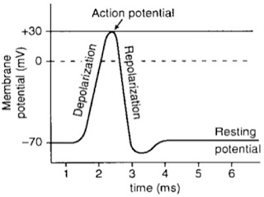
Overshoot

Slide 16
Channels in cell memberane causing Action Potential
1. Voltage gated Na+ channels
-activation gates
-inactivation gates
2.Voltage gated K+ channels
3.Slow Ca+ - Na+ Channel

Slide 17
1.Voltage-Gated Na+ channels
Na+ channels have two gates.
Activation Gates near outside of the channel
Inactivation Gates near inside of the channel
During resting stage of A.P the activation gate is closed, thus preventing entry of any Na ions through these channels.

Slide 18
-Activation of Na+ Channels
During depolarization stage, when the membrane potential reaches somewhere between -70 to -50 mV a conformational change occurs in activation gate, flipping it open.
This is the activated state of the channel and allows for Na+ ions influx.

Slide 19
-Inactivation of Na+ Channels
At the same time when activation gate opens, the inactivation gate closes.
But closing of inactivation gate is a slow process so closing occurs few milliseconds after the opening of activation gate.
With the closing of this gate, no more Na ions will be allowed to move inside.

Slide 20
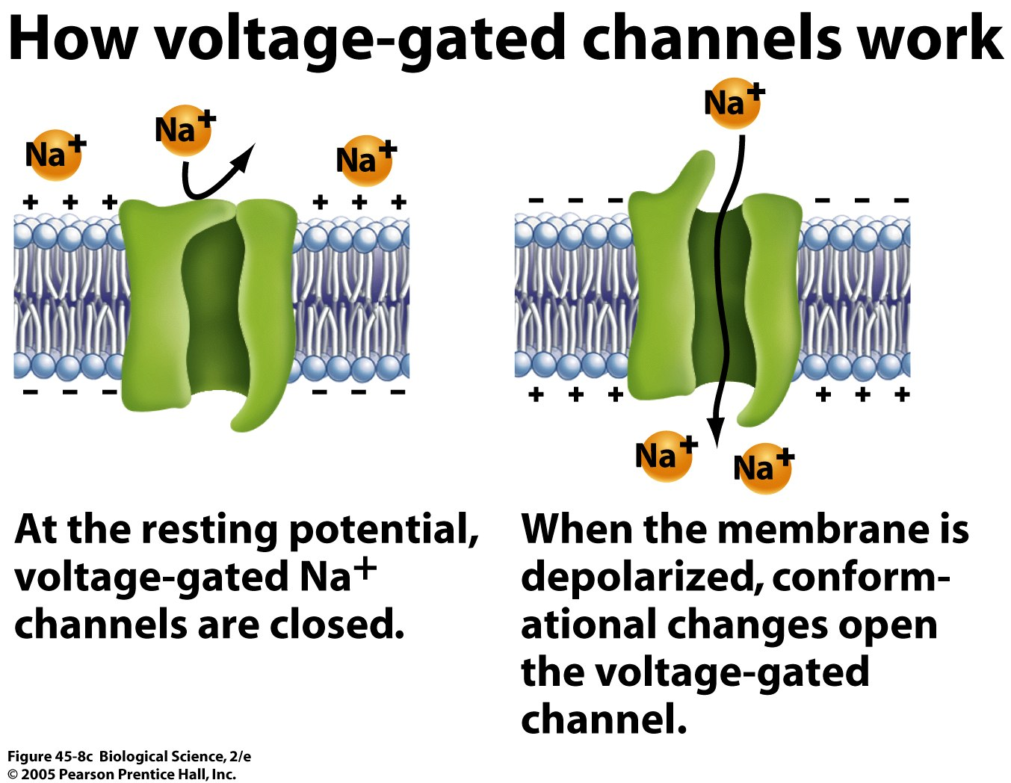

Slide 21
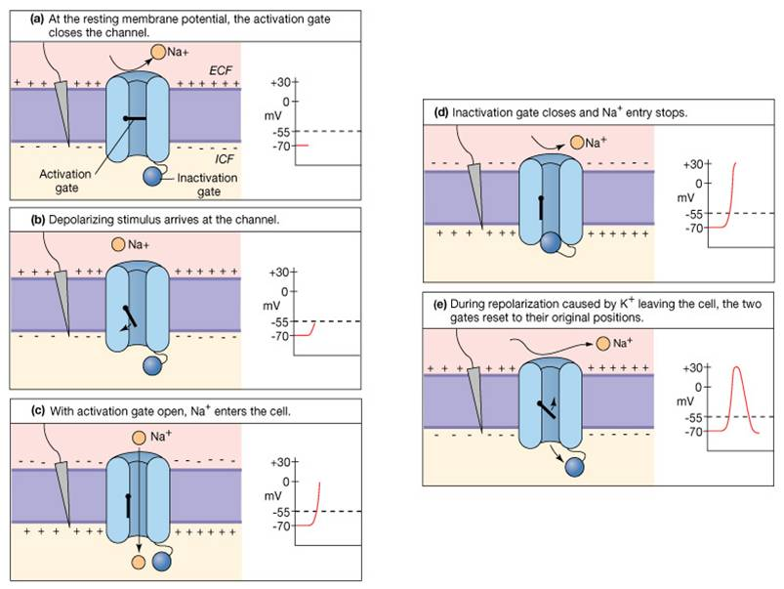

Slide 22
2.Voltage-Gated K+ Channels
During resting stage, the gate of K+ channel is closed thus preventing K+ ions to diffuse out.
When the membrane potential rises from -90 mV towards zero, conformational change in gate will cause it to open.
As this is a slow process, the K channels open almost at the same time when Na channels are beginning to close.

Slide 24
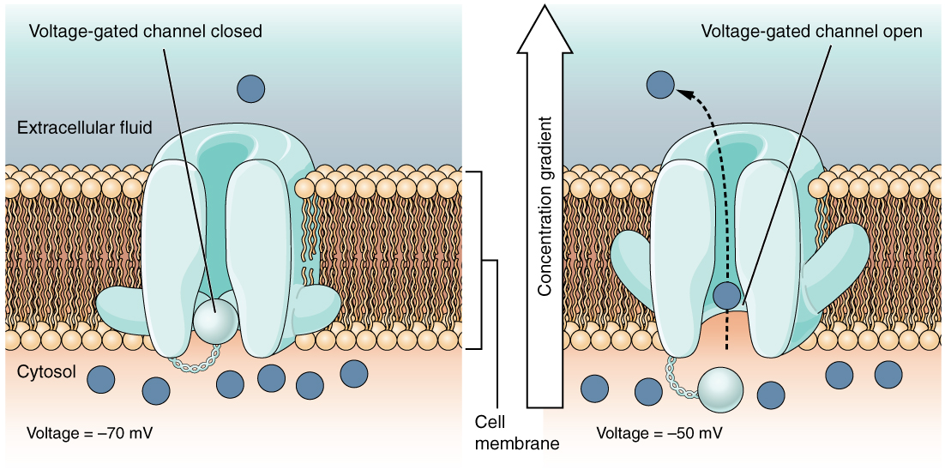

Slide 25
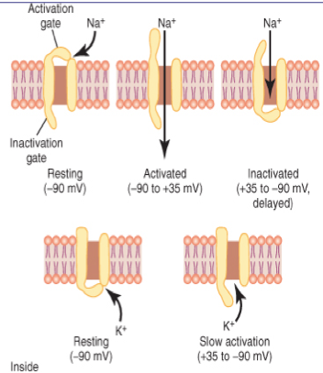

Slide 26
Initiation of Action Potiential
A Positive-Feedback Vicious Cycle Opens the Sodium Channels.
A sudden rise in membrane potential of 15 to 30 millivolts usually is required for initiation of action potential. This level of –65 millivolts is said to be the threshold for stimulation.

Slide 27
Propagation of AP
An action potential elicited at any one point on an excitable membrane usually excites adjacent portions of the membrane, resulting in propagation of the action potential along the membrane
Positive charges increase the voltage for a distance of 1 to 3 millimeters inside the large myelinated fiber to above the threshold voltage value for initiating an action potential
This transmission of the depolarization process along a nerve or muscle fiber is called a nerve or muscle impulse.
the action potential travels in all directions away from the stimulus

Slide 28
the depolarization process travels over the entire membrane if conditions are right, or it does not travel at all if conditions are not right. This is called the all-or-nothing principle

Slide 29
Re-establishing Sodium and Potassium Ionic Gradient After Action Potentials Are Completed
Sodium ions that have diffused to the interior of the cell during the action potentials and potassium ions that have diffused to the exterior must be returned to their original state by the Na-K pump
This “recharging” of the nerve fiber is an active metabolic process using energy derived from ATP
A special feature of the Na-K ATPase pump is that its degree of activity is strongly stimulated when excess sodium ions accumulate inside the cell membrane

Slide 30
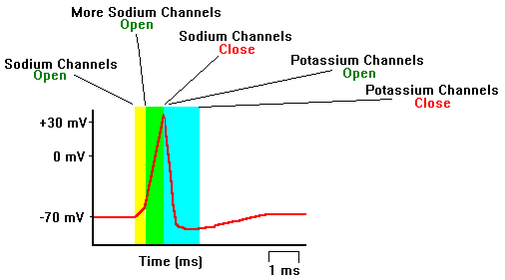

Slide 31
REPETITIVE DISCHARGE
Repetitive self-induced discharges occur normally in the heart, in most smooth muscle, and in many of the neurons of the central nervous system

Slide 32
REFRACTORY PERIOD
Period After an Action Potential, During Which a New Stimulus Cannot Be Elicited
The period during which a second action potential cannot be elicited, even with a strong stimulus, is called the absolute refractory period.
This period for large myelinated nerve fibers is about 1/2500 second.
Therefore, one can readily calculate that such a fiber can transmit a maximum of about 2500 impulses per second.

Slide 33

JazakAllah Khair!

