Slide 1
DR. CHRISTINA SAMUEL

Slide 2
Develops from mesenchyme by ossification
Lacrimal Maxillary Frontal Ethmoid
Palatine Zygomatic Sphenoid
28-30ml volume

Slide 4
Roof Floor Side walls
Orbital apex

Slide 5
Roof of orbit
Frontal bone [Orbital plate] & lesser wing of sphenoid
Separated from frontal sinus and anterior cranial fossa above
Lacrimal gland fossa and trochlear fossa behind orbital rim

Slide 6
Medial wall
Body of sphenoid Ethmoid
Lacrimal
Maxilla[frontal
process]

Slide 7
Floor of orbit
Maxilla Zygomatic Palatine
Triangular segment
- thinnest
Inferior orbital groove

Slide 8
Lateral wall
Greater wing –sphenoid
Orbital surface –
Frontal process of zygomatic
Inferiorly – inf orbital fissure Medially – sup orbital fissure

Slide 9
Extraocular Muscles
Voluntary Muscles:
Superior rectus
Inferior rectus
Medial rectus
Lateral rectus
Superior oblique
Inferior oblique
Levator palpebrae superioris.
Involuntary Muscles:
Superior tarsal or Muller’s muscle,
Inferior tarsal muscle.

Slide 11
Eye ball Orbital fat
Connective tissue system Blood vessels
Nerves
Extraocular muscles

Slide 12
Def: Purulent inflammation of the cellular tissue of the orbit.
Cause:
-Spread of inflammation from neighboring parts – nasal sinuses, Dacryocystitis, dental infection, deep injuries, retained foreign body,
-septic operations, DCR, RD, SQUINT
-posterior extension of suppurative infection of eye lid, panophthalmitis, facial erysipelas,
- Metastases in pyaemia

Slide 13
Streptococcus pneumoniae. Staphylococcus aureus Streptococcus pyogenes Haemophilus influenzae. (children
below 5 years)

Slide 14
Swelling, erythema, warmth, pain, tendernes of the lid
Orbital abscess pointing on the skin or conjunctiva

Slide 15
Proptosis – lateral and down
Restriction and pain of ocular movements
Diplopia
Afferent pupillary defect
Diminished vision due to compression of optic nerve, its blood supply, optic neuritis

Slide 16
Periorbital abscess
Exposure keratopathy
Panophthalmitis is the inflammation of all coats of the animal eye including intraocular structures. It can be caused by infection, particularly from Pseudomonas species
Intracranial complications
- meningitis, brain abscess,
- Cavernous Sinus thrombosis

Slide 17
T.C.D.C,ESR
CT orbit, sinus, brain
Blood, nasal, conjunctival and throat culture and sensitivity

Slide 18
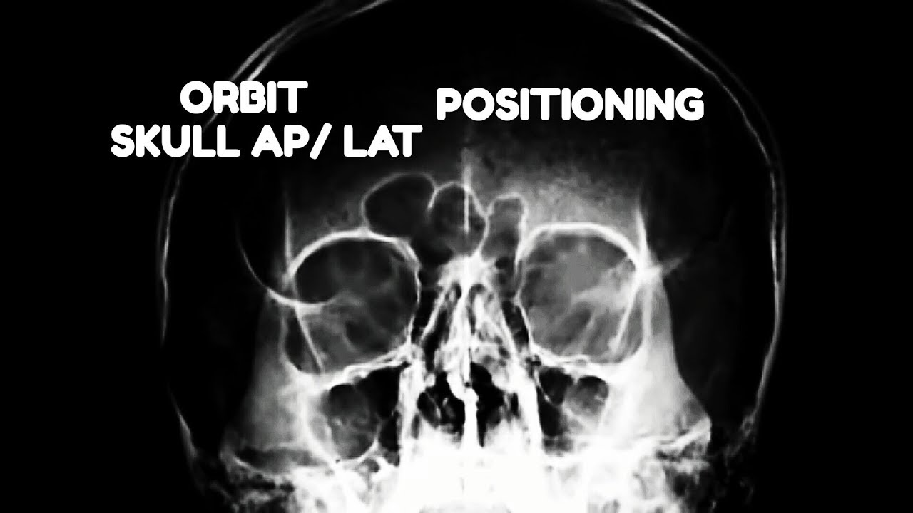
X-ray

Slide 19
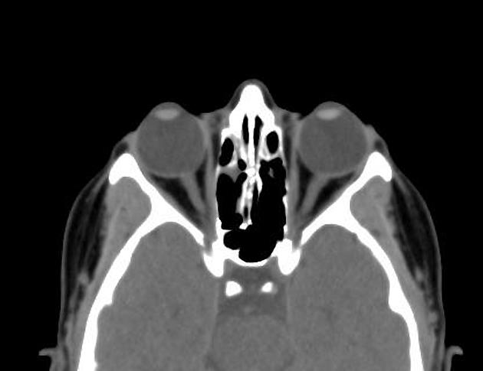
Normal CT

Slide 20
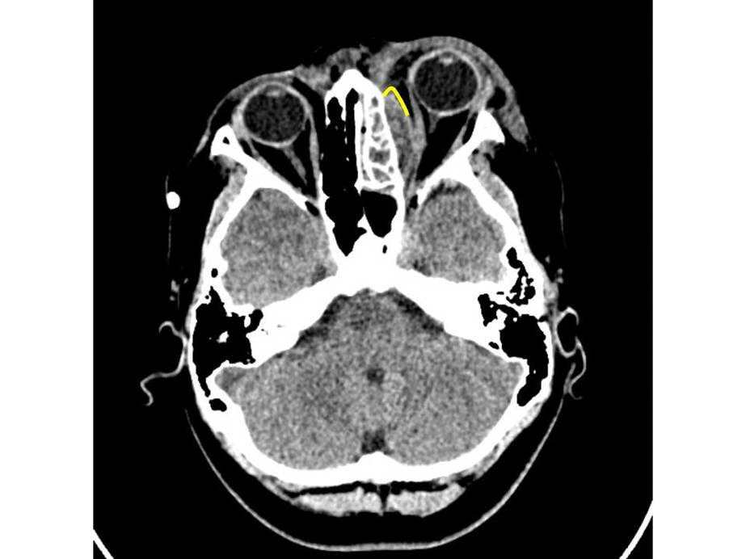
Orbit CT-Cellulitis

Slide 21
Broad spectrum antibiotic
N.S.A.I.D
Steroids
Close monitoring by ophthalmologist, neuro surgeon, ENT surgeon
Surgical – drainage of the abscess, biopsy, orbital decompression.

Slide 22
