Slide 1
Requirements Elicitation Process
Lecture-8

Slide 2
Recap
Elicitation process
Stakeholder analysis
Elicitation techniques
Interviews
How to create effective questionnaire?
Interview template

Slide 3
Today’s lecture
Elicitation process
Elicitation techniques
Scenarios
Observation and social analysis
Prototyping

Slide 4
Scenarios
Scenarios are stories which explain how a system might
be used. They should include
A description of the system state before entering the scenario
The normal flow of events in the scenario
Exceptions to the normal flow of events
Information about concurrent activities
A description of the system state at the end of the scenario
Scenarios are examples of interaction sessions which describe how a user interacts with a system
Discovering scenarios exposes possible system interactions and reveals system facilities which may be required

Slide 5
Library scenario - document ordering
Log on to EDDIS system
Issue order document command
Enter reference number of the required document
Select a delivery option
Log out from EDDIS
This sequence of events can be illustrated in a diagram

Slide 6
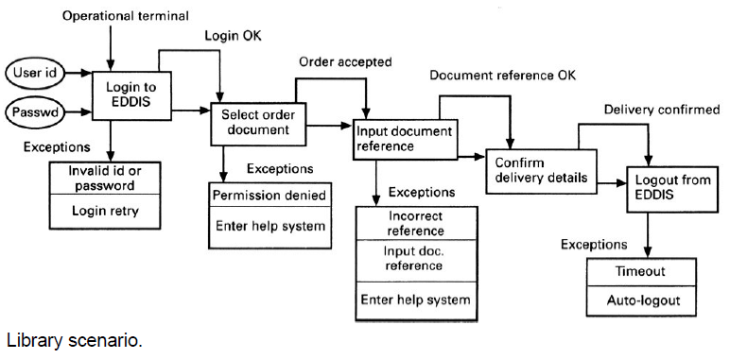
Library Scenario

Slide 7
Scenarios and OOD
Scenarios are an inherent part of some object-oriented development methods
The term use-case (i.e. a specific case of system usage) is sometimes used to refer to a scenario
There are different views on the relationship between use cases and scenarios:
A use-case is a scenario
A scenario is a collection of use-cases. Therefore, each exceptional interaction is represented as a separate use-case

Slide 8
Observation and social analysis
People often find it hard to describe what they do because it is so natural to them. Sometimes, the best way to understand it is to observe them at work
Ethnography is a technique from the social sciences which has proved to be valuable in understanding actual work processes
Actual work processes often differ from formal, prescribed processes
An ethnographer spends some time observing people at work and building up a picture of how work is done

Slide 9
Ethnography guidelines
Assume that people are good at doing their job and look for non-standard ways of working
Spend time getting to know the people and establish a trust relationship
Keep detailed notes of all work practices. Analyze them and draw conclusions from them
Combine observation with open-ended interviewing
Organize regular de-briefing session where the ethnographer talks with people outside the process
Combine ethnography with other elicitation techniques

Slide 10
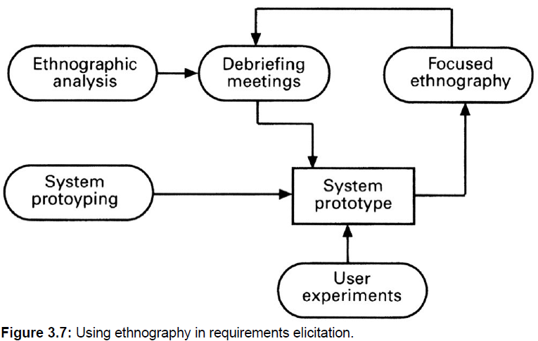
Ethnography in elicitation

Slide 11
Ethnographic perspectives
The work setting viewpoint
This describes the context and the physical location of the work and how people use objects to carry out tasks. Therefore, in a study of a help desk (say), this would describe the objects which the helper had to hand and how these were organized.
Social and organizational perspectives
This tries to bring out the day -to-day experience of work as seen by different people who are involved. Each individual typically sees the work in a different ways and this viewpoint tries to organize and integrate all of these perceptions.
The workflow viewpoint
This viewpoint presents the work from a series of work activities with information flowing from one activity to another.

Slide 12
Requirements reuse
Reuse involves taking the requirements which have been developed for one system and using them in a different system
Requirements reuse saves time and effort as reused requirements have already been analyzed and validated in other systems
Currently, requirements reuse is an informal process but more systematic reuse could lead to larger cost savings

Slide 13
Reuse possibilities
Where the requirement is concerned with providing application domain information.
Where the requirement is concerned with the style of information presentation. Reuse leads to a consistency of style across applications.
Where the requirement reflects company policies such as security policies.

Slide 14
Prototyping
A prototype is an initial version of a system which may be used for experimentation
Prototypes are valuable for requirements elicitation because users can experiment with the system and point out its strengths and weaknesses. They have something concrete to criticize
Rapid development of prototypes is essential so that they are available early in the elicitation process

Slide 15
Prototyping benefits
The prototype allows users to experiment and discover what they really need to support their work
Establishes feasibility and usefulness before high development costs are incurred
Essential for developing the ‘look and feel’ of a user interface
Can be used for system testing and the development of documentation
Forces a detailed study of the requirements which reveals inconsistencies and omissions

Slide 16
Types of prototyping
Throw-away prototyping
Intended to help elicit and develop the system requirements.
The requirements which should be prototyped are those which cause most difficulties to customers and which are the hardest to understand. Requirements which are well-understood need not be implemented by the prototype.
Evolutionary prototyping
Intended to deliver a workable system quickly to the customer.
Therefore, the requirements which should be supported by the initial versions of this prototype are those which are well-understood and which can deliver useful end -user functionality. It is only after extensive use that poorly understood requirements should be implemented.

Slide 17
Prototyping costs and problems
Training costs - prototype development may require the use of special purpose tools
Development costs - depend on the type of prototype being developed
Extended development schedules - developing a prototype may extend the schedule although the prototyping time may be recovered because rework is avoided
Incompleteness - it may not be possible to prototype critical system requirements

Slide 18
Approaches to prototyping
Paper prototyping
A paper mock -up of the system is developed and used for system experiments
‘Wizard of Oz’ prototyping
A person simulates the responses of the system in response to some user inputs
Executable prototyping
A fourth generation language or other rapid development environment is used to develop an executable prototype

Slide 19
Executable prototype development
Fourth generation languages based around database systems
Visual programming languages such as Visual Basic or Object Works
Internet-based prototyping solutions based on World Wide Web browsers and languages such as Java

Slide 20
Summary
Scenarios
Requirements reuse
Observation and social analysis
Prototyping

