Slide 1
Name: Sahab Hussain khan
Id #16362
Program:B.S Radiology 2nd semester Section (A)
Assignment : Human Anatomy (Endocrine System )
Instructor : M.Jaffar
Final Term

Slide 2
Endocrine System :
Endocrine System
Pituitary gland
Thyroid gland
Adrenal gland
ENDOCRINE GLANDS :
Glands that secrete their products ( hormones ) directly into the blood is called Endocrine glands.

Slide 3
Continue…..
1. PITUITARY GLAND :
It is the major Endocrine gland
It is about the pea size body attached to the base of the brain
It is important in controlling growth and development

Slide 4
Continue……
Hormones of pituitary gland :( Anterior lobe)
Growth Hormone (GH)
Prolactin
Thyroid Stimulating Hormone (TSH)
Adrenocorticotrophic Hormone (ACTH)
Folical Stimulating Hormone (FSH)
Luteinizing Hormone (LH)

Slide 5
Continue…..
Posterior Lobe :
Vasopressin (ADH)
Oxytocin

Slide 6
Continue…..
Anterior Pituitary
Growth hormone
Stimulating growth of bones, cartilage and connective tissue
Increase calcium absorption
Decrease sodium, potassium, phosphorus excretion through kidneys.
Disease of growth hormone
Gigantism :
it is due to over production of growth hormone

Slide 7
Continue……
Dwarfism
It is due to less production of growth hormone.
Shortness of stature
Small genital

Slide 8
Continue……
2.Prolactin
It plays an important role in development of mammary gland and in milk synthesis
3. Thyroid Stimulating Hormone (TSH)
It stimulates the thyroid gland to produce Thyroxin (T4) and Triiodothyronine(T3)
4. Adrenocorticotrophic Hormone ( ACTH)
It is produced in biological stress
It’s principal effects the production and release of corticosteroids.

Slide 9
Continue…..
5.Folical Stimulating Hormone (FSH)
It regulates the development of pubertal maturation and reproductive processes of the body.
6.Luteinizing Hormone (LH)
In females an acute rise of LH triggers ovulation, while in males it stimulates the production of testosterone

Slide 10
Continue……
Posterior Pituitary
Vasopressin (ADH) Anti-diuretic Hormone
It retains water in the body
2. Oxytocin
It is synthesized in hypothalamus
It stimulates the contraction of mammary gland
It stimulates the contraction of smooth muscles of uterus

Slide 11
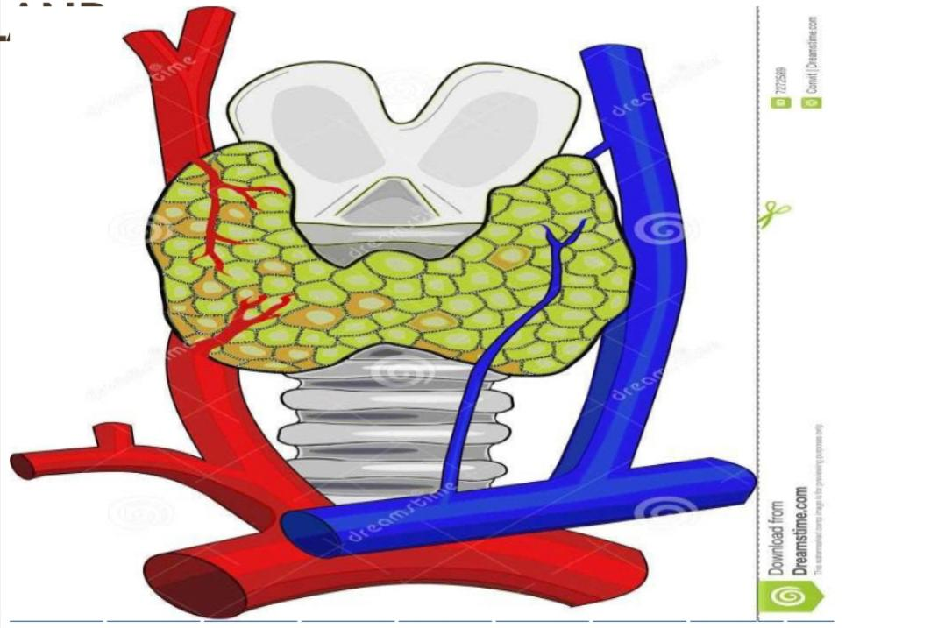
Continue…..
Thyroid Gland :
It is an Endocrine gland in neck

Slide 12
Continue…..
Hormones of Thyroid Gland
Triiodothyronine(T3)
It affects all the physiological processes in body, e.g.
Growth and development
Body temperature
Heart rate
Metabolism
2. Thyroxin (T4)
Controls the development and maturation

Slide 13
Continue…..
Calcitonine
This is secreted by the C cells of thyroid gland
Its main function is to increase bone calcium level and decrease blood calcium levels
Disease of thyroid gland
Goiter
Enlargement of thyroid gland is called goiter
It is caused by iron deficiency

Slide 14
Continue……
Symptoms
Swelling in the neck
Coughing
Hoarseness
Swallowing difficulties
Breathing difficulties

Slide 15
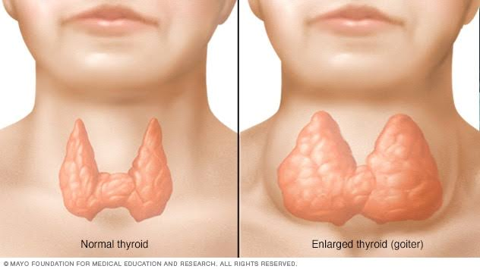
Goiter

Slide 16
Continue
Adrenal Gland
There are two adrenal glands on each kidney, they are yellowish in colour
It has two parts
Outer part( Adrenal cortex)
Inner part ( Adrenal medulla )

Slide 17
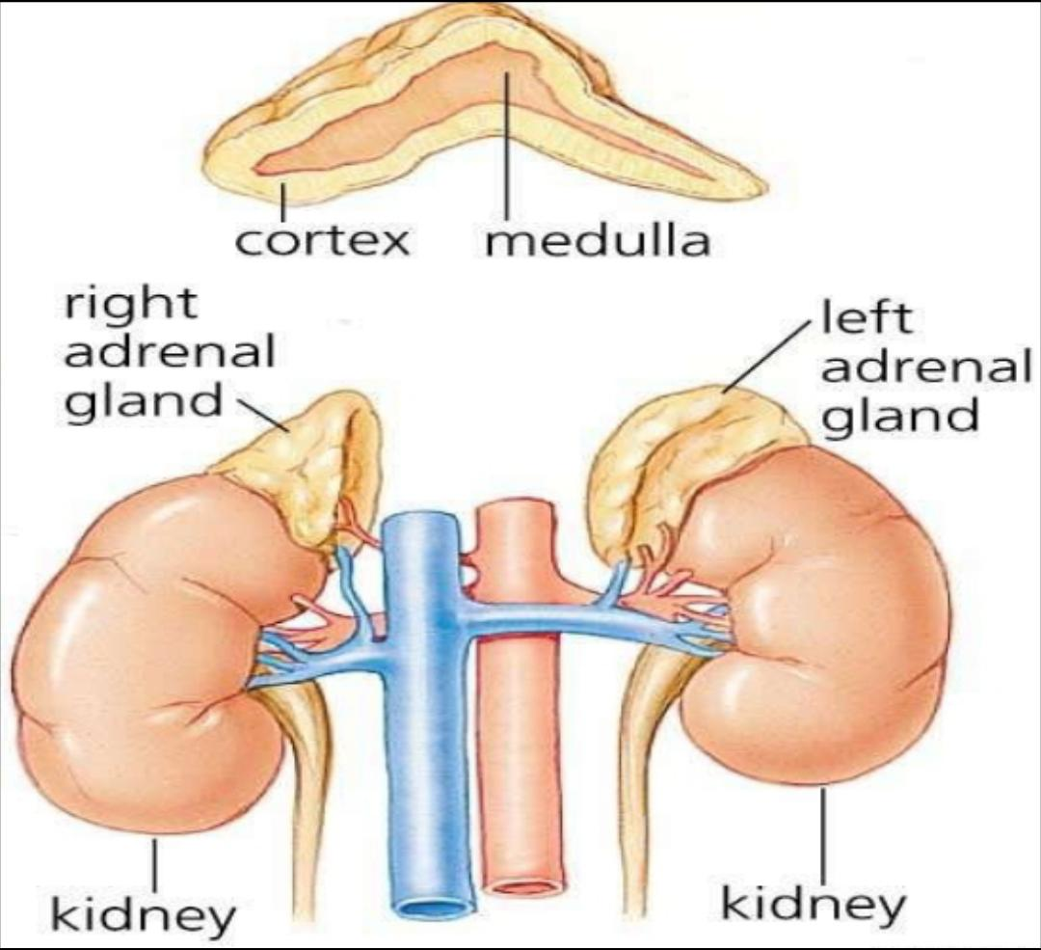
Adrenal Glands:

Slide 18
Continue……
It produces 3 Hormones
Glucocorticoids
Mineralocorticoids
Sex Hormones

Slide 19
Continue……
Glucocorticoids
Cortisol is the main glucocorticoids
They are essential for life regulating metabolism and stress
2. Mineralocorticoids
Aldosterone is the main Mineralocorticoids
It maintains water and electrolyte balance
3. Sex hormone
Androgens are main sex hormone
They contribute to the onset of puberty

Slide 20
Continue…..
Adrenal Medulla
It is surrounded by the cortex
It produces 2 hormones
Adrenaline
Nor adrenaline

Slide 21
Continue……
Adrenaline and nor adrenaline
They are released into the blood
They are structurally very similar and have similar affects e.g.
Increasing blood pressure
Dilating the pupils
Increasing heart rate
Increasing metabolic rate

Slide 22
Difference between adrenal cortex and medulla :
Adrenal cortex
Adrenal cortex refers to the part of the kidney that contains glomeruli and proximal and distal convoluted tubules
Outer layer of kidney, situated between renal capsul and renal medulla
Pale brown or reddish color
Consist of blood vessels
Contains glomeruli and convoluted tubules
Filter the blood

Slide 23
Continue……
Adrenal Medulla
Renal medulla refers to the inner most part of the kidney, which is composed of collecting tubules
Inner most layer of kidney
Dark reddish brown in color
Consist of many structures of nephron
Contains loop of henle and collecting tubules
Regulate water and salt in blood.

Slide 24
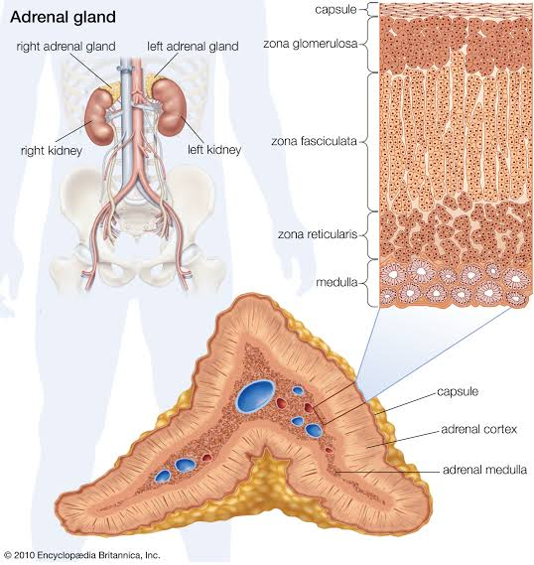
Adrenal Cortex and Medulla

Slide 25
Thank you

