Slide 1
Name Mazhar Alam ID 16444 Bs Radiology(2nd semester) Physiology Assignment instructor : sir Shahzeb

Slide 2
Blood
Blood is specialized body fluid.Blood is reddish fluid that circulates in the body.Its volume is different in various animals.In a healthy person the amount of blood is about 8per of his body weight or about 5 litres.
Blood has many different functions including transporting oxygen and nutrients to the lungs and tissues.
Composition of Blood.
Blood is composed of two main parts,
Plasma
Blood Cells

Slide 3
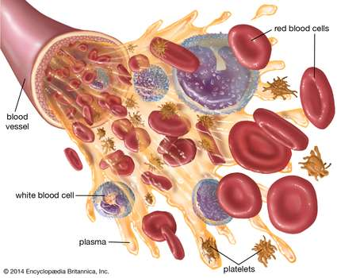
Plasma
The fluid part of the blood is called plasma. 55 per of the blood consists of blood plasma. It is yellow in colour and the cells are suspended in it.It is mainly composed of water and proteins.Plasma contains 90% water, protein 7 % , sugar 0.1% , inorganic salts 0.9 % and urea+ gases 2 %. An important properly of plasma is fibrinogen.It is essential for blood clotting. Plasma also contain amino acids, hormones and vitamins.

Slide 4
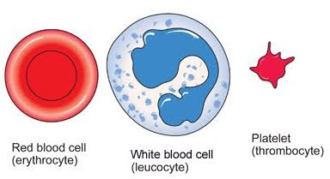
2.Blood cells.
Plasma contains about 45% blood cells.These blood cells are of three types.
Red Blood Cells ( RBCs) or Erythrocytes
White Blood Cells (WBCs) or leukocytes
Platelets or thrombocytes

Slide 5
1.Red Blood Cells ( RBCs) OR Erythrocytes
In mammals, red blood cells are spherical and biconcave
They lack nucleus and mitochondria
RBCs is produced in the bone marrow
In mammals as the young cells go through the process of maturation, their nuclei disappear.

Slide 6
Continue…
The hemoglobin level of females is also less than males. That’s why females cannot perform hard physical labour.
In frog RBCs are spherical, biconvex and have a nucleus.
Function of RBCs.
The main function of RBCs is to carry oxygen from the lungs to the body tissues and carbon dioxide as a waste product, away from the tissues and back to the lungs . Hemoglobin is an important protein in the RBCs that carries oxygen from the lungs to all part of the body.

Slide 7
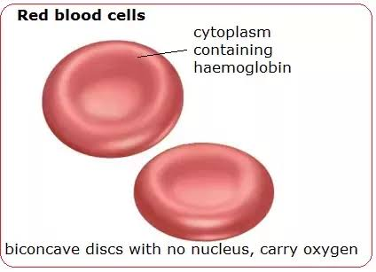
Continue…

Slide 8
White Blood Cells (WBCs) or leukocytes
White blood cells are colourless. They do not containn any coloured pigment. They are irregular in shape , it contain nucleus and moveable through the thin walls of capillaries. There are 1 or 2 WBCs for every 1000 RBCs. One cubic millimeters of blood contains 7000 to 8000 WBCs. There life span is very short i.e from 7 hours to 3 days. WBCs are also produced in red bone marrow.
Function of WBCs
The function of WBCs is to protect our body from germs and bacterial disease. They provide defence system to the body. This property is called immunity.

Slide 9
Platelets or thrombocytes
Platelets are not true cells. They are fragments of large cells of bone marrow called magakaryocytes. They are spindle shaped. They do not have nucleus. Platelets are colourless. One cubic millimeters of blood contains 250,000 to 500, 000 platelets. The average life span of a blood platelet is about 7 to 8 days.
Function of Platelets.
Platelets are tiny blood cells that help your body from clot to stop bleeding. If one of your blood vessels gets damaged it sends out signals to the platelets . The platelets then rush to the site of damage they from plug (clot) to fix the damage.

Slide 10
Functions of Blood
Blood performs the following functions.
The blood is the major agent for the transport of materials in the body
Oxygen and carbon dioxide are transported by blood to all cells of the body
The blood helps in maintaining the body temperature, the concentration of water and salt
Plasma transports digested food , minerals, water, enzymes, hormones and waste materials

Slide 11
Physiology of Cardiovascular System.
The heart is an muscular pumping organ .It is enclosed in a tough membrane called the pericardium. There is fluid between the heart and the pericardium called pericardial fluid. This fluid lubricates the heart during movement. The pericardium also prevents the heart from becoming larger in certain conditions.
The heart consists of following four chambers.
Right auricle or atrium
Left auricle or atrium
Right ventricle
Left ventricle

Slide 12
Function of Heart.
Right auricle and right ventricle contain deoxygenated blood .The auricles bring blood back towards the heart while the ventricles always carry blood away from the heart. The right auricle opens into the right ventricle through a value called tricuspid valve. There is a bicuspid valve between the left auricle and left ventricle. These valves control the blood flow and keep it in only one direction.
The blood flows into the right auricle by means of a superior vena cava and inferior vena cava . The superior vena cava brings the deoxygenated blood from the upper region of the body such as the head and arms. The inferior vena cava brings the deoxygenated blood from the lower region of the body.

Slide 13
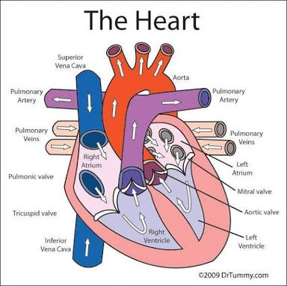

Slide 14
Blood Vessels.
Blood is transported from the heart to the whole body through a very specialized of vessels.
These vessels are arteries, veins and capillaries
Arteries
Those blood vessels, which carry blood from the heart to all parts of the body , are called arteries. They carry oxygenated blood except pulmonary artery , which carries deoxygenated blood to the lungs for oxygenation. The wall of artery is made of three layers

Slide 15
2. Capillaries
They are the finest microscopic blood vessles. Their diameter is 8-10 micro meter. Their wall is only one cell thick and very permeable.These capillaries come very close to the cells in such a way the exchange of materials take place between the capillaries and cells of the tissues .After the exchange of material, capillaries start joining to from venules. The venules join to form veins.
3. Veins.
Those blood vessels, which bring from all parts of the body back to the heart, are called veins except pulmonary vein which brings oxygenated blood from lungs to the heart. Vein prevent the back flow of blood.When they arise from the capillaries they are very narrow. They gradually join together forming large veins in the body.

Slide 16
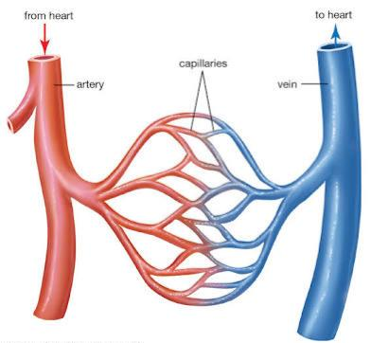

Slide 17
Physiology of pulmonary system circulation
The pulmonary circulation is the portion of the circulatory system which carries deoxygenated blood away from the right ventricle to the lungs and returns oxygenated blood to the left atrium and ventricle of the heart. The term pulmonary circulation is readily paired and contrasted with the systemic circulation. The vessels of the pulmonary circulation are the pulmonary arteries and the pulmonary veins.
A separate system known as the bronchial circulation supplies oxygenated blood to the tussues of the larger airways of the lungs.

Slide 18
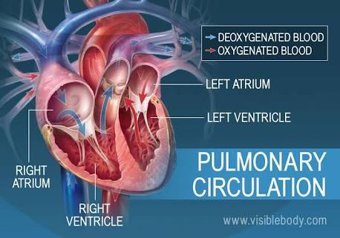

Slide 19
Lungs
The pulmonary arteries carry deoxygenated blood to the lungs, where carbon dioxide is released and oxygen is picked up during respiration. Arteries are futher divided into very fine capillaries which are extremely thin walled. The pulmonary vein returns oxygenated blood to the left atrium of the heart.
. Veins
The oxygenated blood then leaves the lungs through pulmonary veins, which return it to the left part of the heart, completing the pulmonary cycle. This blood then enters the left atrium, which pumps it through the mitral valve into the left ventricle from the left ventricle, the blood passes through the aortic valve to the aorta. The blood is then distributed to the body through the systemic circulation before returning again to the pulmonary circulation.

Slide 20
Arteries.
From the right ventricle, blood is pumped through the semilunar pulmonary valve into the left and right main pulmonary arteries which branch into smaller pulmonary arteries that spread throughout the lungs.

Slide 21
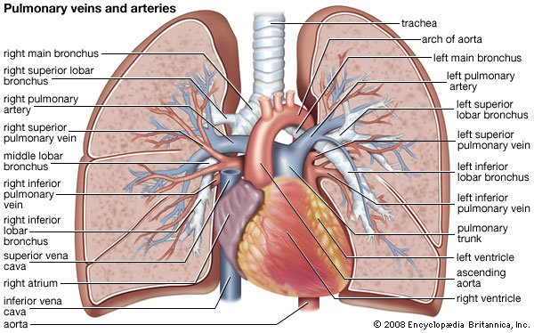

Slide 22
Development
The pulmonary circulation loop is virtually by passed in fetal circulation The fetal lungs are collapsed, and blood passes from the right atrium directly into the left atrium through the foramen ovale an open conduit between the paired atria or through the ductus arteriosus a shut between the pulmonary artery and the aorta.
When the lungs expand at birth, the pulmonary pressure drops and blood is drawn from the right atrium into the right ventricle and through the pulmonary circuit.
Over the course of several months the foramen ovale closes, leaving a shallow depression known as the fossa ovalis.

Slide 23
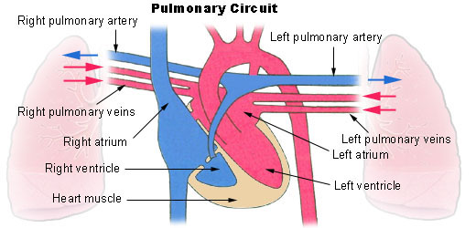

Slide 24
Thank you.........

