Slide 1
Muhammad Umar
I D # 16799

Slide 2
Muhammad Umar
16799

Slide 3
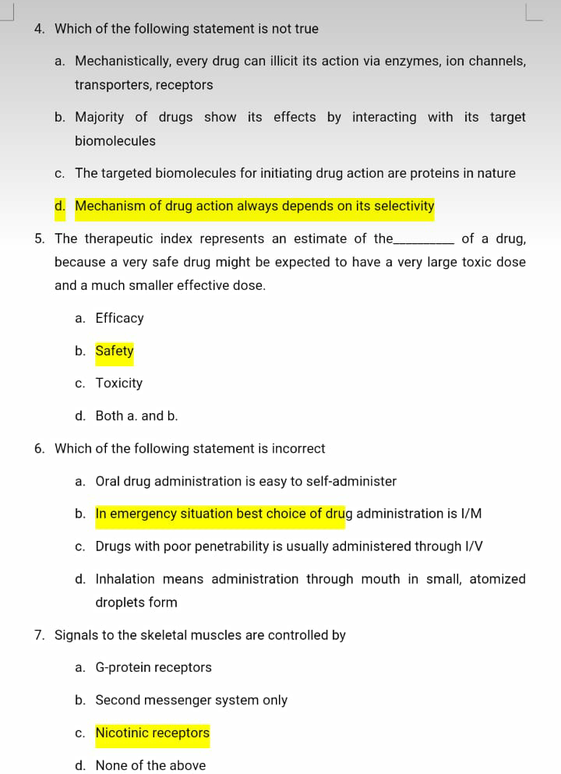

Slide 4
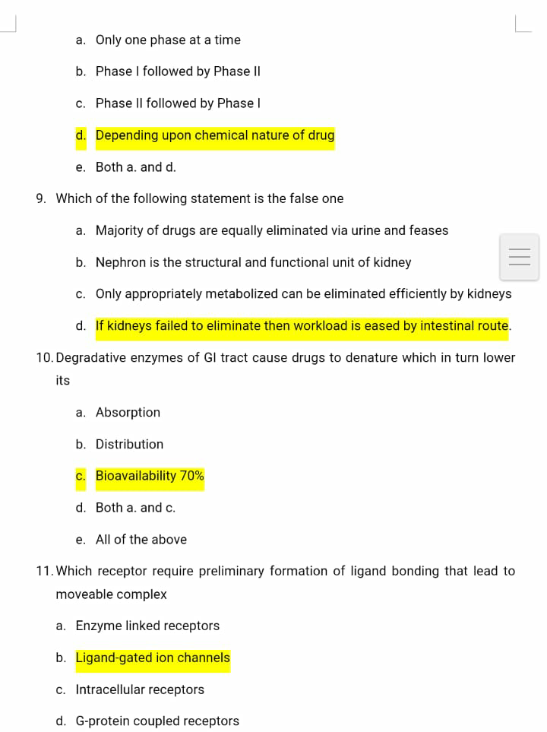
8.

Slide 5
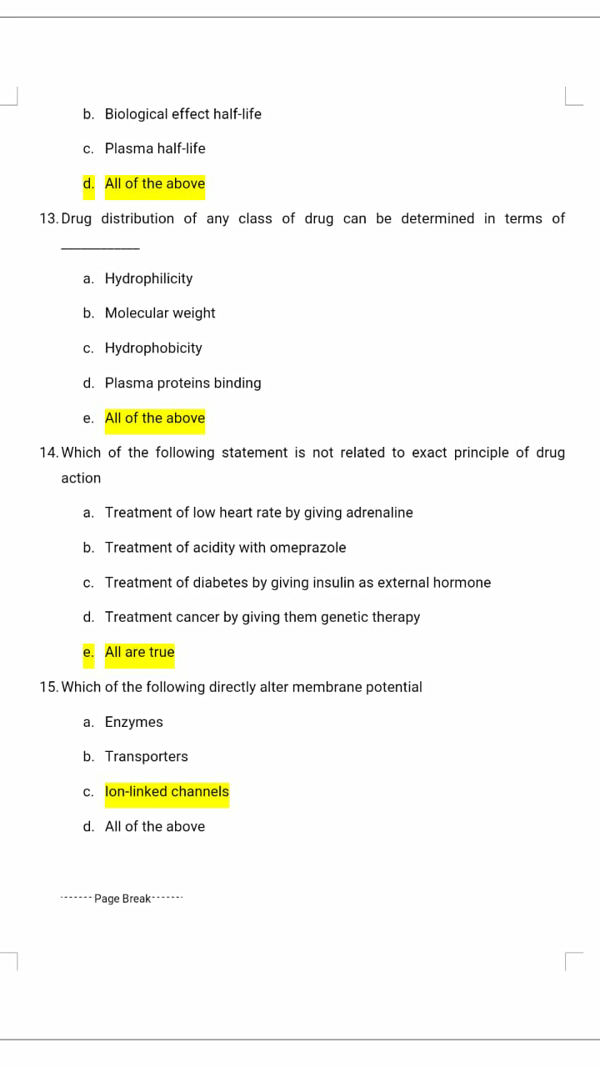
12

Slide 6
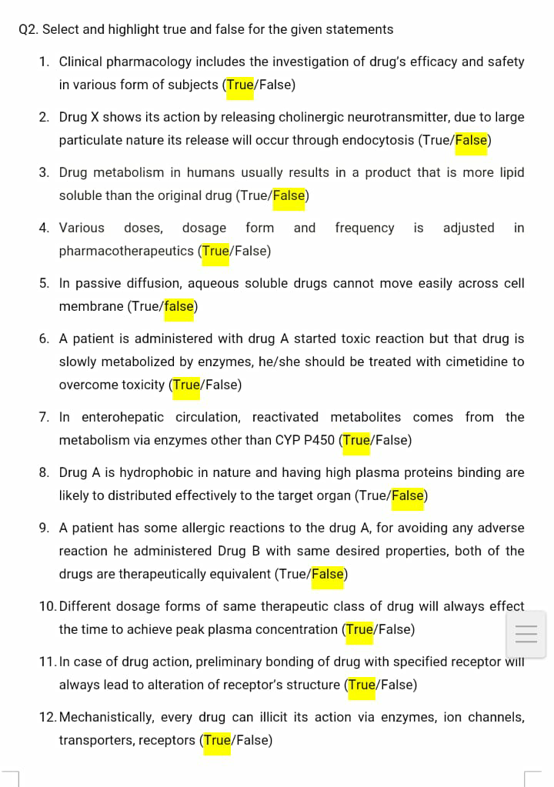

Slide 8
THE END
THANK YOU

