Slide 1
Name : Hafiza Sara Bibi
Assignment : Garments History
Submitted To : Habiba Mudassir
ID: 14173
Department: Arts and Design

Slide 2
Early and Late Baroque Era
In Western classical music the early Baroque extends from 1580–1650 and Late Baroque era, that is the last stage of the Baroque, extends from the 1680s to the middle of the 18th century.

Slide 3
What did People wear in Early Baroque Era
During the early Baroque, women wore long gowns with a low neckline, lace collars for decoration, and virago sleeves.
Elaborate patterns and dark colors were popular. Men's clothing had a militaristic look with outfits consisting of a doublet worn over an undershirt, loose breeches, and boots up to the knee.

Slide 4
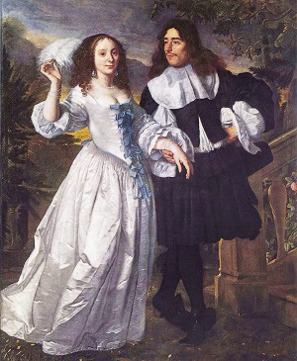
Continued…

Slide 5
What did People wear in Late Baroque Era
As the Baroque period progressed, the main piece of women's clothing continued to be the gown, with simpler patterns and even monochromatic designs. The emphasis was on the shoulders with very low necklines. Tight corsets were worn again, visible and ending in a V-shape at the waist
Over the shirt, men wore a coat designed to fit the body. For the lower part, men wore baggy breeches that almost looked like wide skirts. By the end of the century, breeches changed again and became tighter. Heeled shoes were worn, often decorated with ribbons

Slide 6
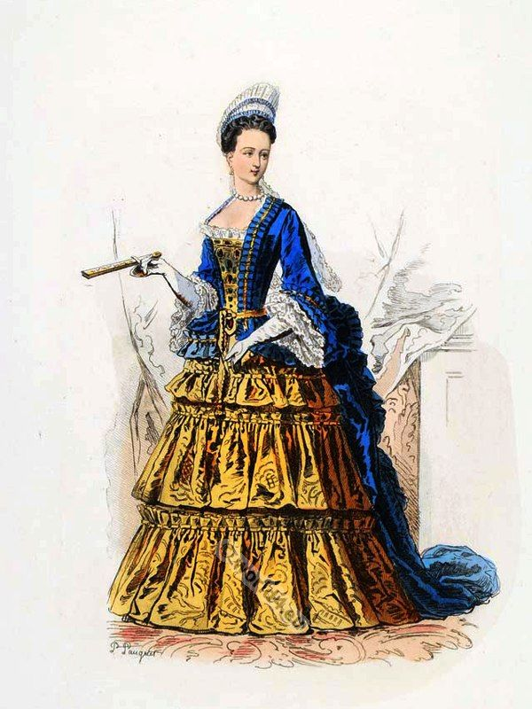
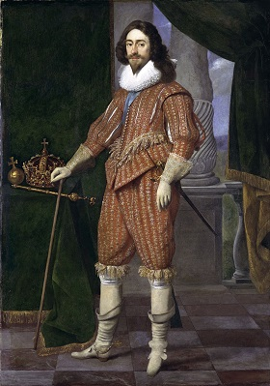
Continued…

Slide 7
Trends Leader in Baroque Fashion
Baroque art was prevalent from the late 17th century to the early 18th century in Europe and they were the main leading body in Baroque trends

Slide 8
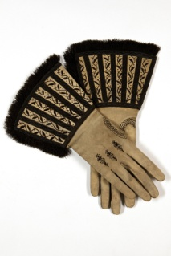
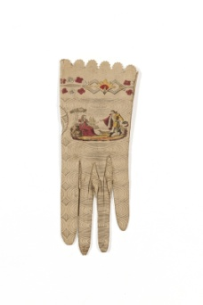
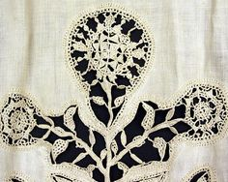
Accessories used in Early and Late Baroque Period
Cuffs, Gloves, pair of Gauntlets etc were used

Slide 9
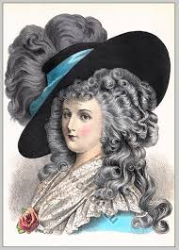
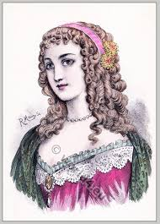
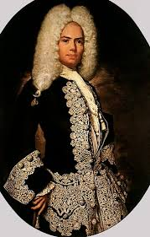
Hairstyle used in early Baroque Period

Slide 10
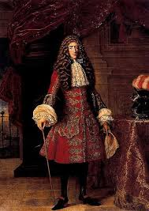
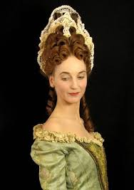
Hairstyles used in Late Baroque Period

