Slide 1
NAME MUHAMMAD HUSSAIN ID 15786 RADIOLOGY SECTION {B}

Slide 2
Select the best option:
{1} A metatarsal bones has the following basic parts:
A. Head, shaft and tail
B. Head, shaft and base
C. Head, neck tubercle and base
D. Head, neck, tubercle and tail
ANSWER: {B}
{2}. Sustentaculam tali is located on ________of calcaneum.
A. Medial surface
B. Lateral surface
C. Interior surface
D. Superior surface
ANSWER.: {A}
{3}. Circumduction is the combination of?
A. Flexion, extention medial rotation and lateral rotation
B.Flexion, extention abduction and adduction
C. Abduction, adduction, medial rotation and lateral rotation
D. Extention, adduction, medial rotation and lateral rotation
ANSWER: {B}

Slide 3
4. It looks like inerveted Y shaped:
A. Illiofemoral ligament
B. Pubefemoral ligamnet
C. Ischiofemoral ligament
D. Plantar aponeourosis
ANSWER: {A}
5. The increase in neck angle with the shaft of femur is called:
A. Coxa valga
B. Coxa vara
C. Coxa benda
D. Coxa increase
ANSWER. {B}
6. The floor of the acetibulam is non articular called:
A. Acetibular fussa
B. Acetibular margin
C. Acetibular notch
D. Capsule
ANSWER {A}
7.The tubarcle separating the tendons of peroneus longus and peroneus brevis is:
A. Anterior tubercle
B. Posterior tubercle
C. Medial tubercle
D. Peroneal tubercle
ANSWER: {D}

Slide 4
8.The symphysis pubis is:
A. Primary cartiligenous joint
B. Scondary cartiligenous joint
C. Synovial joint
D. Fibrous joint
ANSWER: {B}
9. Which bone does not part in the formation of knee joint:
A. Femur
B. Tibia
C. Fibulla
D. Patella
ANSWER: {C}
10. Regarding tibia:
A. Anterior border is subcutaneous
B. Lateral border is subcutaneous
C. Medial border is subcutaneous
D. Medial surface is subcutaneous
ANSWER :{A}

Slide 5
QUESTION NO 1 ANSWER ARCHES OF FOOT
ANSWER
The arches of foot formed by the tarsal and metatarsal bones,strengthened by the ligaments and tendons, allow the foot to support the weight of the body in the erect posture with the least weight.
An arch is a structure that spans a space and support the structure and weight below it.
An arch may be defined as mechanical arrangment of wedge shaped block of stone or bricks mutually supporting each other and supporting at the end by piers or abutments.

Slide 6
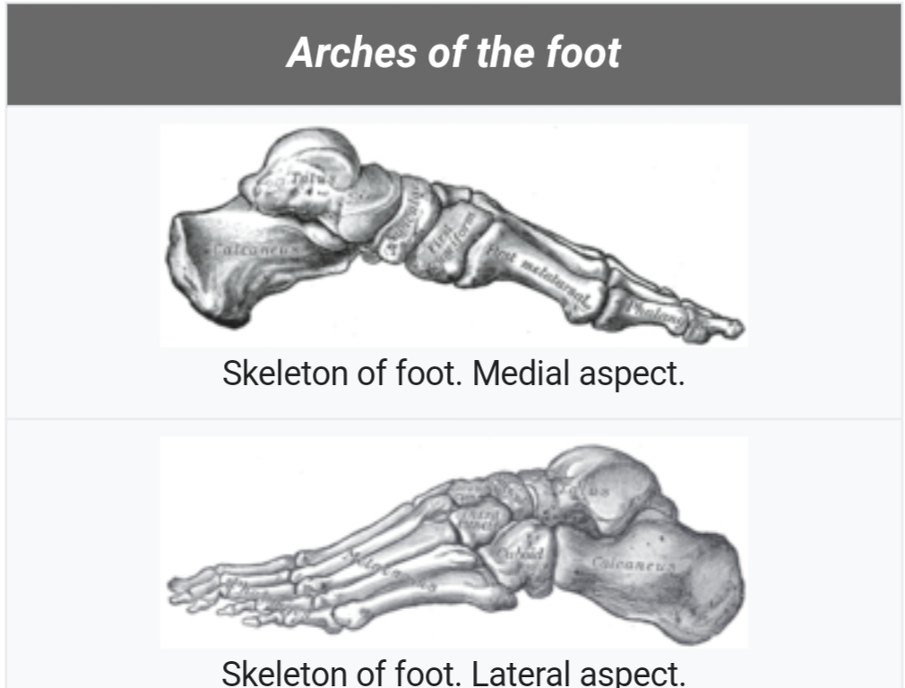

Slide 7
FUNCTION OF ARCHES OF FOOT
{1}. Body weight distribution.
{2}. Act as a spring which help in walking and running.
{3}. Act as a shock absorber in stepping and particularly in jumping.
{4}. Concavity of arches protect the soft tissues of the sole against the pressure.
{5}. They provide space in the sole of foot to contain and protect the muscle, nerves,and blood vessels of the sole.

Slide 8
STRUCTURE OF ARCHES OF FOOT
LONGITUDINAL ARCHES:
The longitudinal arches can be divided into two arches.
1 : Medial arches
2: Lateral arches
MEDIAL ARCHES :
The medial arches is higher than the lateral longitudinal arch. It is made up by the calceneus, the talus,the navicular, the three cuneiform ( medial, intermedial and lateral, and the first, second and third, metatarsal.
LATERAL ARCHES:
The lateral arch is composed of the calceneus, the cuboid, and the forth and fifth metatarsal.

Slide 9
FACTORS RESPONSIBLE FOR MAINTENANCE OF ARCHES:
• Shape of the bones.
• Intersegment ties or ligaments and muscles hold different segments of arch together.
• The beams that connect the two ends of the arch.
• Slings keep the summit of arch pulled up.

Slide 10
QUESTION NO: 4 ANSWER: {HAMSTRINGS}
The muscles in the posterior compartment of the thigh are collectively known as hamstring.
They consist of the biceps femoris, semitendinosus and semimembranosus, which form prominent tendons medially and laterally at the back of the knee.As group, these muscles act as to extend at the hip, and flex at the knee.
The hamstring muscles are responsible for your hip and knee movements in walking, squatting, bending you knees, and tilting your pelvis.

Slide 11
SEMIMAMBRANOSUS:
Semimambranosus is one of four posterior thigh muscle that are responsible for extinding the hip. The other three muscle that belong to the hip extensor group are semitendinosus, biceps femoris and gluteus maximus.
Semimambranosus along with semitendinosus occupies the medial aspect of the posterior thigh.
It is reletively long muscle that spans the full length of the thigh from the hip to the knee.

Slide 12
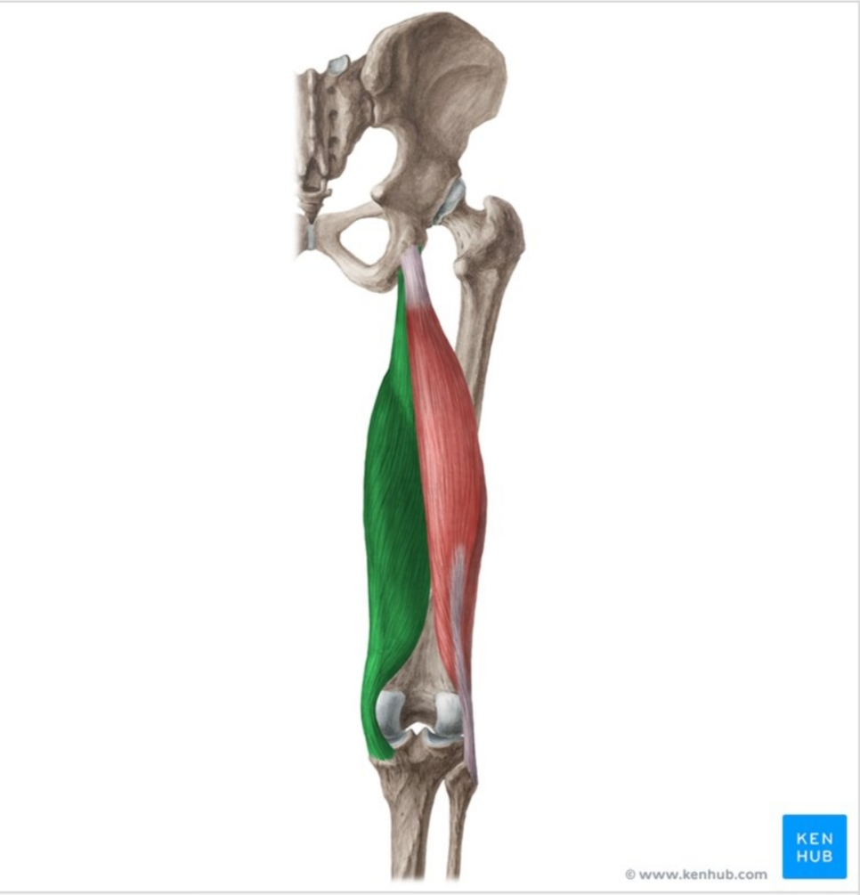

Slide 13
ORIGIN:
Superolateral impression of ischial tuberosity.
INSERTION:
Medical condyle of tibia.
ACTION:
Hip joint: Thigh extention and internal rotation.
Knee joint: Flexion and internal rotation of the leg stabilizes pelvis.
BLOOD SUPPLY: Perforating branches of femoral and popliteal arteries.

Slide 14
SEMITENDINOSUS:
Semitendinosus is a fusiform muscle of the posterior compartment of thigh. Along with semimambranosus and long head of biceps femoris
As a prime mover, semitendinosus extend and internally rotates the thigh, flexes and internally rotates the leg. It also has a pastural role, stabilising the pelvic girlde.

Slide 15
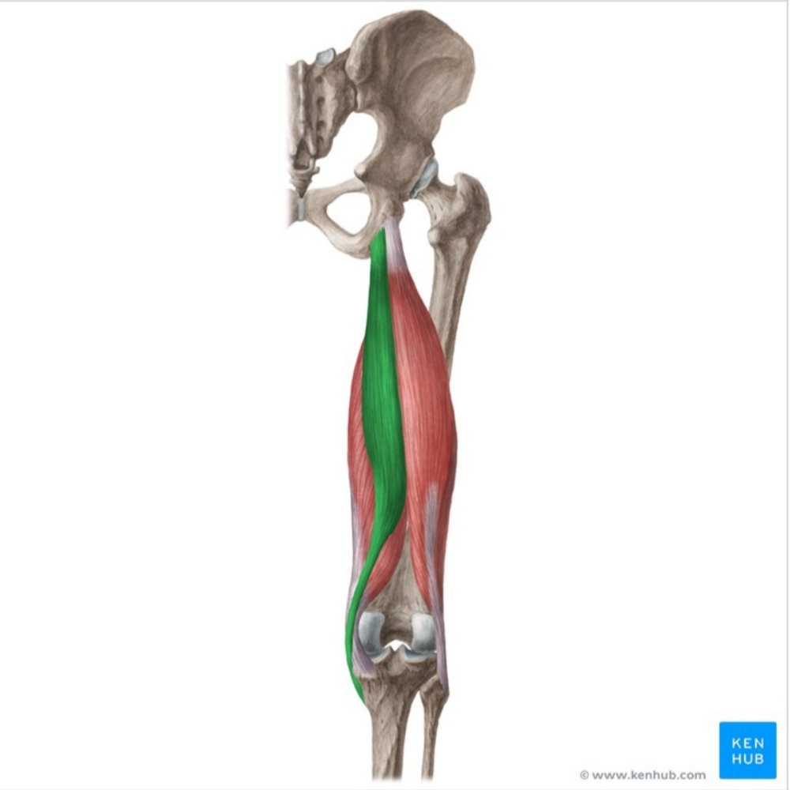

Slide 16
ORIGIN:
Posteriomedial impression of ischial tuberosity.
INSERTION:
Proximal end of tibia below medial condyle (via pesanserinas)
ACTION:
Hip joint: Thigh extention, thigh internal rotation, stabilises pelvis.
Knee joint: Leg flexion, leg internal rotation.
BLOOD SUPPLY:
First perforating branch of deep femoral artery, medial femoral circumflex artery, inferior gluteal artery and inferior medial geniculate artery.

Slide 17
BICEPS FEMORIS:
Biceps femoris is the long muscle of the posterior aspects of the thigh.
Biceps femoris muscle runs from the ischial tuberosity, all the way to the proximal part of the fibula. In doing so the muscles crosses the two joint, the hip joint the knee joint.
Acting simultaneously on these joint, biceps femoris has many important functions.
Flexion and external rotation at the knee joint, extention and external rotation of the hip joint.
As its name suggest, this muscle consist of two heads, one lying deep to the other. Each head has different origin and innervation but they share the same insertion.

Slide 18
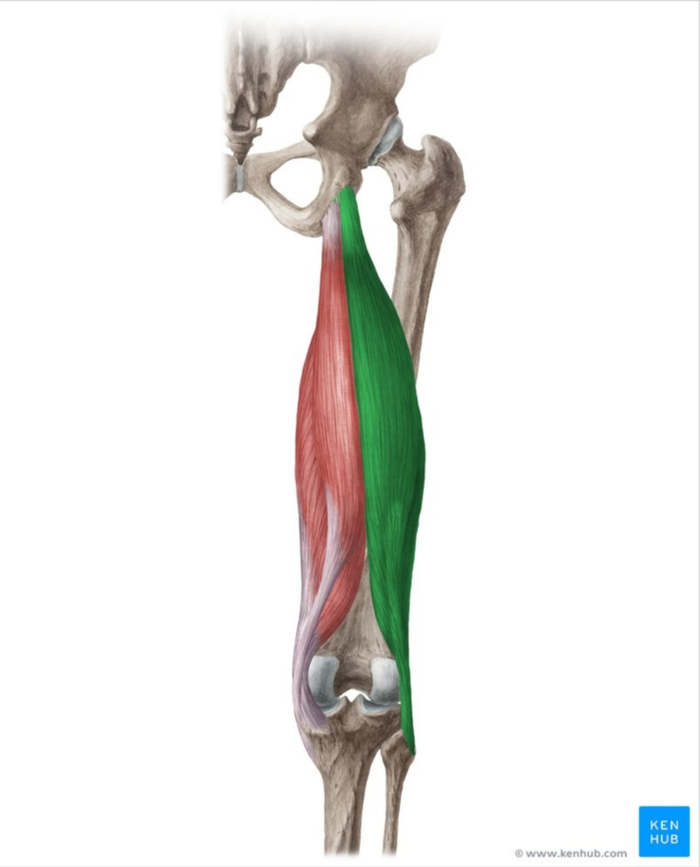

Slide 19
ORIGIN:
Long head:inferomedial impression of ischial tuberosity sacrotuberous ligaments.
Short head: Linea aspera of femur (lateral lip), lateral supracondylar line of femur.
INSERTION:
Lateral aspect of head of fibula.
ACTION:
Hip joint: thigh extention, thigh external rotation;
Knee joint: leg flexion, leg external rotation; stabilizes pelvis.
BLOOD SUPPLY:
Inferior gluteal artery, perforating arteries, popliteal artery.

Slide 20
QUESTION NO 3 ANSWER:-
GREATER SCIATIC FORAMEN:
It is a major foramen or fussa of the human pelvis. It is formed by the sacrotuberous and sacrospinous ligaments with the greater sciatic notch.
Its transmitt neurovascular and muscular structure from the interior of the pelvis to the exterior.
BOUNDARIES:
Lateral-- Greater sciatic notch
Inferior-- Sacrospinous ligament
Medial-- Sacrotuberous ligament
Superior-- Interior sacroilliac ligament

Slide 21
CONTENT: 7 nerves, 3 sets of vessels, piriformis muscle.
Generally content is identified as above or below the piriformis:
•ABOVE:sperior gluteal vessels
•BELOW: Pudendal narve,internal pudendal vessel,nerve to obturatar internus, Sciatic nerve, inferior gluteal vessel, posterior cutaneous nerve, of thigh, nerve to quadratus femoris.
RELEATIONSHIP OF STRUCTURE:
• Most medial:pudendal n.
• Moste lateral: sciatic n.
•N.to quadratus femoris m.deep to sciatic n.

Slide 22
LESSER SCIATIC FORAMEN:
It is an opening foramen between the pelvis and the back of the thigh. It is formed by the sacrotuberous ligament and the sacrospinous ligament which runs between the sacrum and ischial spine.
BOUNDRIES:
•Anterior: the tuberosity of the ischium
•Superior: the spine of the ischium and sacrospinous ligament.
•Posterior:the sacrotuberous ligament alternatively, the foramen can be defined by the boundry of the lesser sciatic notchand the two ligament.
CONTENT:
• the tendon of the obturator internus
• Internal pudendal vessel
• Pudendal nerve
•nerve to the obturator internus

Slide 23
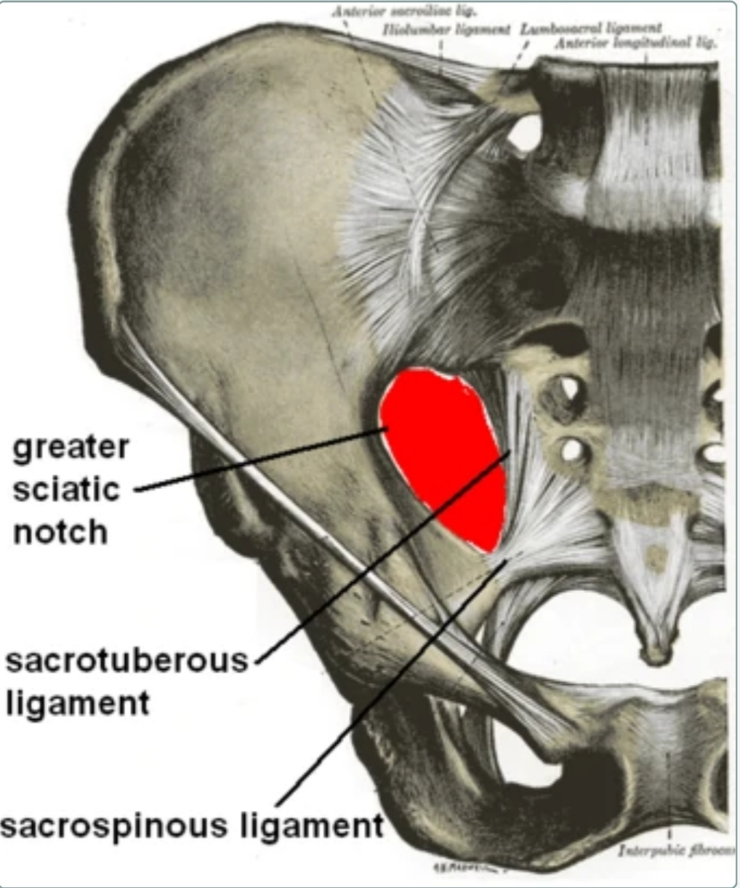

Slide 24
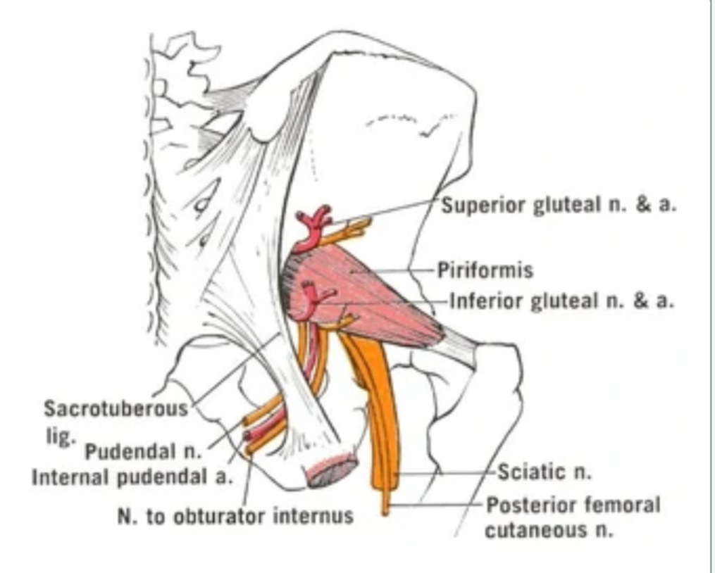

Slide 25
The greater sciatic notch provides passage to many structures either above or below the piriformis muscle originate from the sacrum and the greater sciatic notch and then insert into the greater trochanter of the femur. There are structure that pass through the greater sciatic notch either above or below the piriformis muscle.
Structure passing above the piriformis muscle:
{1}. Superior gluteal artery
{2}. Superior gluteal nerve
The greater sciatic notch is a passage from the pelvis into the buttock and thigh. The greater sciatic notch is the large, deep notch on the posterior pary of the pelvis. The ischial spine separates the greater and lesser sciatic notch. The lesser sciatic notch is formed by the sacrotuberous ligament and the sacrospinous ligaments. The sacrospinous ligaments separates the greater sciatic and the lesser sciatic foramina.

Slide 26
QUESTION NO 2
The gluteus maximus is the main extensor muscle of the hip. Its is the largest and outermost of the three gluteal muscle and makes up a large part of the shape and appearence of each side of the hip. Its thick flesht mass, in a quadrilateral shape, forms the prominent of the buttocks. The other gluteal muscle are the medius and minimus, and sometimes informally these are collectively referred to as the glutes, :
ORIGIN: Gluteal surface of ilium, lumbar fascia, sacrum, sacrotuberous ligament.
NERVE: Inferior gluteal nerve(L5,S1 and S2 nerve roots
ACTIONS: External rotation and extention of the hip joint, support the extended knee through the illiotibial tract, chief integrivity muscle in sitting and abduction of the hip.

Slide 27
Its large size is one of the most characteristics feature of the muscular system in human, connected as it is with the power of maintaining the trunk in the erect posture. Other primates have much flatter hips and can not sustain standing erectly.
The muscle is made up of muscle fascicles lying parellel with one another, and collected together into larger bundle separated by fibrous septa.
INJECTION SITES:
Possible sites for IM injection include: deltoid, dorsogluteal, rectus femoris, vastus lateralis, and ventrogluteal muscle, side that are bruised, tendon, red, swollen, inflammed, or scarred are avoided.
DELTOID MUSCLE: The deltoid muscle is recommended for use with injection of small volume, usually equal or less than 2ml, including vaccination. This site is not recommended for repeated injection;due to its small area, it is difficult to rotate the injection site.

Slide 28
VENTROGLUTEAL SITE:
The ventrogluteal site is recommended for injection requiring a large volume to be administrated, greater than 1 ml, and for medication knowns to be irritating, viscous or oily. It is also given for narcotic, antibiotic, sedative and anti emetic medications.
VASTUS LATERALIS:
The vastus lateralis is recommended for infants less than 7 month old and those unable to walk, with loss of muscular tone. To locate the side, divide the front thigh into thirds vertically and horizantally to make nine square and inject in the outer middle square.
DORSOGLUTEAL SITE:
The dorsogluteal site is not recomended for use in any patient population due to its location near major blood vessel and nerves as well as having inconsistent dipth of adipose tissue, with very few injection in this area injected to the correct dipth to the administar as a true intramuscular Injection.

