Slide 1
NAME: SUBHAN ULLAH
ID : 16161
Dep: BS MLT
SECTION: B
SUBJECT: COMMUNICATION SKILLS

Slide 2
QUESTION: 1 ANSWER: .

Slide 3
A.V
P.V
1 Some boys were helping the wounded man.
2 They caught the thief.
3 Little strokes fell great oaks.
4 The wind blew down the trees.
5 One can not be gathered grapes from thistles.
1 The wounded man was being helped by some boys.
2 The thief was caught.
3 Great oaks are felled by little strikes.
4 The trees were blown down by the wind.
5 : Grapes cannot be gathered from thistles.

Slide 4
QUESTION:2
ANSWER:

Slide 5
Direct speech
Iindirect speech
1 He said,"will you listen to such a man."
2 The examinar's orders were,"No one is to bring books in to the room nor ask me questions about what I have toled you to do.
1 He asked whether I would listen to such a man.
2 The examinars orders were that no body was to bring books into the room nor ask her questions about what she had told us to do.

Slide 6
3 He said to us,"Why are you all sitting about there doing nothing?
4 Go down to the bazaar ,"Bring me some oil and a lump of ice."ordered his master.
5 He said."Oh!thats anuisance."
3 He asked us why were we all settig about there doing nothing.
4 His master ordered him to go down to the bazaar to/and bring him some oil and a lump of ice.
5 He exclaimed with sorrow that, that was a nuisance.

Slide 7
QUESTION: 3 ANSWER:

Slide 8
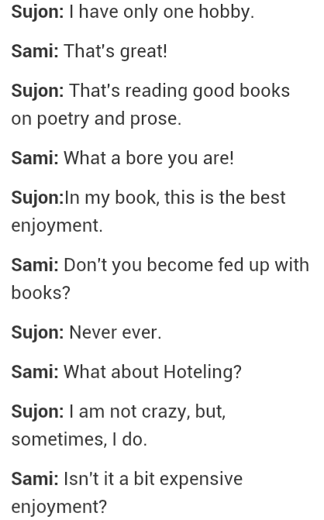

Slide 9
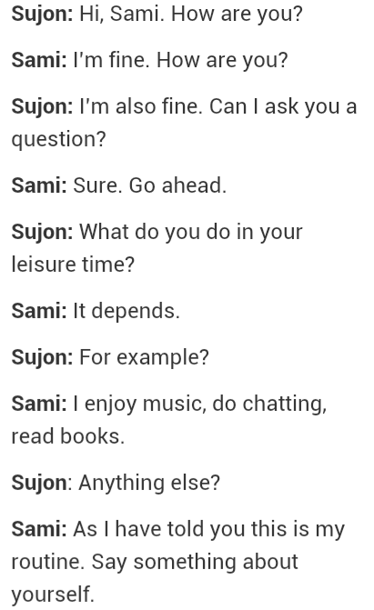

Slide 10
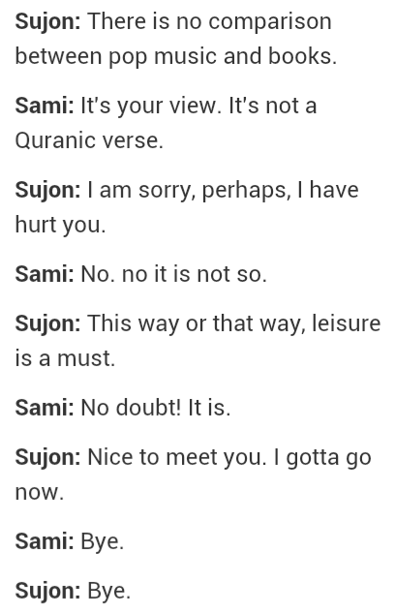

Slide 11
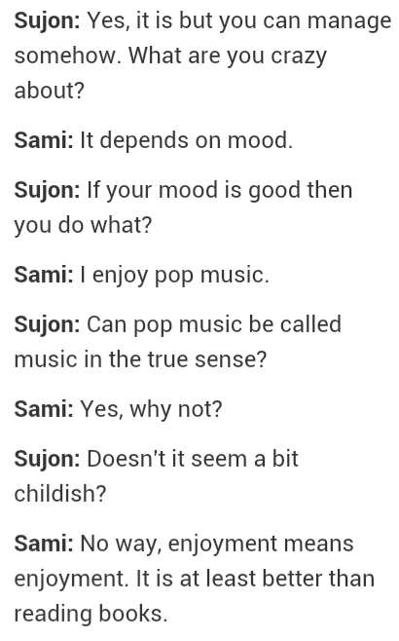

Slide 12
QUESTION: 4 ANSWER: .

Slide 13
CUMMUNICATION:

Slide 14
DEFINITION:
The imparting or exchanging of information by speaking, writing, or using some other medium.
Communication is the process of interchanging information, ideas, feelings and opinions, with or without the use of words, i.e. signals.

Slide 15
The Process of Communication
Sender
Encoding
Message
Decoding
Noise
Receiver
Feedback

Slide 16
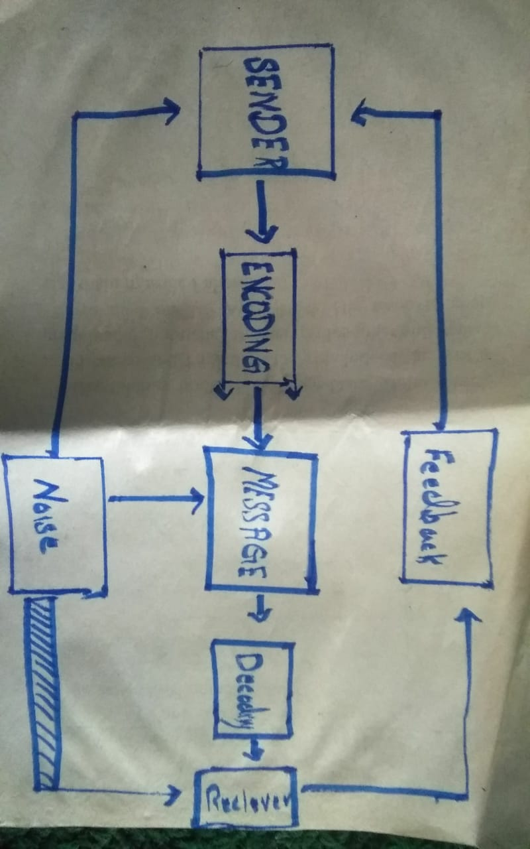

Slide 17
Types of Communication
Verbal Communication
2. Non Verbal Communication

Slide 18
Verbal Communication: Definition:
Communication with the use of words and language to communicate message to other party is called Verbal Communication.
Types of Verbal Communication
Oral Communication
Written Communication

Slide 19
TYPES: Oral communication and written cummunication:
Oral Communication
Face to Face conversation
Telephone Conversation
Voice Chat conversation on whatsapp
Written Communication
Letters
Reports
Typed Messages etc

Slide 20
NON VERBAL COMMUNICATION:
Definition:
Non verbal communication is the transmission of message or signales through a non verbal platform is called non verbal communication.

Slide 21
Types of Non-Verbal Communication
Kinesics... Communication through body gestures
Gestures, Postures, Smileys, Emoticons etc
2. Artifacts... Phsical items that can act as implicit communication devices.
Physical Apearance, Dress, Luxuries (mobile, car) etc
3. Proxemics
The distance maintained by a person in communication process.

Slide 22
4. Chronemics... (Time) How puctual a person is? (It presents a good image... a silent communication)
5. Vocalics
Tone and pitch of a person's voice
6. Haptics
The way by which peoples communicate via touching. Touch is the most effective means to communicate feelings and emotions.

Slide 23
THE END

