Slide 1
Name Ikramullah khan
ID 15072
Subject
Department BScs
Semester 2nd Assignment no 2
Submitted to SIR Muhammad Adil

Slide 2
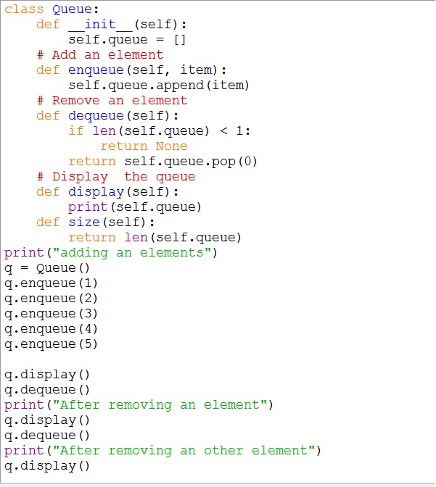

Slide 3
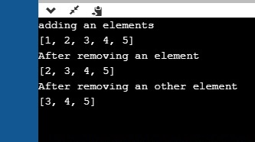
Result:

Slide 4
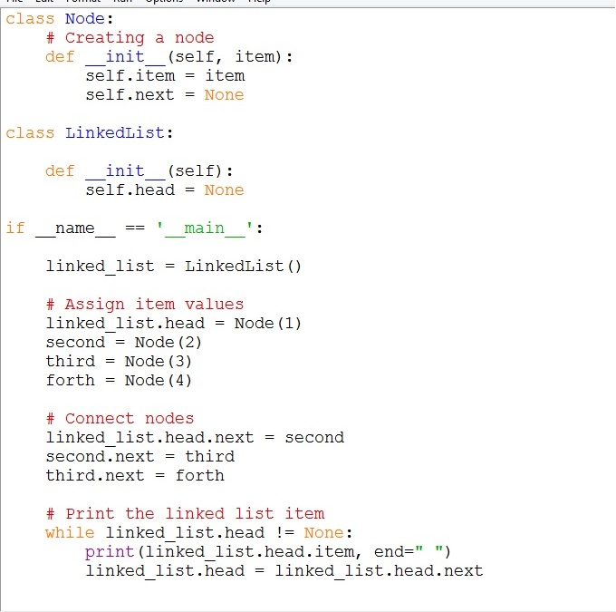

Slide 5
Result:

