Slide 1
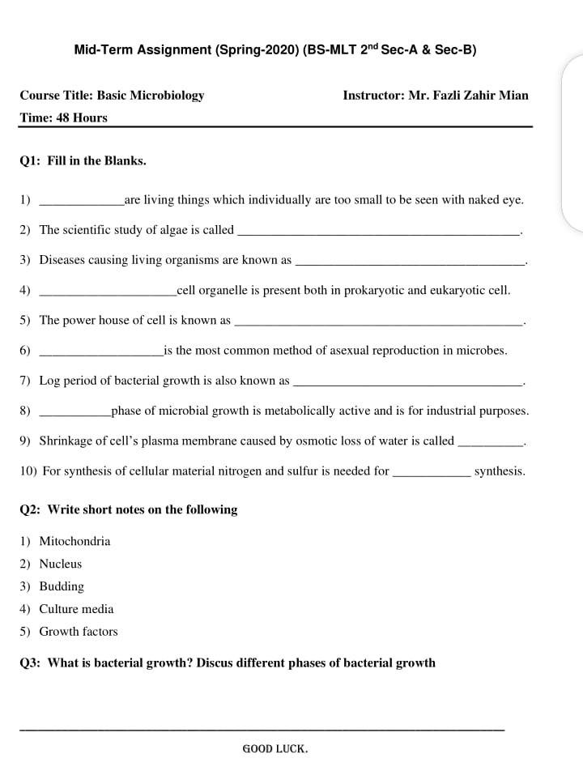

Slide 2
Name: Robeena latif
semester: 2nd
ID: 16404
Department: MLT
Subject : Basic Microbiology
Instructor: Mr. Fazli Zahir Mian

Slide 3
Q1: Fill in the blanks.
Answers;
1) microorganism
2) Phycology
3) Pathogens
4) Ribosomes
5) Mitochondrian
6) Binary fission
7) Exponential phase
8) Stationary phase
9) Plasmolysis
10) Protien

Slide 4
Q2: Write short note on the following.
1) Mitochondria:
Definition;
Mitochondria are organelles located in the cells of each complex organism but, these organelles are shape in a rod like structure located in both plant and animal cells, and they create around 90% of the chemical energy which cells need in the order to survive.
2) Nucleus:
Definition;
All cells having a dark staining mass of deoxyriboneuclic acid (DNA) called nucleus. Inclosed in a neuclear membrane having RNA, responsible for synthesis of protiens. Nucleus is the master of cells and of all its activities, without nucleus the cell dies.

Slide 5
3) Budding;
Definition;
▪The process of asexual reproduction in which in outgrowth (Bud) develops into a new organisms.
4) Culture media:
Definition;
A culture media is a special medium used in microbiological laboratories in growth different kind of microorganism. A growth of culture media is composed of different nutrients that are essential for microbial growth.
5) Growth factors:
Definitions;
Growth factor can exert their stimulation through endocrine, paracrine or autocrine mechanism due to

Slide 6
their short and slow diffusion in intercellular spaces, growth factors usually act locally growth factor is initiated by budding to their receptors on the surface of target cells e,g. Amino acids, purines, pyramidines.

Slide 7
Q3: What is bacterial growth ? Discuss different phases.
Definition;
The bacterial growth curve represents the number of live cells in a bacterial population over in a period of time.¤ Bacterial division:
Binary fission;
In this method of asexual reproduction, the body of parent organism divides into two daughter organism.
For example: Amoeba, Euglena bacteria etc.
Chromosomes >> DNA replication >> Segregation >> cytokinesis.
Budding;
The process of asexual reproduction in which in outgrowth (Bud) develops in a new organisms.

Slide 8
E,g. Spongos and hydra.
Growth phases:
1) Lag phase:-
No increase in number but there may be an increase in size of the cell.
2) Log phase:-
Cell starts dividing and their number increases exponentially.
3) Stationary phase:-
Cell division stops due to depletion of nutrients and accomulation of toxic products.
4) Phase of decline:-
Population decreases due to the death of cells.

Slide 9
Factor affecting Bacterial growth:
> Temperature
> H-ion concentration
> Radiation
Temperature:-
▪Temperature range - growth does not occure above the maximum or below the maximum.
▪Optimum temperature - growth occures best 37°C for most pathogenic bacteria.
▪Mesophiloc - grows best between 25°C and 40°C e,g. Most bacterial pathogens.

Slide 10
▪psychrophilic - grows best below 20°C e,g. Flavobacteriums pps.
▪Thermophilic - grows best at high temp, 55 to 58°C.
e,g. Bacillus sterotgermophilic
H - ion concentration:-
▪PH range, optimum PH
▪Neutral or slightly alkaline PH (7.2 - 7.6) majority of pathigenic bacteria growth best.
▪Lctobacilli - acidic PH
Radiation:-
▪Xrays and gamma rays exposure - lethal.

